Slide 1
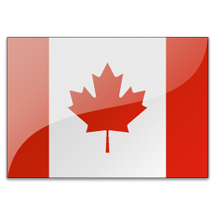
CANADA

Slide 2
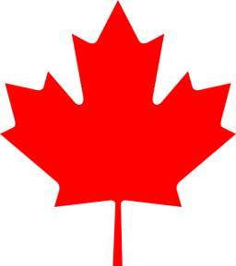
CANADA
Location
Economy
Cities
Symbols
Climate
Population
Landscape
Holidays

Slide 3
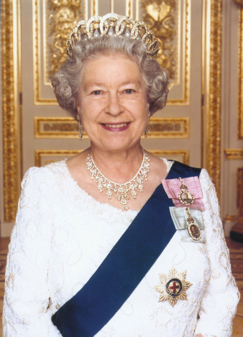
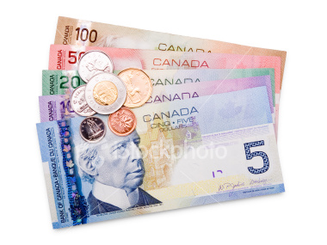
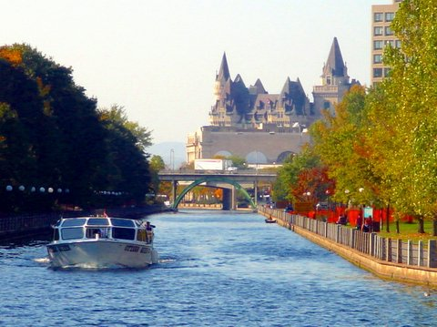
Canada
Capital city: Ottawa
Languages: English and French
Membeship: G8, NATO, Commonwealth
Currency: Canadian dollar
Constitutional monarchy

Slide 4
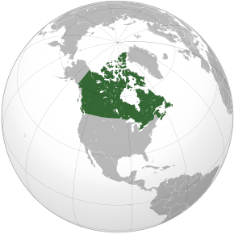
1) Location
North America
Borders:
    In the North – the Arctic ocean
    In the West – the Pacific ocean
    In the South – the USA
    In the East – the Atlantic ocean
Second-world-largest country

Slide 5
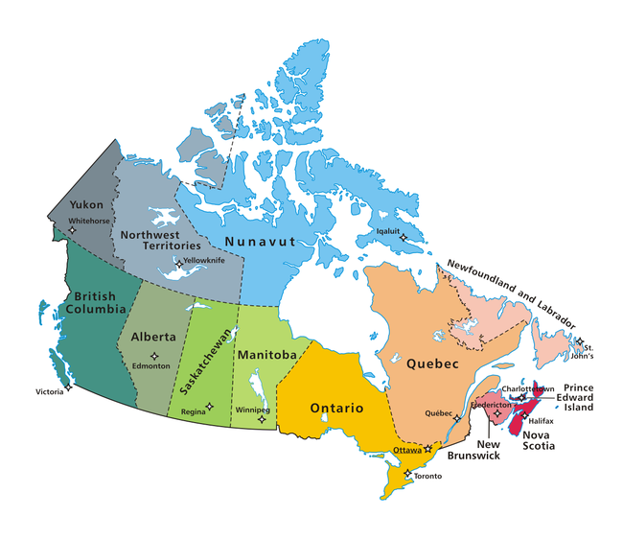
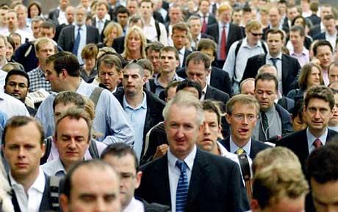
2) Population
Origin:
  Vikings, Eskimos
Religion:
  Christianity – 77 %
  Islam – 2%
Population density:
  3 inhabitants per square kilometre
Federation:
  10 Provinces: Alberta, British Columbia, Manitoba, New Brunswick, Newfoundland and Labrador, Nova Scotia, Ontario, Prince Edward Island, Quebec, and Saskatchewan
  3 Territories: Northwest Territories, Nunavut, and Yukon
33 million inhabitants

Slide 6
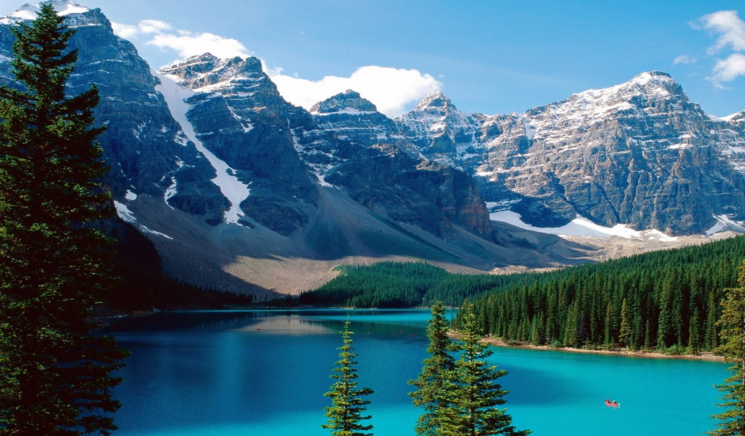
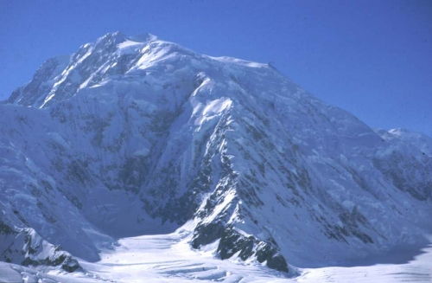
3) Landscape
West part: the Cordirelleras mountain range
East part: Lowland
Lakes: Great Bear Lake, Great Slave Lake
Rivers: the Yukon River, the Mackenzie River, the Saint Lawrence River
The highest peak: Mount Logan (5959)
Banff Nationwide Park
Mount Logan

Slide 7
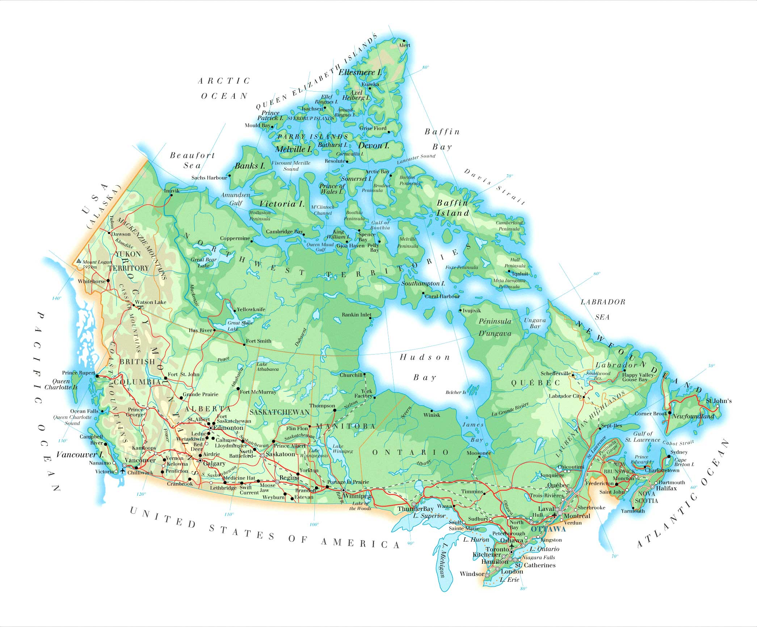

Slide 8
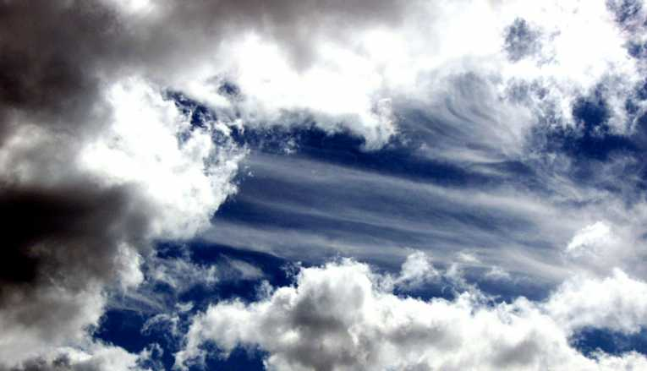
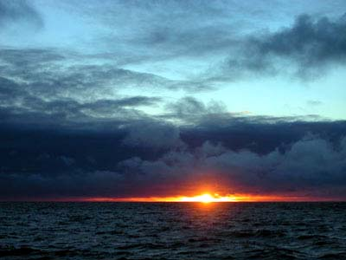
4) Climate
Oceanic regions:
  average high temperatures are generally around 20 °C
Continental regions:
  average high temperature ranges from 25 to 30 °C

Slide 9
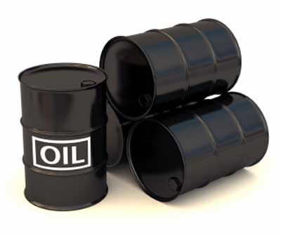
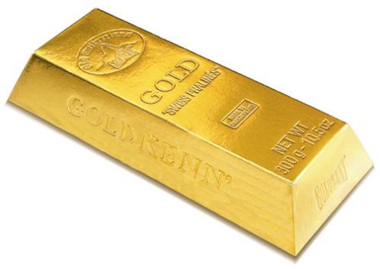
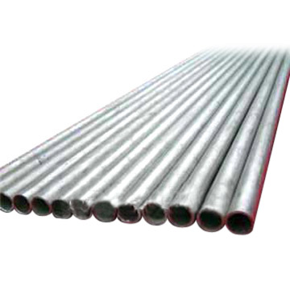
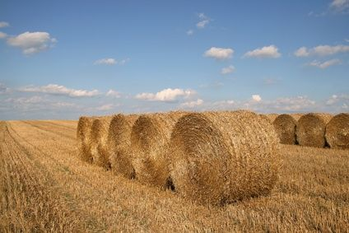
5) Economy
Natural resources
  Oil and gas
  Minerals (nickel)
Service industry
Agriculture

Slide 10
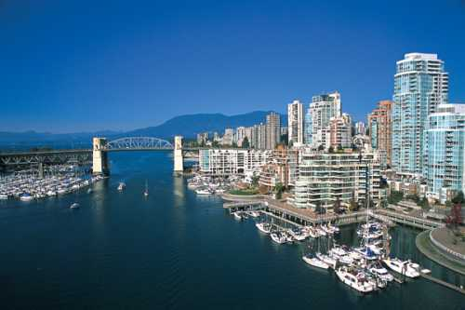
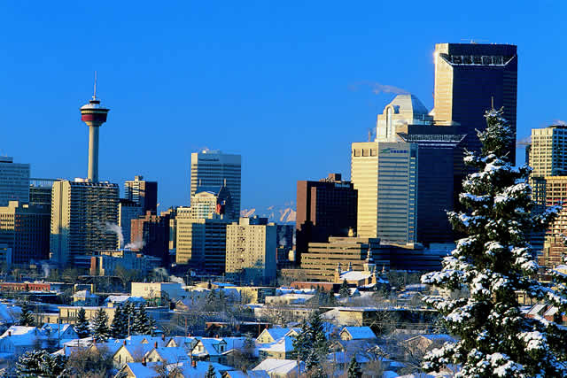
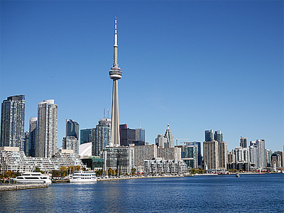
6) Cities
Vancouver: the winter Olympic games in 2010
Calgary: Financial centrum of Canada, centre of winter sports
Toronto: Largest city, CN tower
Vancouver
Calgary
Toronto

Slide 11
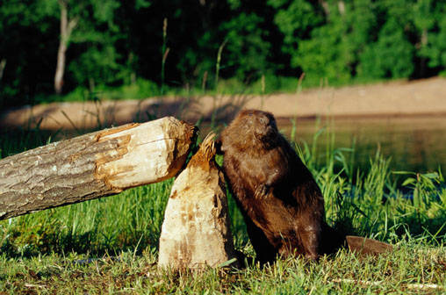
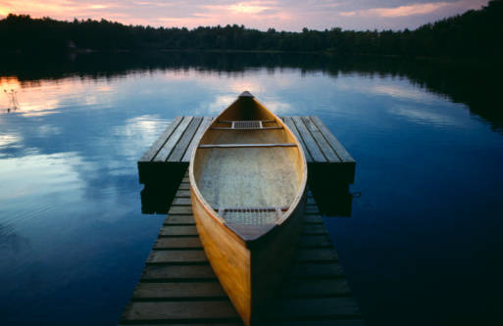
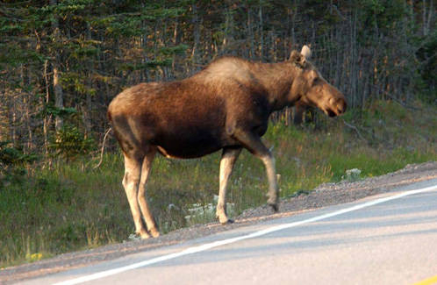
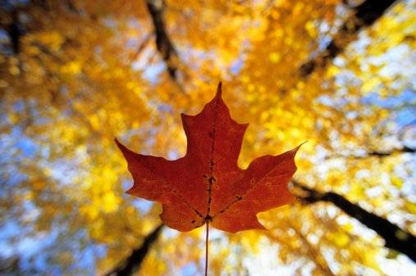
7) Symbols of Canada
Canoe | Major form of transportation
Ice Hockey/ Lacrosse | Most popular winter/summer sport
the Moose | Large animal across Canada, especially near lakes
the Loon | Its sound brings Canadians back to a peaceful
the Maple leaf | National symbol of Canada
the Beaver | Canadian national mascot

Slide 12
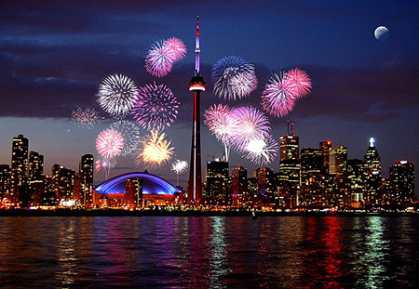
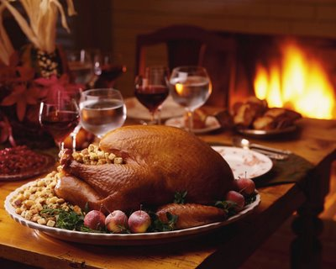
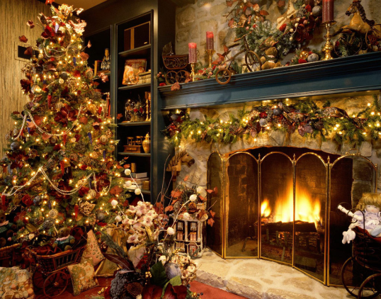
8) Holidays
Name | Date | Character
New Year´s Day | January, 1st | Celebrates the first day of year
Easter Monday | Monday after Easter Day | Celebrates the resurrection of Jesus
Victoria Day | Monday preceding May 25th | Celebrates the birthday of the current Canadian monarch
Canada Day | July, 1st | Celebrates Canada's 1867 Confederation
Labour Day | First Monday in Sempteber | Celebrates economic and social achievements
Thanksgiving Day | Second Monday in October | Celebrates the harvest of the past year
Remembrance Day | November, 11th | Commemorates Canada's war dead
Christmas Day | December, 25th | Celebrates the birth of Jesus
Boxing Day | December, 26th | Giving gifts

Slide 13
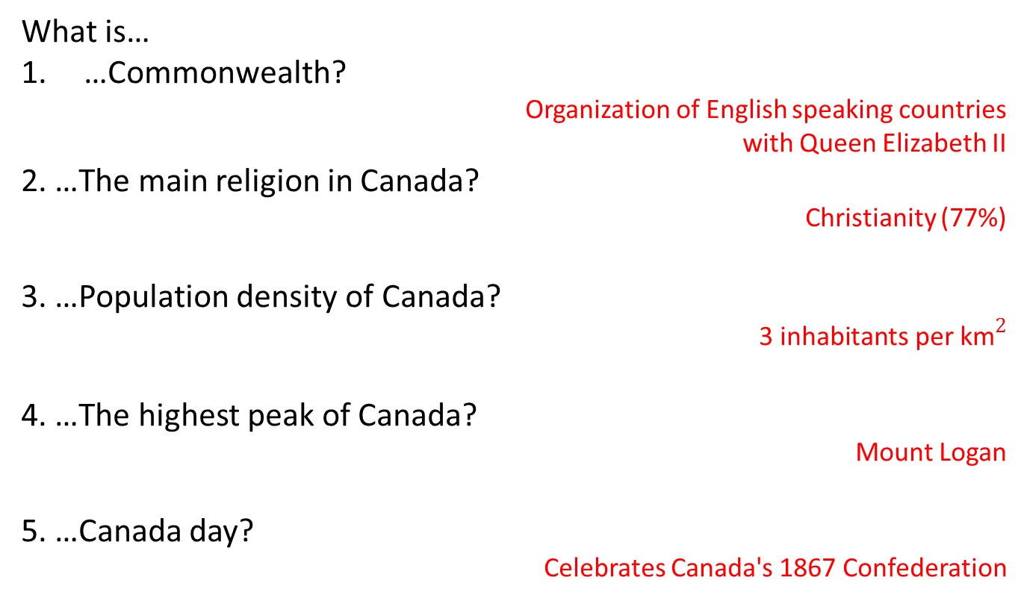
Quiz:
What is…
…Commonwealth?
Organization of English speaking countries
with Queen Elizabeth II
2. …The main religion in Canada?
Christianity (77%)
3. …Population density of Canada?
$${\text{3 }\text{inhabitants} \text{per} \text{km}}^{2}$$
4. …The highest peak of Canada?
Mount Logan
5. …Canada day?
Celebrates Canada's 1867 Confederation

Slide 14
Written by:
Michal Singer
6.XB
Information sources:
www.wikipedie.cz
Geographic books

