Slide 1
A U S T R A L I A

Slide 2
Basic information
- Official name: The Commonwealth of Australia
Total area: about 8 million km²
Location: Southeast Asia
The nearest neighbours: Indonesia, Papua New Guinea, New Zealand
Population: 22,7 million inhabitants
Political system: constitutional monarchy and parliamentary democracy
Member of Commonwealth, UN, OECD, G20
The capital is Canberra (360 000 inhabitants)
Australia contents of 6 states and 2 territories
Official language: English

Slide 3
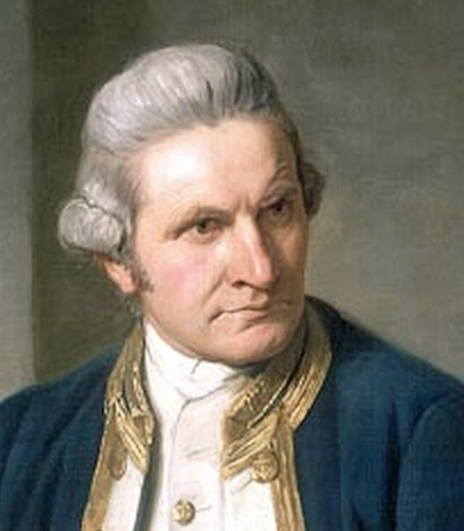
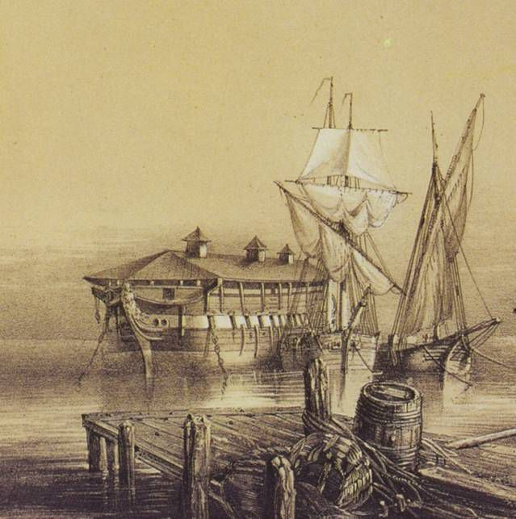
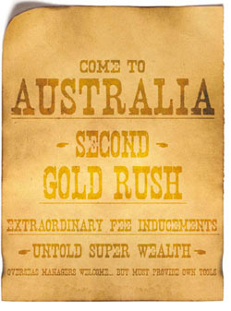
History
Western part of the coast was discovered by Dutch explorer W. Jansz in 1606
In eastern coast sailed as the first James Cook in 1770
Creation of penal colony for convicts in 18th century
In the middle of 19th century began the gold rush in Australia
Member of Commonwealth since 1907

Slide 4
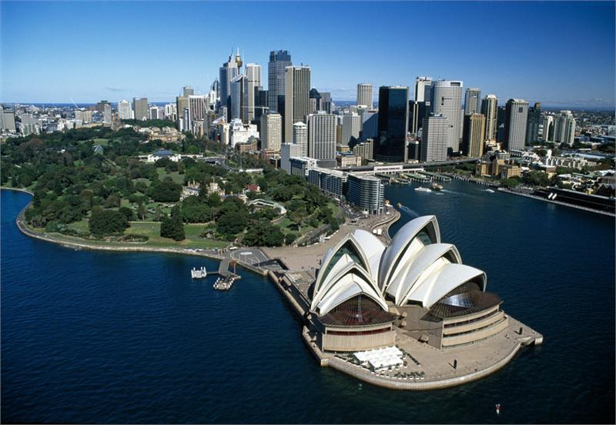
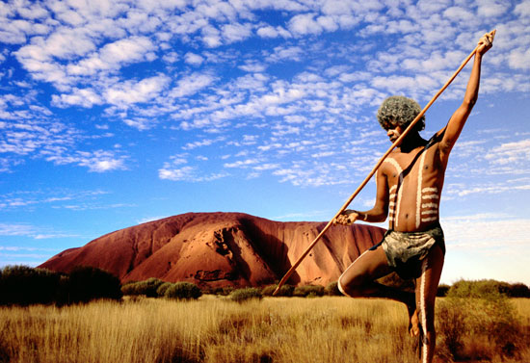
Cities and Population
85% Australians live in urban areas along the southeast coast
The biggest city is Sydney with 4,6 million inhabitants
Other cities – Melbourne, Canberra, Brisbane, Alice Springs, Darwin and Adelaide
Density is 2,8 inhabitant per km²
Australian population is a great mixure of various nationalities
Original Australians called Aborigines are now around 580 000

Slide 5
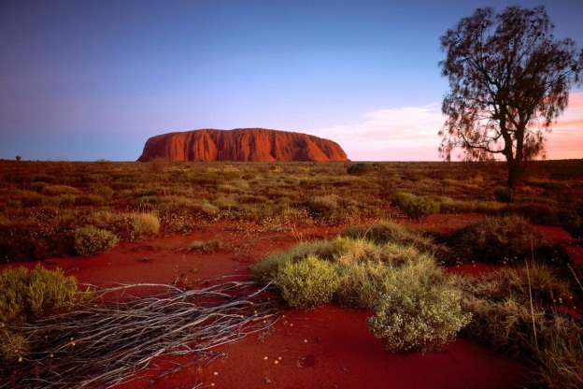
Geography, Climate and Nature
Australia is the smallest continent and the 6th biggest country in the world
The highest mountain is Mt. Kosciuszko (2228 m above the sea level)
The lowest point is Lake Eyre with 16m below sea level
Four great deserts and one special desert with red sand – Ayers Rock
Climate varies from warm to subtropical, 80 % land suffers from drought
Tropical jungles in the northeast, the forests of Eucalyptus in the southeast
Great Barrier Reef – the world´s largest coral reef system
Exeptional animal species as kangaroo, koala bear, bird emu, wombat or platypus

Slide 6
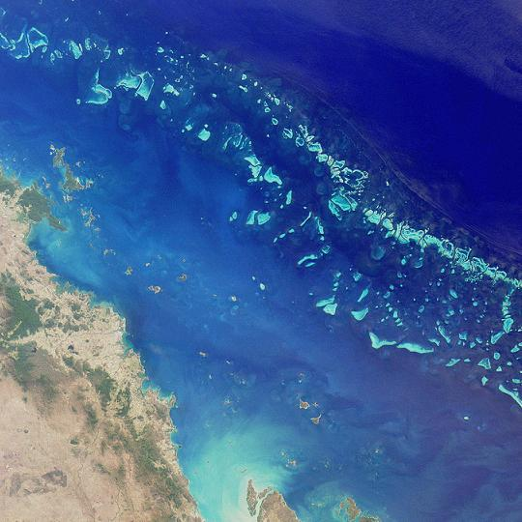
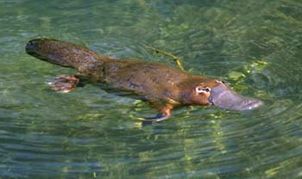
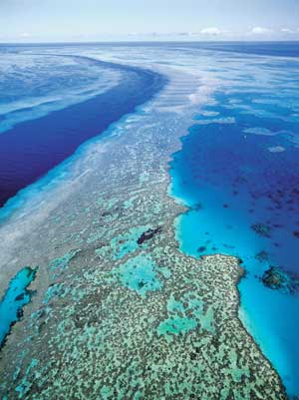
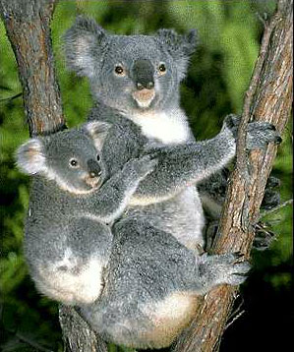
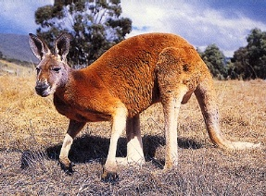
Great Barrier Reef from Satellite

Slide 7
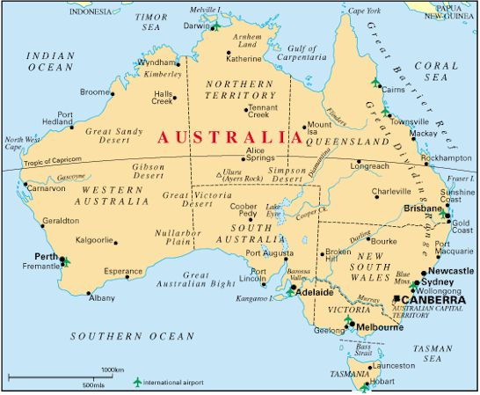
Economy
GDP per capita the 5th in the world
Currency is Australian dollar
The 13th largest economy in the world
Only 9% of land is arable
Important exporter of beef, lamb and wheat
Rich in raw materials as iron ore, coal, gold, bauxite or copper
Industry on high level

Slide 8
Quiz
Who and when discovered Australia?
What kind of climate is there?
Which are the largest cities?
What raw materials are found in Australia?
What is the name of desert with red sand?

Slide 9
END
Sources: www.wikipedia.com
www.google.com
Australia-background studies
Kryštof Kocman
Jakub Matějček
6.XB

