Slide 1
EDUCATION
Education systems in the UK, US and in the Czech Republic
Famous universities
Uniforms

Slide 2
Vocabulary
BrE x AmE
Nursery school
Primary school
Secondary school
Year
Marks
University
Kindergarten
Elementary school
High school
Grade
Grades
College (in BrE – a state educational institution for students over 16 (e.g. sixth-form college)

Slide 3
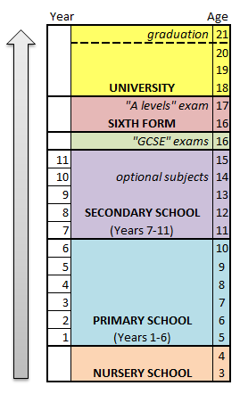
THE UNITED KINGDOM
Education is compulsory from the age of 5 to 16
nursery school: from the age of 3-4
primary (Years 1-6; age 5+);
secondary (Years 7-11; age 11+); with optional 'sixth form' (two or three years of pre-university study)
tertiary education (at the universities, age 18+).
England and Wales have a national curriculum - pupils have to study core subjects

Slide 4
THE UNITED KINGDOM
At 16, they do exams called GCSE (General Certificate of Secondary Education
'A level' exams in their specialised subjects as part of the university entrance procedure.
About 40% of pupils go on to higher education.
Most students borrow money from a bank for studying at university

Slide 5
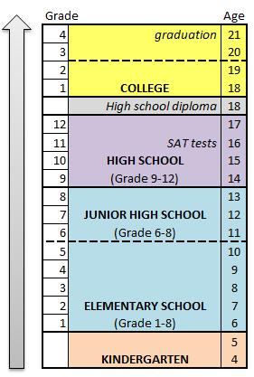
THE UNITED STATES OF AMERICA
90% of schools are free state schools.
There is no national system but most states have compulsory education from 6 or 7 to 17 or 18.
elementary school (lst-8th grade);
high school (9th-12th grade). Some states have 'junior high' schools (6th-8th grade).
There is no national curriculum but in most states, core subjects are compulsory.
College - Two-year colleges for vocational training / four-year colleges for academic degrees.
  Needed to pass SAT tests

Slide 6
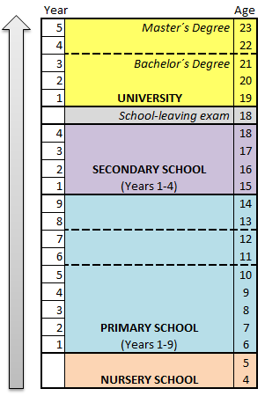
THE CZECH REPUBLIC
compulsory from the age from 6 or 7 to 15 or 16
The teachers are supposed to follow the national curriculum.
At 6 - primary school
At the age of 15 pupils transfer to secondary school (also possible at the age of 11 or 13)
Secondary schools:
  Grammar schools
  Special schools
  training schools
Universities last from 4 to 6 years.

Slide 7

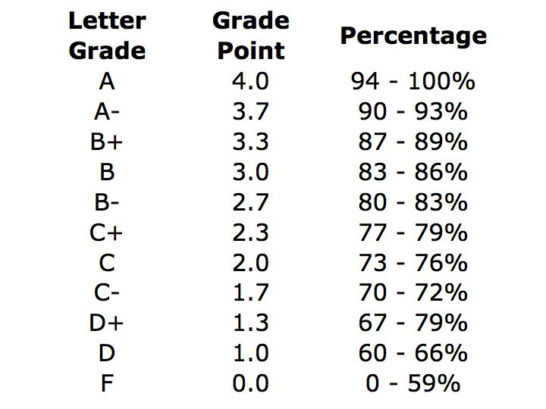
DIFFERENCES
The system of assessment
In the US and the UK marks, or grades, are expressed differently than in the CR. The overall percentage (0-100%) is converted into a letter grade (A, B, C, D or F).
In the Czech Republic pupils and students are evaluated by marks from 1 to 5

Slide 8
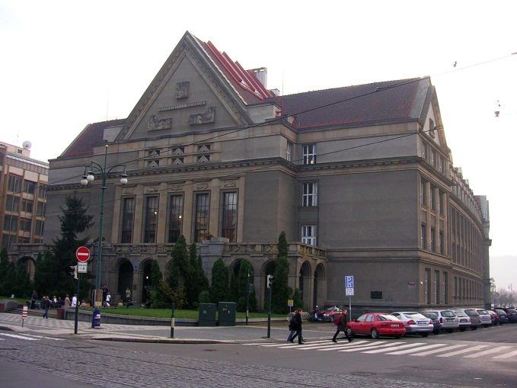
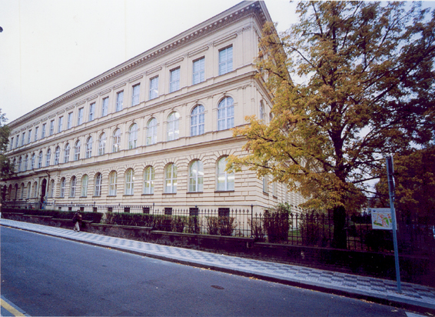

FAMOUS UNIVERSITIES
Charles University - School of Medicine
Charles University - The Faculty of Law
Charles University – The Faculty of arts

Slide 9
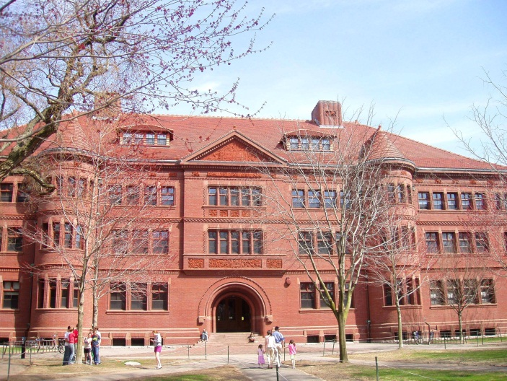
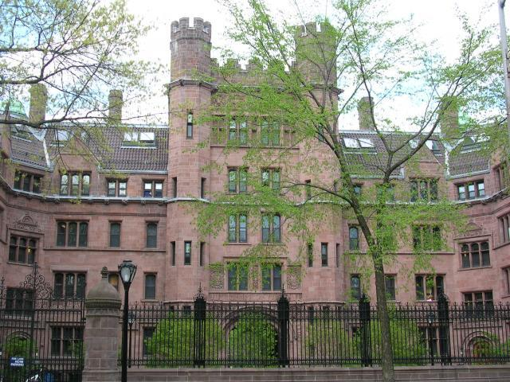
FAMOUS UNIVERSITIES
Yale University
Harvard University

Slide 10
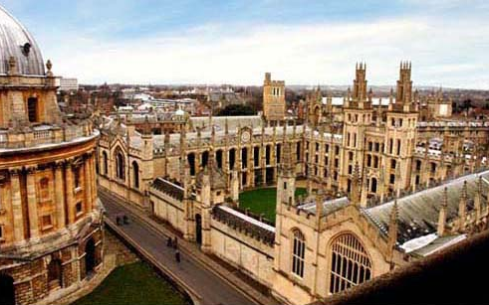
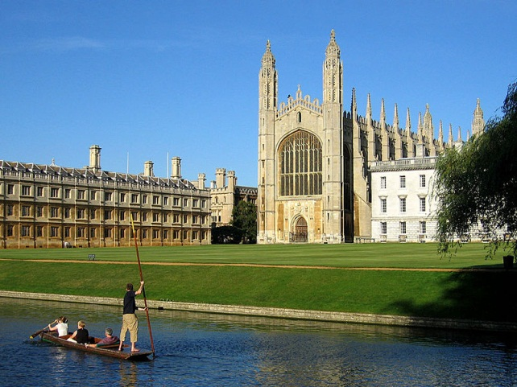
FAMOUS UNIVERSITIES
Cambridge
Oxford

Slide 11
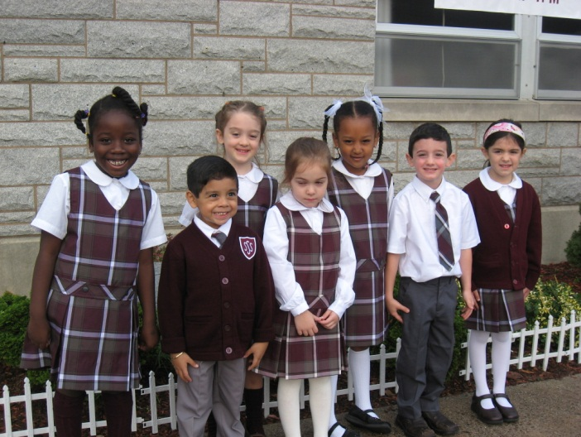
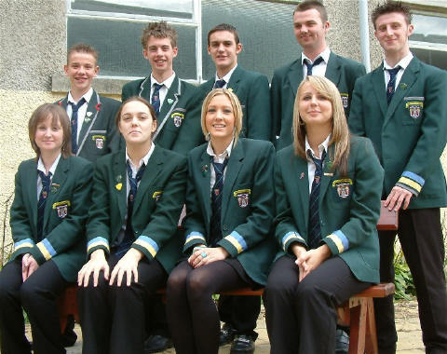

UNIFORMS
UK: Primary + secondary school – Pupils wear uniforms
US: only 23% of public, private, and sectarian schools had any sort of uniform policy

Slide 12
Complete the sentences
Sentence | UK | US | CR
The school attandance is compulsory from the age of… | 5 | 6 /7 | 6 /7
The important exam for finishing studies at secondary (high) school is … | GCSE | Exam for getting High school diploma | School leaving exam
The important exam for studying at university is .. | A-level | SAT test | -
One of the most famous univerties is … | Cambridge Oxford Eton | Yale Harvard Princeton | Charles University Masaryk University
?
?
?
?
?
?
?
?
?
?
?
?

