Slide 1

History of the United States of America

Slide 2
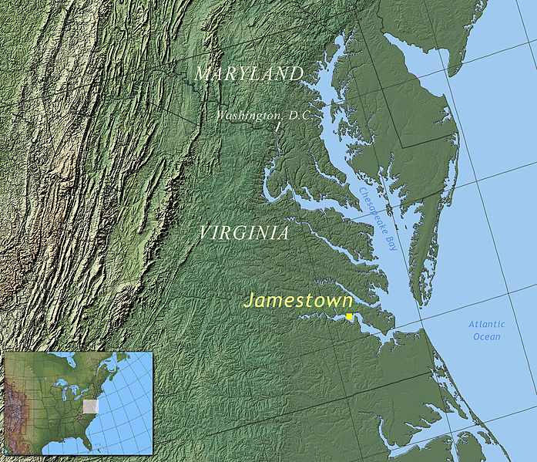

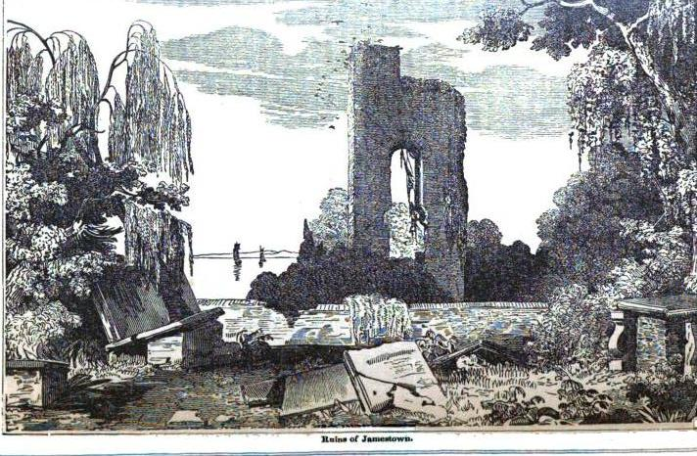
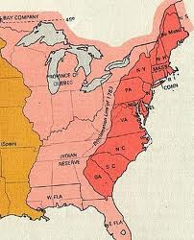
In 1507, German cartographer Martin Waldseemüller produced a world map on which he named the lands of the Western Hemisphere "America" after Italian explorer and cartographer Amerigo Vespucci.
May 14, 1607- establishment of the first permanent English settlement in Northern America- Jamestown
Between 1607 and 1733- establishment of 13 colonies.

Slide 3
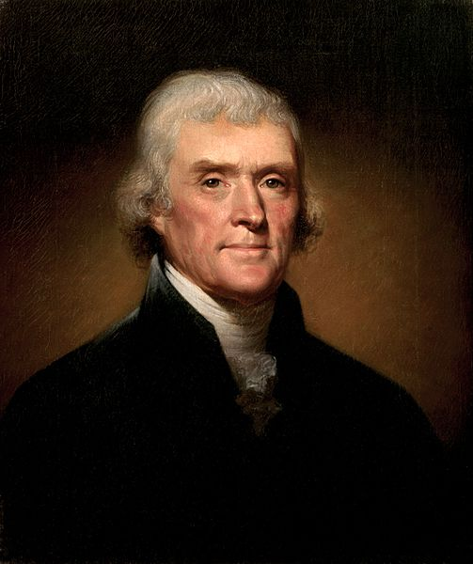
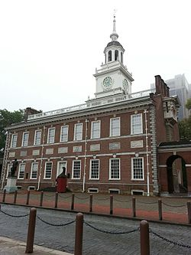
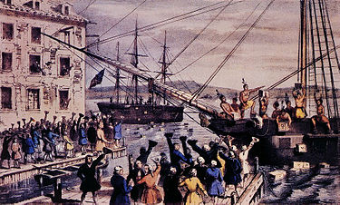
December 16, 1773- Boston Tea Party- was a political protest act against British tax politic. A group of colonists entered British ships and destroyed boxes with tea by throwing them into Boston Harbor.
July 4, 1776- Declaration of Independence was a statement adopted by the Continental Congress, which announced that the thirteen American colonies, then at war with Great Britain, regarded themselves as independent states, and no longer a part of the British Empire. Author of the Declaration was Thomas Jefferson.

Slide 4


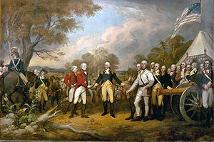
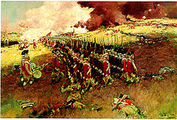
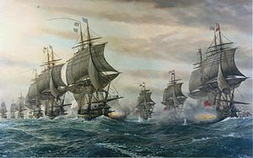
1775-1783-American Revolutionary War- it began as war between the British Empire and the United States of America, but later France, Netherlands and Spain joined the conflict as allies of the United States. The result of the war was independence of the US.
Most important battles:
Battles of Lexington and Concord, 1776- first battle of the war,
American victory
Battle of Saratoga, 1777- American victory, France enters the war
Battle of Yorktown, 1781- American victory, capitulation of British ground forces.

Slide 5
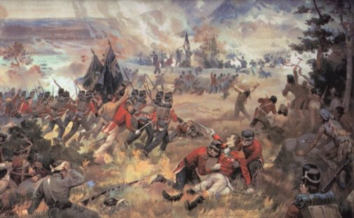
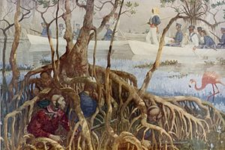
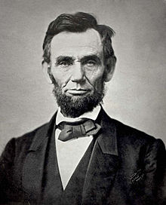
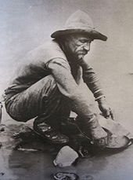
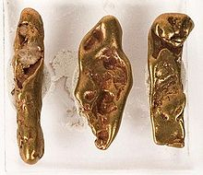
19th century:
War of 1812
Indian removal
and colonization of the west- from
cca. 1830-1890
Annexion of Texas and California- 1840s
California gold rush- 1848-1855
Abraham Lincoln won 1860
president elections

Slide 6

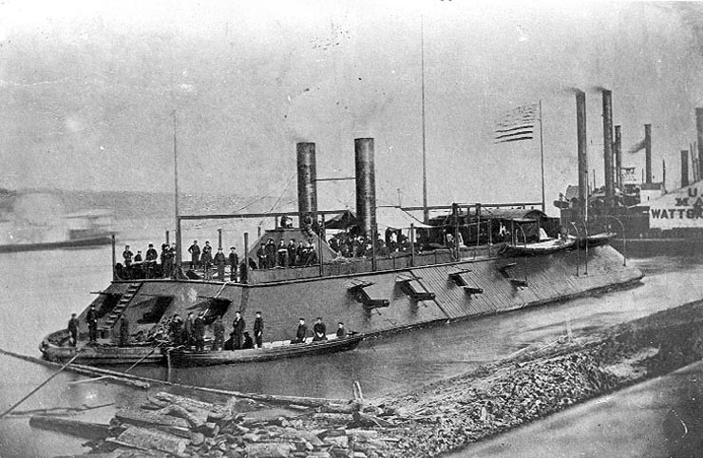
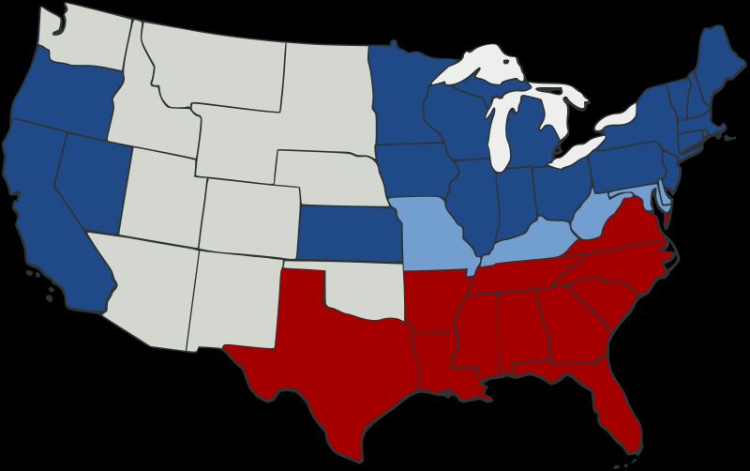
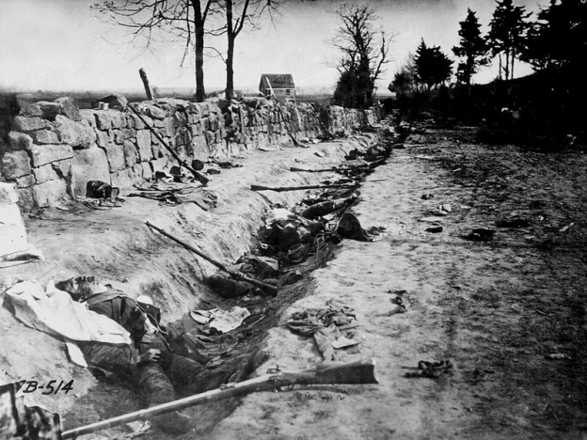
American Civil War, 1861-1865
Eleven southern slave states declared their secession from the United States and formed the Confederate States of America ("the Confederacy"); the other 25 states supported the federal government ("the Union"). After four years of warfare, mostly within the Southern states, the Confederacy surrendered and slavery was abolished everywhere in the nation. Issues that led to war were partially resolved in the Reconstruction Era that followed, though others remained unresolved.

Slide 7

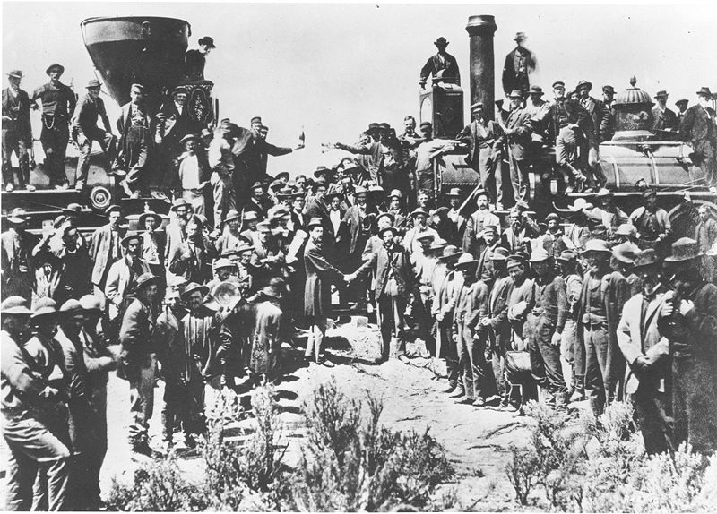
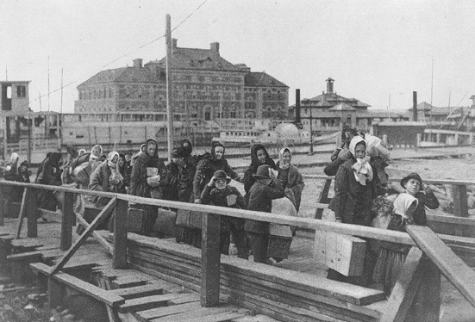
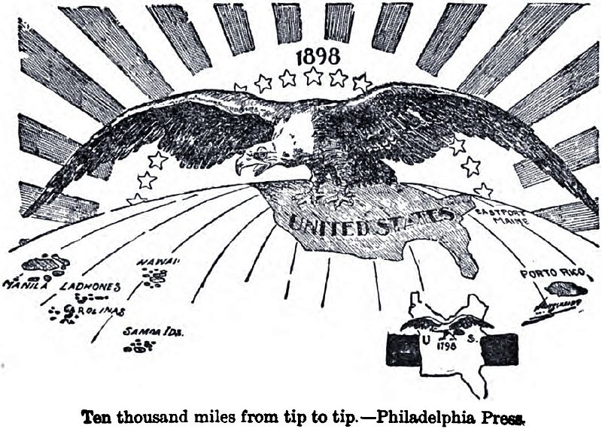
The second part of the 19th century
reconstruction of the Southern States
the end of Wild West era
US became the most developed
industrial country in the world
Wave of immigration from Europe
Raise of US imperialism

Slide 8
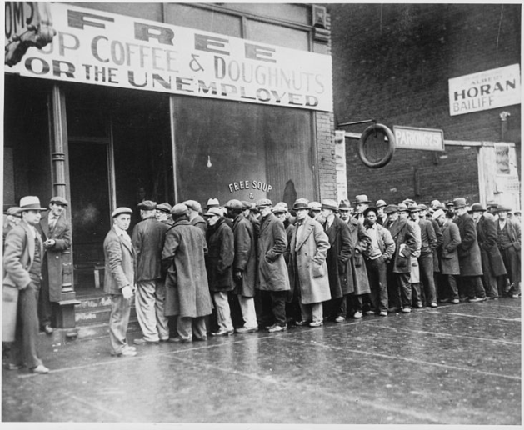
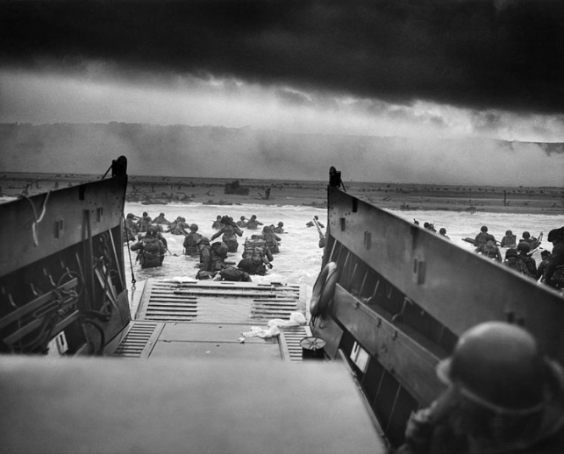
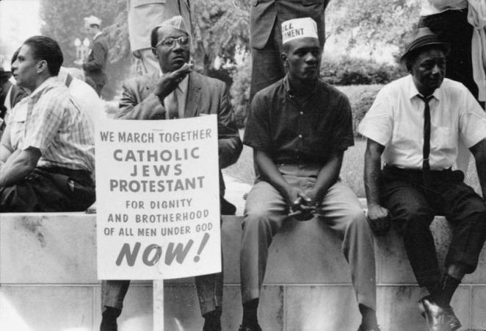
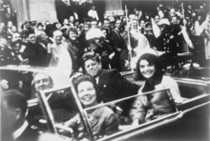
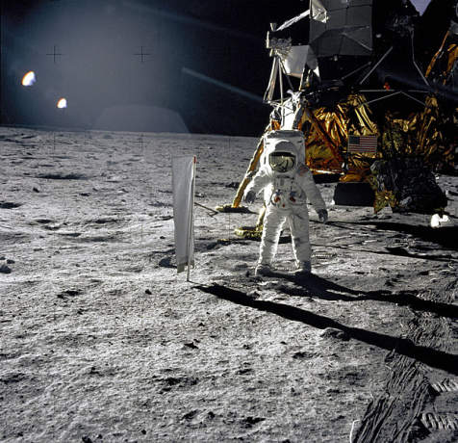
20th century
1st World War
the Great Depression and Prohibition
2nd World War
Fight against racial segregation
Assassination of J.F. Kennedy
by Lee Harvey Oswald
First man on the moon

Slide 9

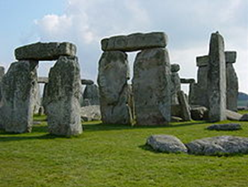
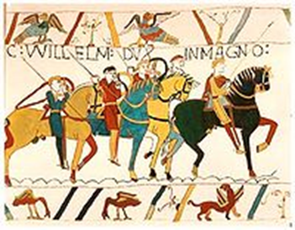
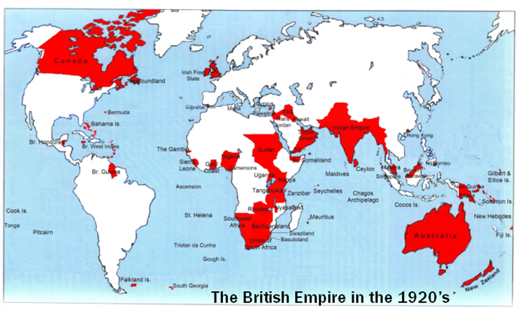
Brief British history
Conquered by Romans in 43 AD
From 5th till 10th centuries- rule of Anglo-Saxons
11th century- England was conquered by Normans
Hundred years war
English Civil War and the Glorious Revolution
18th – 19th centuries- greatest naval and economical power, biggest empire, industrial revolution
20th century- 1st World War, Great Depression,
2nd World War, Decolonization, Falklands War,
Good Friday Agreement, War in Afghanistan

Slide 10
Quiz
What was the name of the first English settlement in the Northern America?
What is Boston tea party?
When the Declaration of Independence was adopted, who was the author?
When was American civil war?
Who assassinated J.F. Kennedy?

