Slide 1
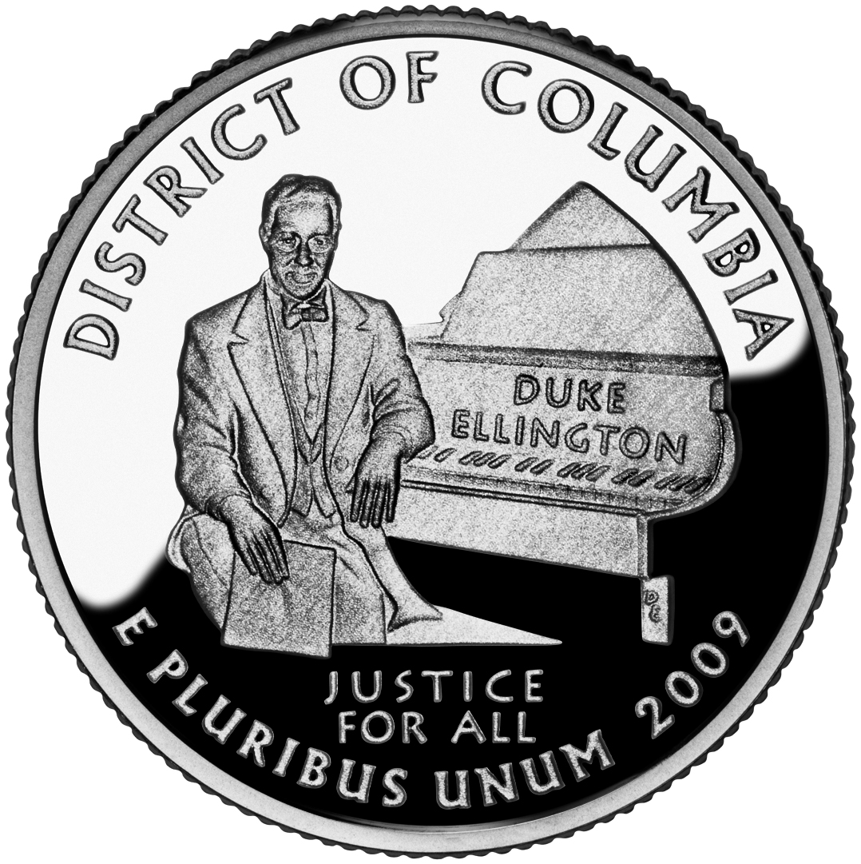
Washington D. C.
Justice for all

Slide 2
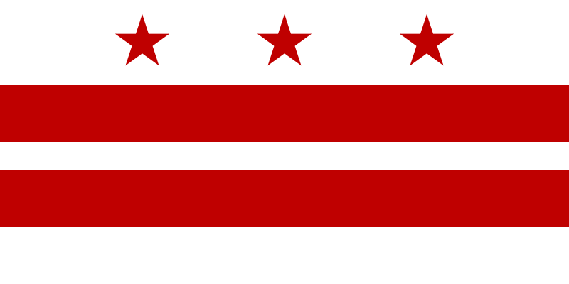
Basic Information
Washington, D. C., formally the District of Columbia is the capital of the United States
Washington D. C. is not part of any U. S., but it´s also not a state itself
Area: 177 km²
Population: 617 976 inhabitants
Flag of Washington, D.C.

Slide 3
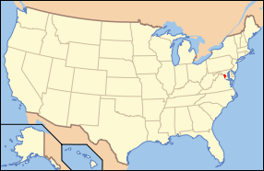
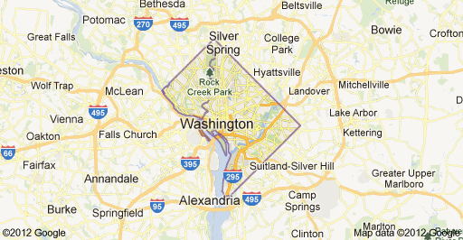
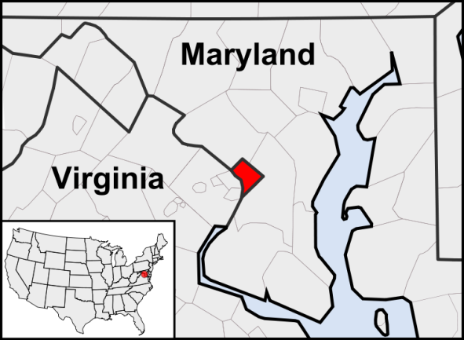
Location
Washington, D. C. is located along the Pontomac river on the counry´s East Coast
On the east it borders on Maryland; on the west on Virginia

Slide 4
History
In 1790 George Washington chose this area for building a new future capital city
Named in honour of George Washington, the City of Washington was founded in 1791 to serve as the new national capital
It was created by 2 architects
The Government moved here in 1800

Slide 5
Importance
One of the most important cities in the U. S.
The centres of all three branches of the federal government of the United States are in the District, including the Congress, President, and Supreme Court.
So there are a lot of important buildings, such as:

Slide 6
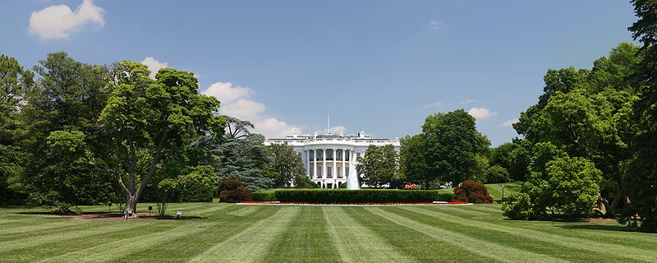
The White House
The White House is the official residence and principal workplace of the President of the United States

Slide 7
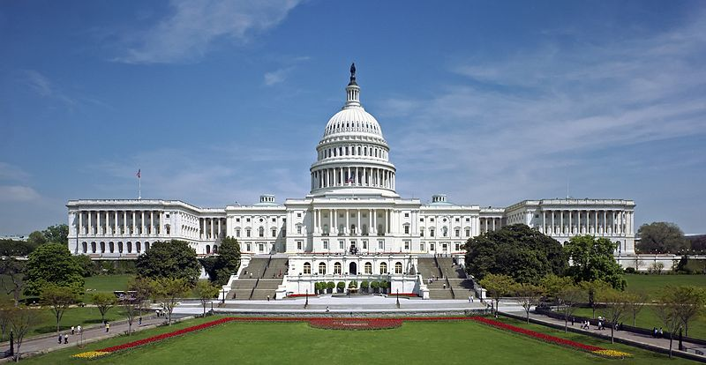
The United States Capitol
The United States Capitol is the meeting place of the United States Congress, the legislature of the federal government of the United States

Slide 8
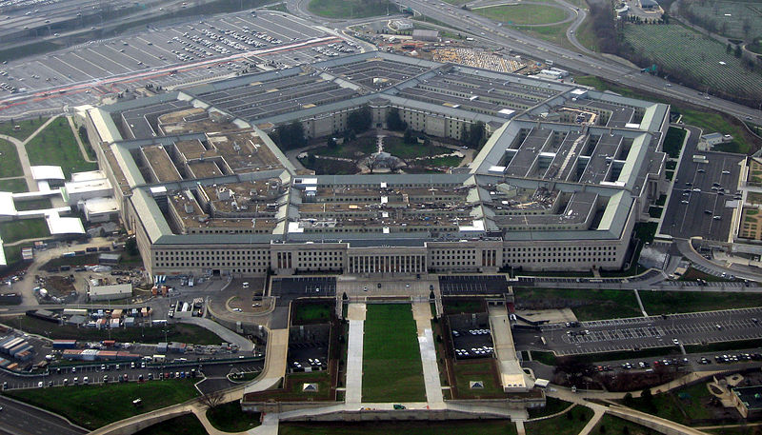
The Pentagon
The Pentagon is the headquarters of the United States Department of Defense

Slide 9
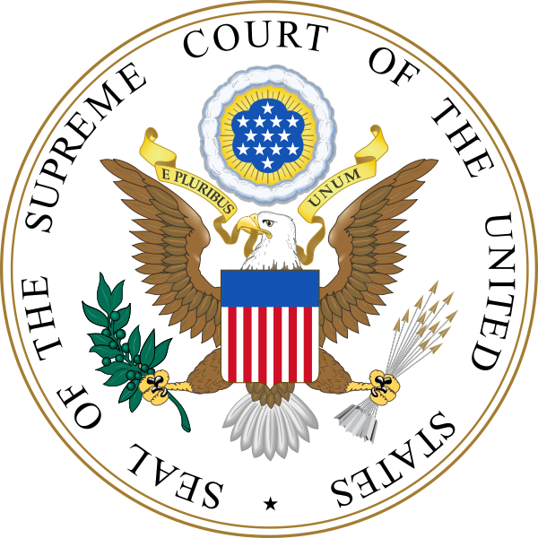
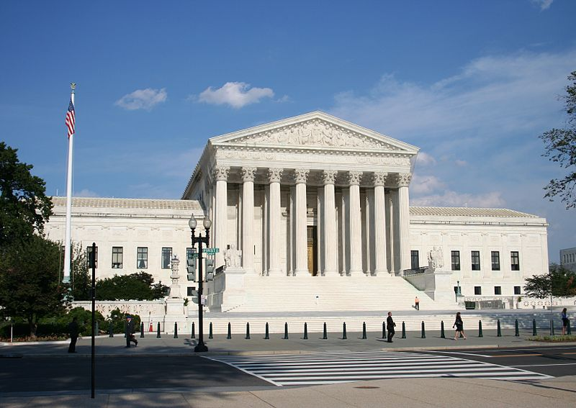
The Supreme Court
The Supreme Court of the United States is the highest court in the United States

Slide 10
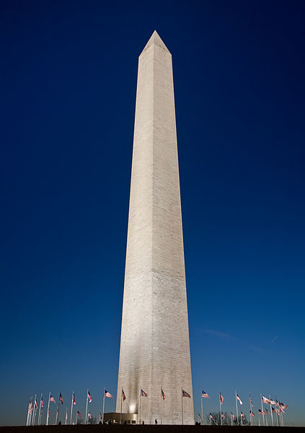
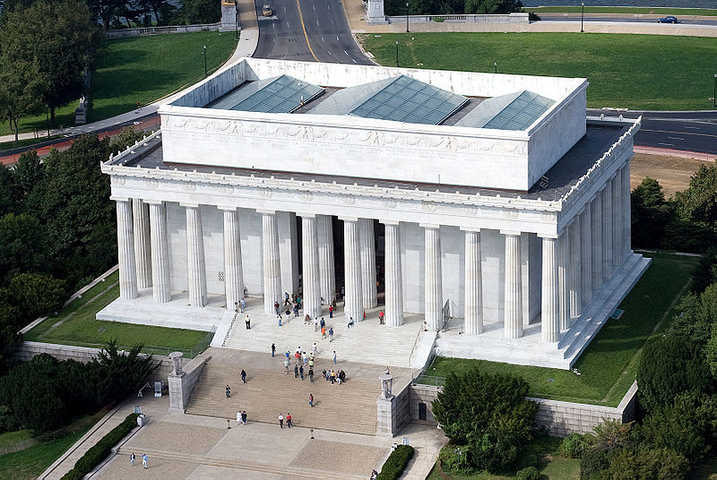
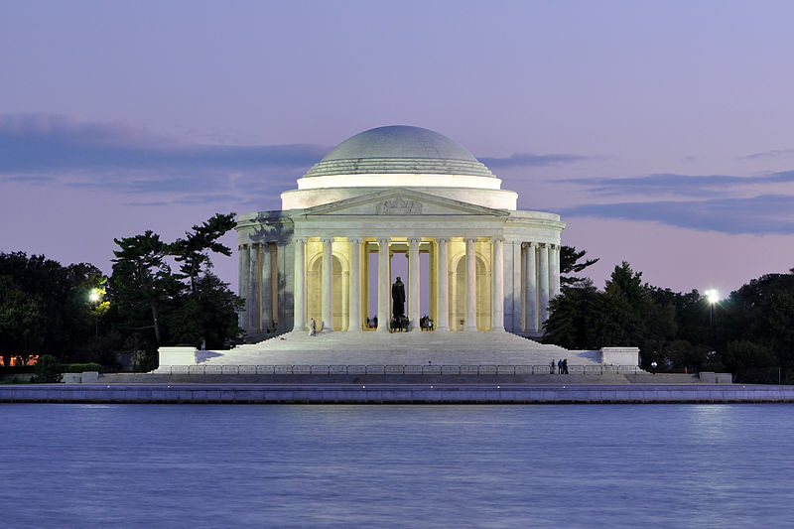
Sights
Lincoln memorial
Washington monument
Jefferson memorial

Slide 11
That´s all folks!
Created by: Jakub Matějček, Kryštof Kocman
Source: http://en.wikipedia.org/

