Slide 1
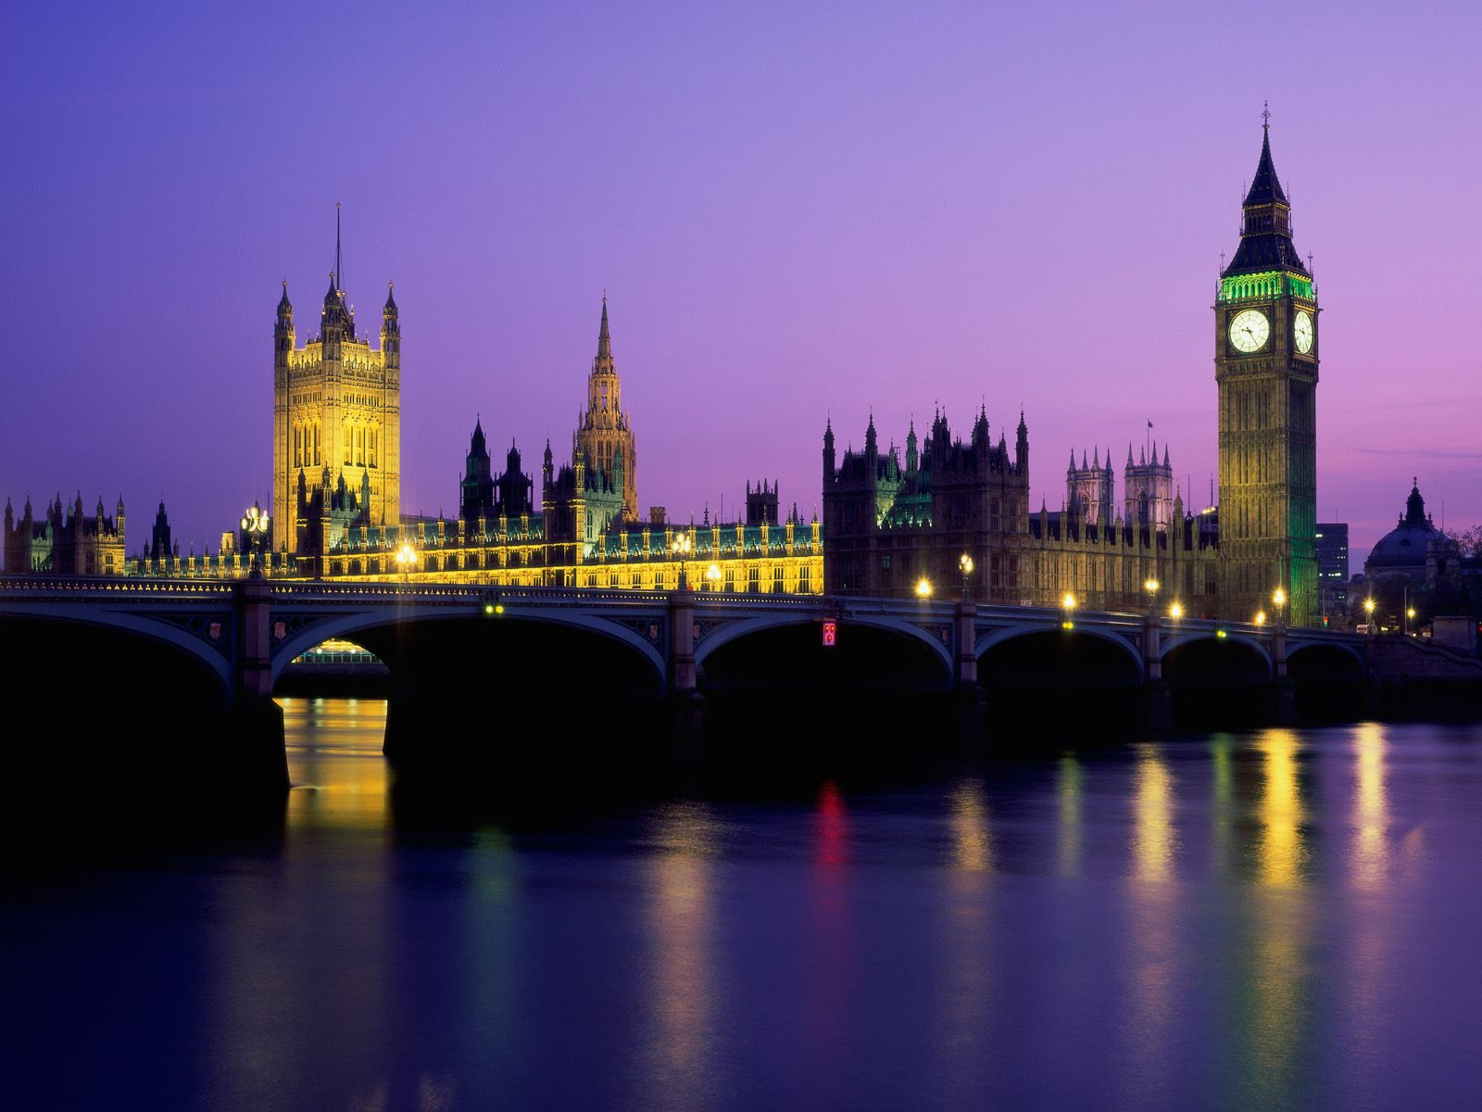
LONDON AND OTHER BRITISH CITIES

Slide 2
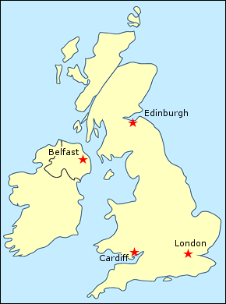
GENERAL INFORMATION
London is the capital city of the United Kingdom
It is located on the Thames river in the southeast part
of England.
London has a diverse range of peoples and cultures
Its population is 8 million people (10 million with
suburbs)
It includes the city of London and 32 boroughs
Seat of Monarchy, the Parliament, the Goverment
and the Supreme Court
Central London = The City of London - the oldest
part of London
The East End - a lot of imigrant groups
The West End – there are theatres, beautiful residential areas, great parks.

Slide 3
HISTORY
London was founded by the Romans around 43 AD.
When the Romans left, the period of history known as the Dark Ages started. The city was largely ruinous and declining. But then, by the trading with distant empires, London became commercial centre again.
1665 - Great plague
1666 - Great fire, lasted five days and virtually destroyed the city.
By the 14th century - London became the political capital of England
The reign of Elizabeth I. - centre of England's Renaissance culture
Many buildings of central London were destroyed or damaged in air raids during World War II.
Nowadays, London is a major financial, political, cultural and educational centre.

Slide 4
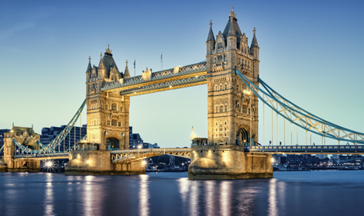
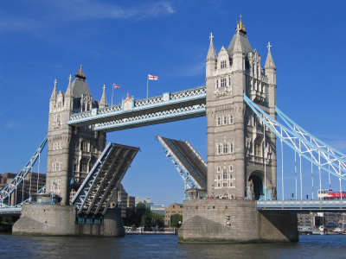
THE MOST IMPORTANTS SIGHTS
Tower Bridge is a bascule bridge over the river Thames. It is close to the Tower of London, from which it takes its name. Construction started in 1886 and took eight years.
Tower Bridge can open in the middle and let large ships go through.

Slide 5
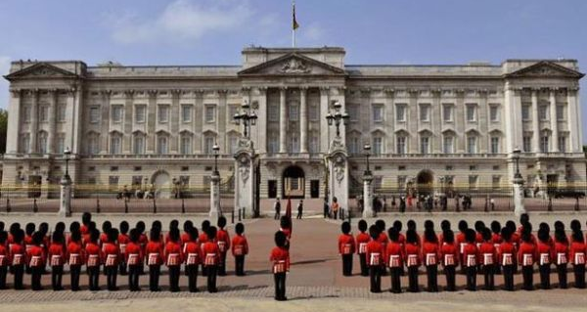
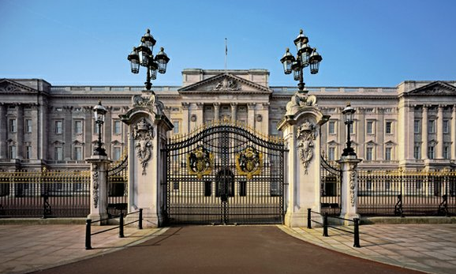
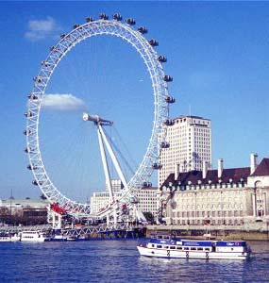
Buckingham Palace is the official London residence and main workplace of the British monarch.
Outside the place the changing of the guard ceremony takes place. It is one of the biggest London's parades.
London Eye
The London Eye is a giant wheel situated on the bank of the Thames. The entire structure is 135 metres tall. The wheel has 32 passenger capsules.

Slide 6
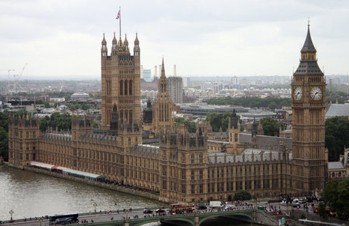
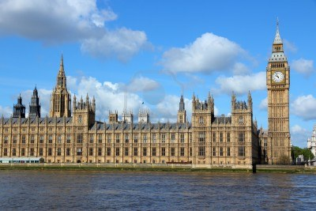
Palace of Westminster is the meeting place of the House of Commons and the House of Lords, the two houses of the Parliament of the United Kingdom.
Commonly known as the Houses of Parliament after its tenants, the Palace lies on the bank of the river Thames in the City of Westminster, in central London.
The Palace of Westminster is part of UNESCO World Heritage since 1987.

Slide 7
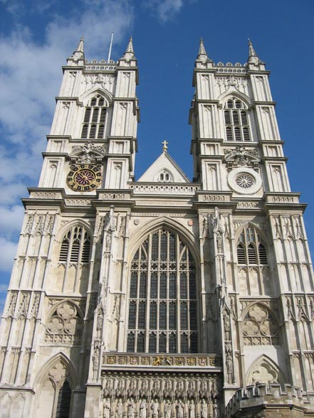
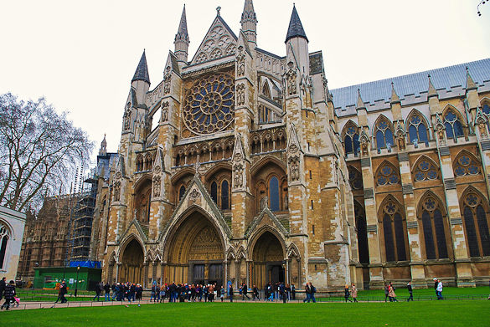
Westminster Abbey is a large, mainly gothic church.
It was was first constructed in the eleventh century by King Edward the Confessor.
It is the crowning place of English monarchs and several generations of English sovereigns are buried here.
Famous english persons are buried here too, f.e. Isaac Newton, Charles Darwin. There are also many memorials of great statesmen, politicians, scientists, and poets.
Place for royal weddings.

Slide 8
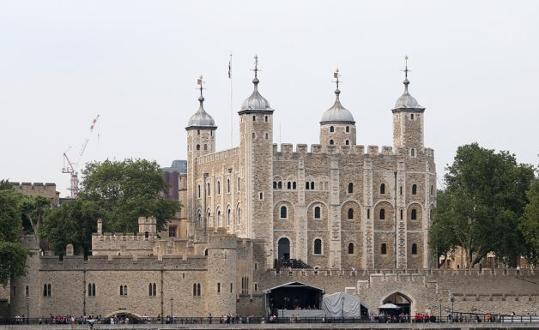
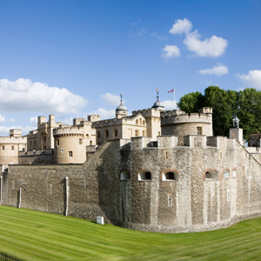
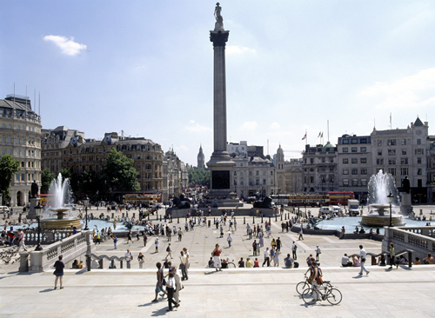
Tower of London is a castle on the north bank of the river Thames in central London. The castle was used as a prison. Tower of London was built at the time of William the Conqueror. The crown jewels are kept there.
Trafalgar Square was named after Admiral Nelson's victory over Napoleon at the Battle of Trafalgar (1805). Nelson's statue surrounded by four lions is situated here.
The National Gallery also lies here.

Slide 9
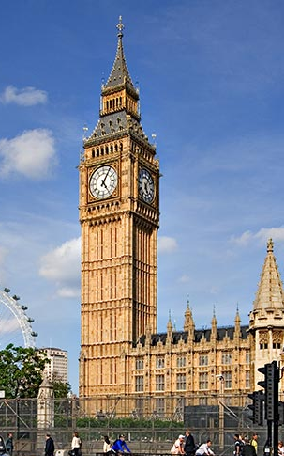
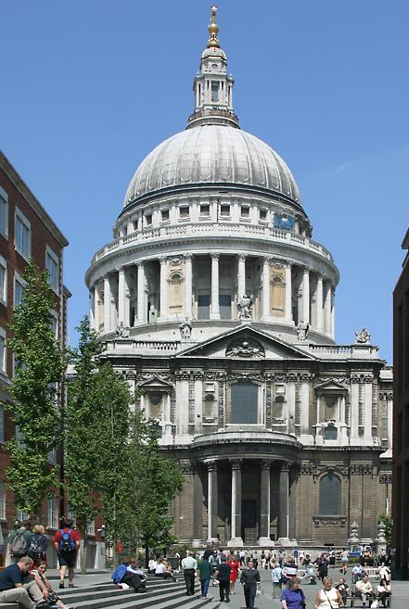
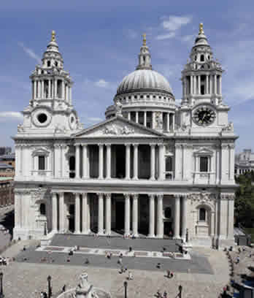
Big Ben is the nickname for the great bell and clock tower at the north end of the Palace of Westminster in London.
Officially named Elizabeth Tower.
St. Paul's Cathedral is a masterpiece of the architect Sir Christopher Wren and was built after the Great Fire in 1666. In 1981 Charles and Diana were married here.

Slide 10
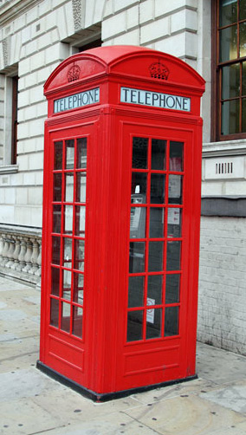
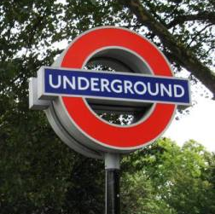
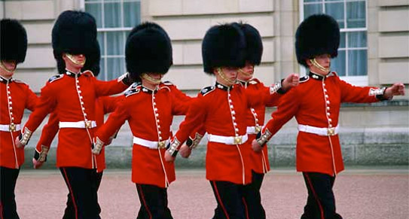
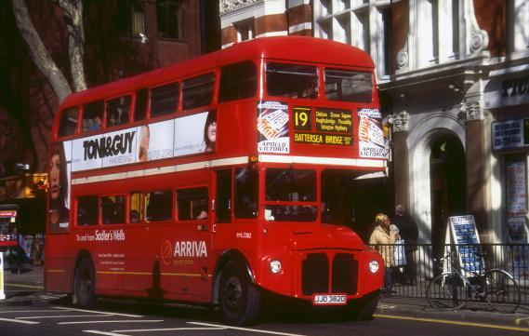
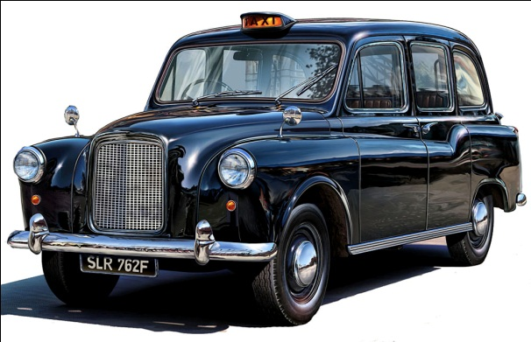
SYMBOLS OF LONDON
Red double-deckers
Old fashioned black taxis
Red phone-boxes
Guardsmen
The London Underground (tube) - the first
underground railway for passengers in the world.

Slide 11
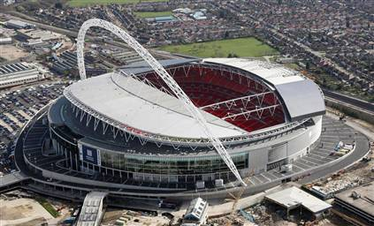
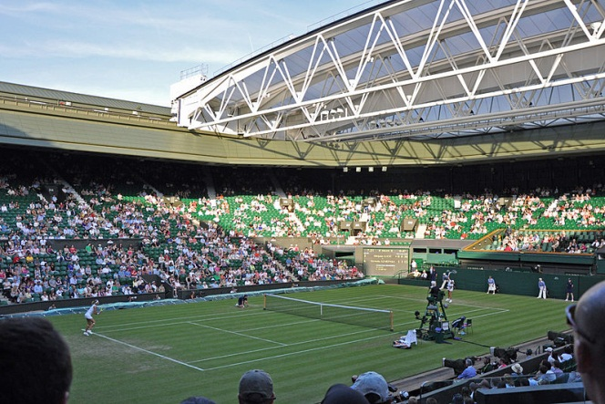
SPORT IN LONDON
Olympic Games in London
In 2012 there were Summer Olympic Games
London became the first city in the world that
hosted the Olympic Games three times, because there were Olympic games in 1908 and 1948 as well.
Arsenal, Chelsea and Tottenham Hotspur are London's most successful football teams in domestic and European competitions.
Wembley Stadium, England's national stadium.
It is the home venue of the England national
football team.
Wimbledon is a district in southwest London.
It is home to the Wimbledon Tennis
Championships

Slide 12
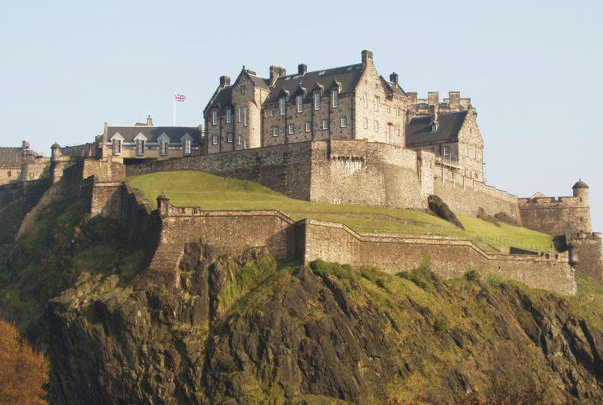
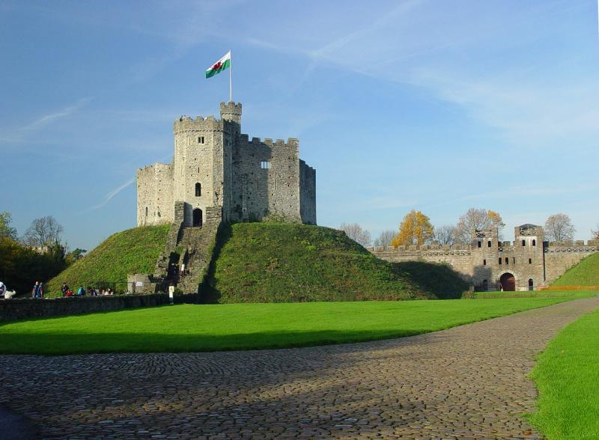
EDINBURGH
Located in the south east of Scotland
Edinburgh is the capital city of Scotland
Beautiful city with its large collection of Medieval and Georgian buildings
Edinburgh castle on a piece of volcanic rock
CARDIFF
The capital city of Wales
Centre of the Welsh culture
Cardiff is known for Cardiff castle, the National Museum Gallery of Wales, Millenium Stadium, and Cardiff Bay.

Slide 13
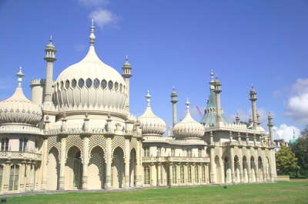
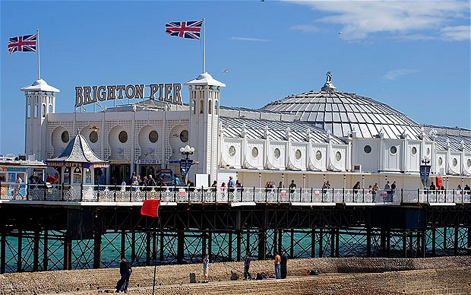
BRIGHTON
Located on the south coast of England by the seaside – popular summer resort.
is known as a student town and is full of young people, so you'll notice many schools, music stores, vegetarian restaurants, great pubs, fish and chip shops and a couple of cool malls.
Famous for the Royal Pavilion built in oriental style and Brighton Pier

Slide 14
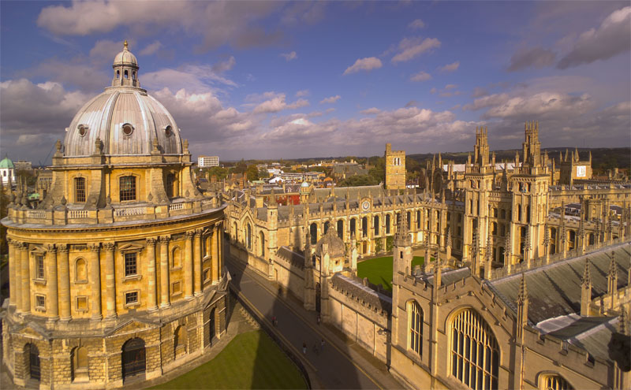
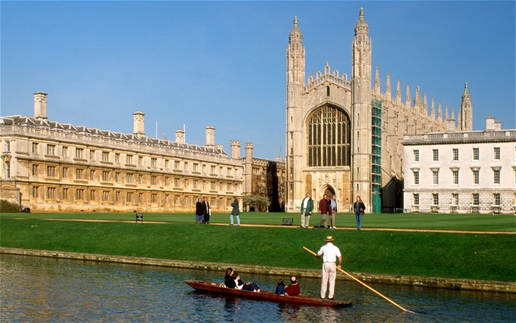
OXFORD CAMBRIDGE
There is the oldest university in England.
Oxford University consists of 38 independent colleges.
The largest is called Christ Church.
The city is situated at the meeting of two rivers- The Thames and The Cherwell.
There are many museums, libraries, galleries.
Cambridge is a university town with 30 colleges
Second oldest university in England
Firstly only for men, later also for women.
There is very famous bridge over the river called Bridge of Sighs.
There is a long history of rivalry between Oxford and Cambridge, big competition

Slide 15
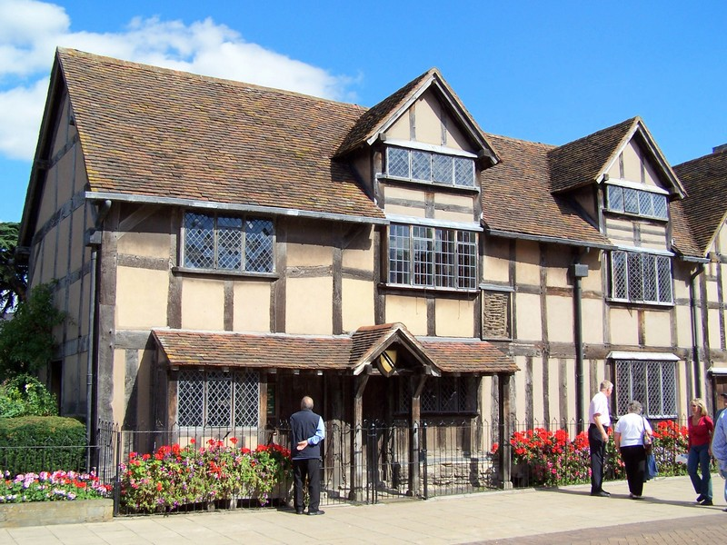
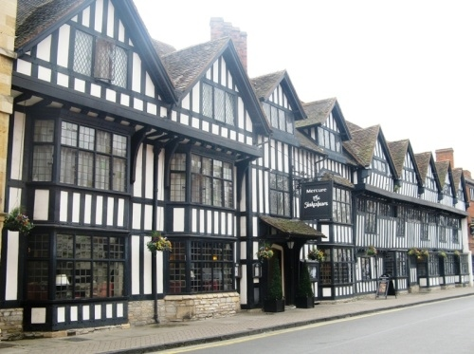
STRATFORD-UPON-AVON
Small, but very popular and visited city
This city was founded by german tribe of Saxons.
William Shakespeare was born here
In Holy Trinity Church you can see the grave of Shakespeare, his wife and other members of his family. There is the Royal Shakespeare Theatre where the Shakepeare’s plays have been played.
Shakespeare’s birthplace is the house where Shakespeare was born in 1564.
William Shakespeare‘s birthplace

Slide 16
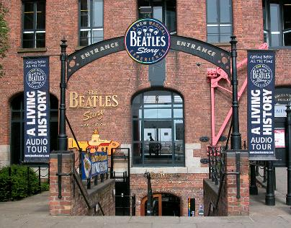
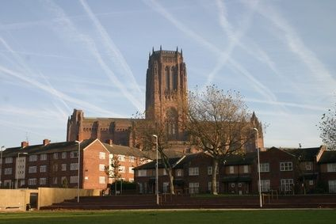
LIVERPOOL
This city is connected with popular music
In Liverpool the music group Beatles was formed.
Liverpool was one of the biggest centres of industry, but today Liverpool one of the poorest parts of England.
There is a big port
Liverpool's Anglican Cathedral, completed in 1978, is the largest in the UK and the fifth largest in the world

Slide 17
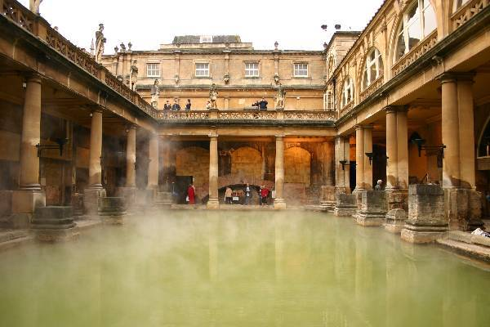
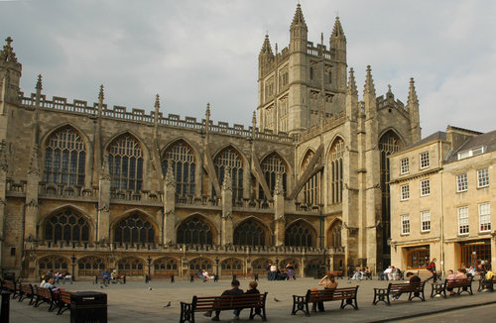
BATH
Situated 150 km west of London
The Romans founded this city
Famous for spa, one of the most beautiful in the United Kingdom.
It's a World Heritage city, full of roman ruins, Bath abbey
Natural hot springs
Theatres, museums, parks…

Slide 18
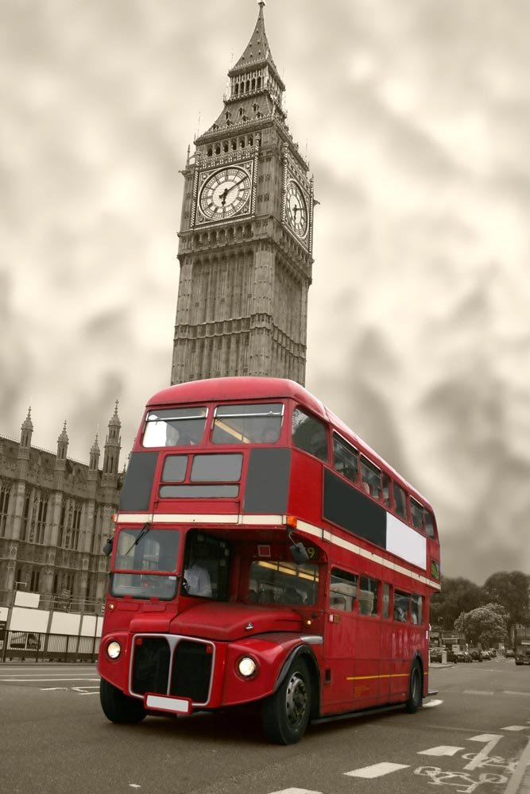
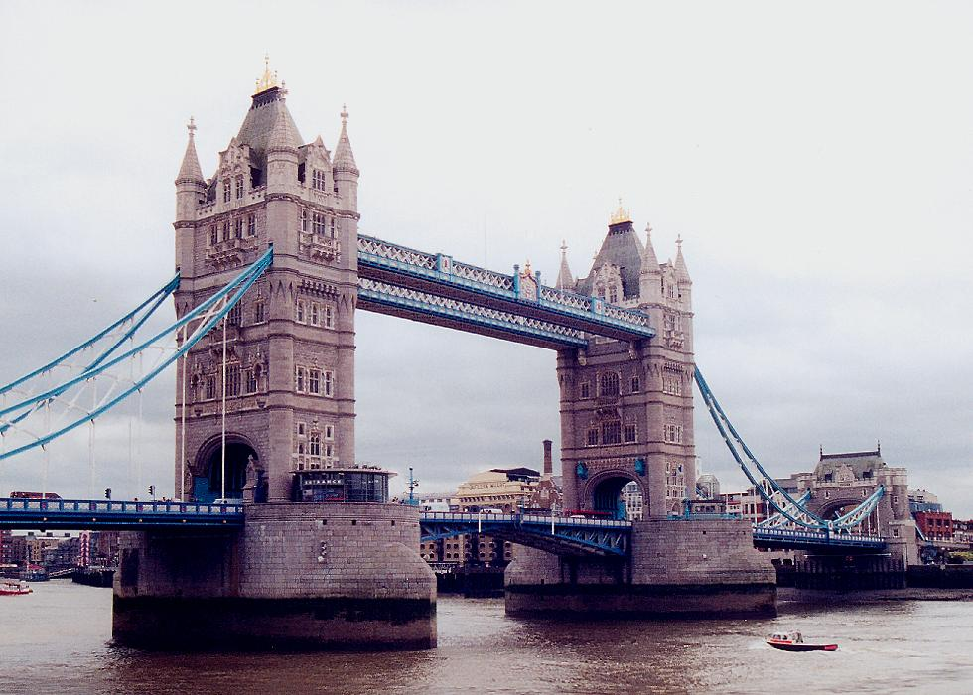
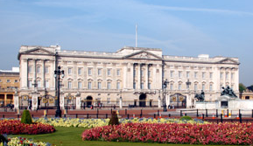
QUESTIONS
What happened in London in 1666?
Name 4 sights in London.
What is Stratford-upon-Avon famour for?
What is Liverpool famous for?
What can you see in the pictures?

Slide 19
THE END
Marie Jindrová
XB
Sources: www.google.com

