Slide 1
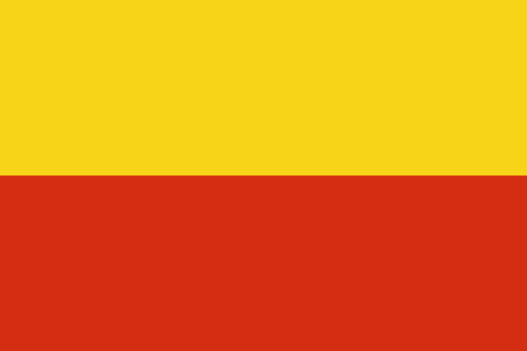
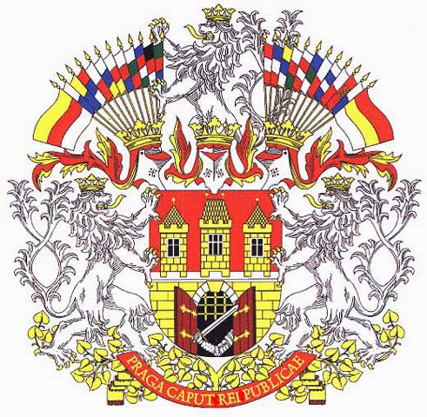
Prague

Slide 2
Basic information
the capital and largest city of the Czech Republic
14th largest city in the EU (area - 496 km²)
1,3 Million inhabitants
political, cultural, and economic centre
President of the Czech Republic and government have seats here
considered one of the most beautiful cities in Europe
visited by many tourists

Slide 3
history
the capital city of the Czech state for 11 centuries
originated as settlement around the Prague Castle (founded around 880)
In 1348, Emperor Charles IV founded the New Town of Prague - created one of the biggest cities in medieval Europe
1583-1612 Rudolf II Habsburg chose the Prague castle for permanent residence – art boom
1618-1648 Thirty Years' War – end of boom
In 1784 the Emperor Joseph II joined independent Prague cities -Old Town, New Town, Lesser Town and Hradcany -into a single capital city.
In the 19 century - the centre of the Czech national revival
In November 1989 Prague was the birthplace of the "Velvet Revolution"

Slide 4
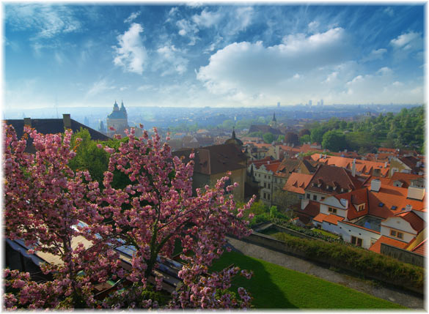
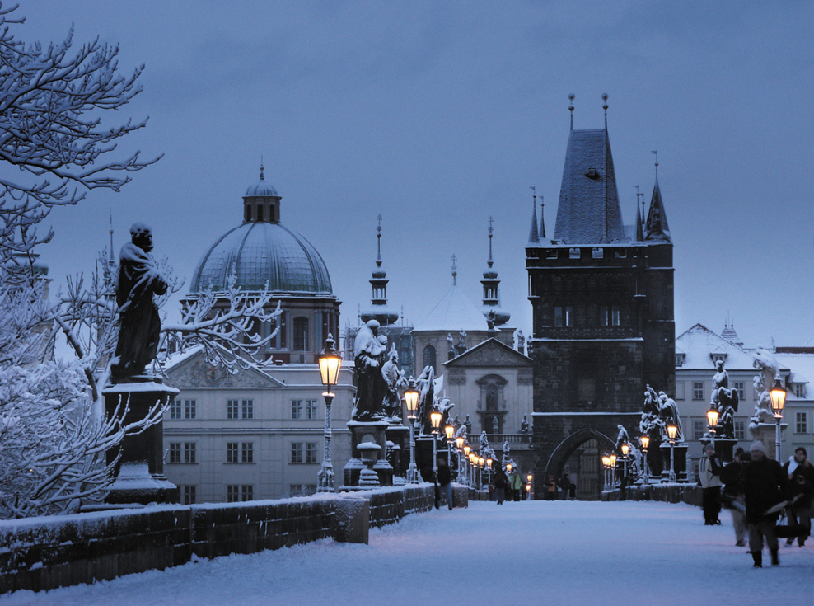
Climate
borderline oceanic climate
winters - relatively cold with very little sunshine
summers - usually bring fine sunny days with highs being around 25 degrees

Slide 5
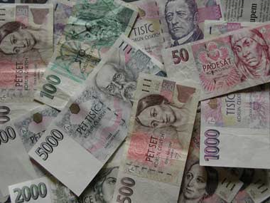
economy
Prague is in comparison with the rest of the CR strongly richer region
one of the most important economic centre of the Czech
Services account for around 80 % of employment.

Slide 6
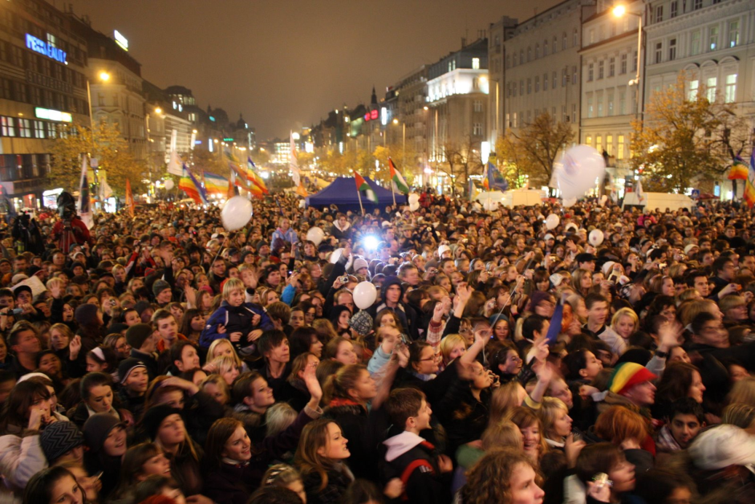
population
1,3 Million
Foreigners – 14%
The most numerous minorities are Ukrainians, Slovaks, Russians and Vietnamese. The city also has got several Roma communities

Slide 7
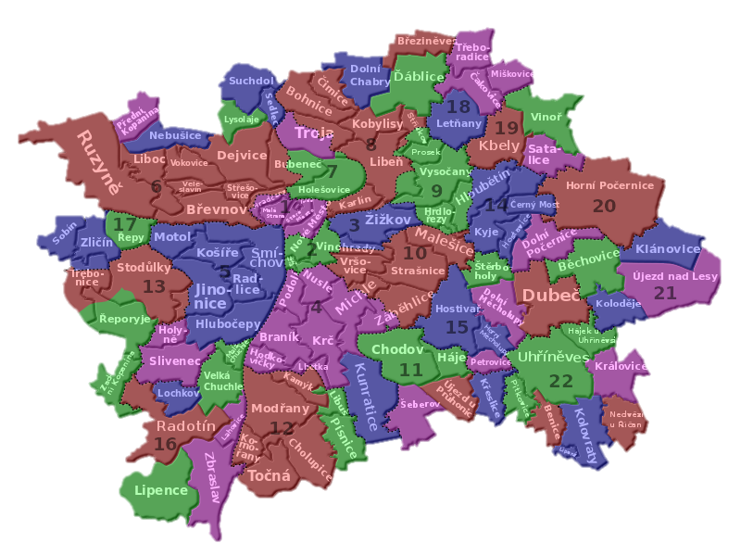
administration
Prague has 57 municipal districts - managed by an elected council, mayor and district office
From 1 July 2001 this level of competence in the whole of Prague is divided into 22 administrative districts and they are named Prague 1-22.

Slide 8
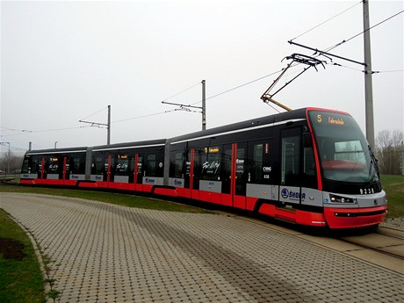
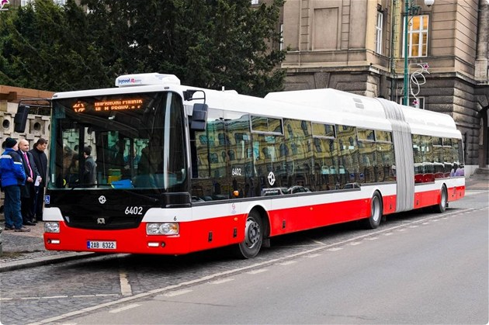
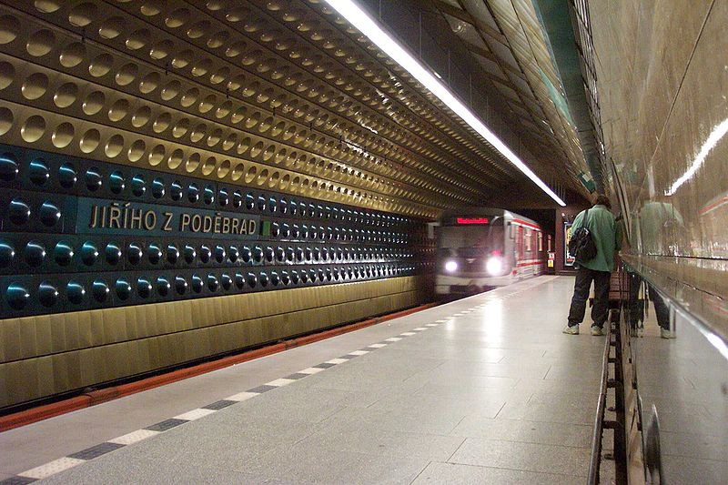
Transport
Prague is a major intersection in the Czech Republic and also in Central Europe
Public transport - Prague Metro, Prague tram system, buses, the Petřín funicular to Petřín Hill, and six ferries

Slide 9
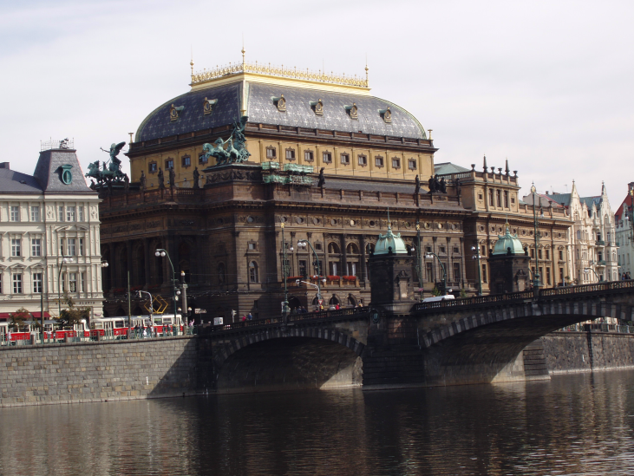
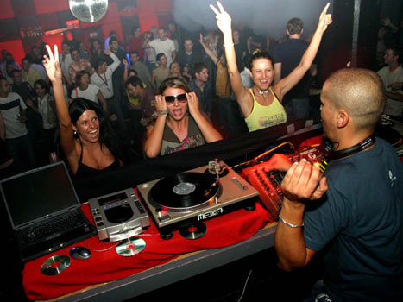
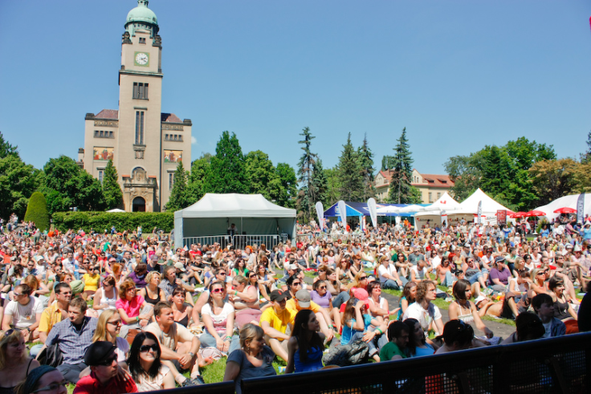
culture
Prague is the cultural centre of the Czech Republic
a lot of museums, galleries, theatres, cinemas and various cultural institutions
hundreds of restaurants, bars and pubs

Slide 10
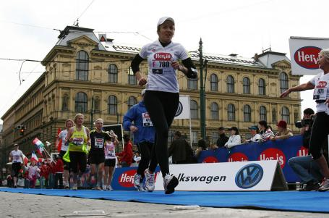
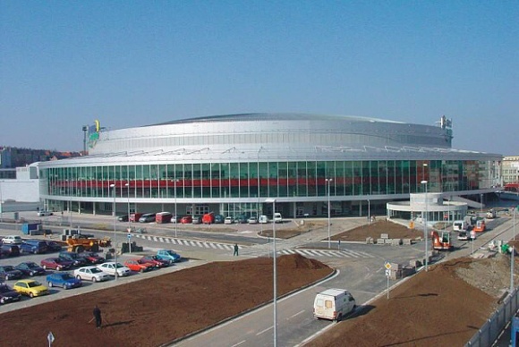
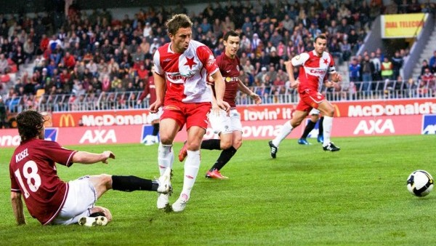
Sport
Prague is home of many sport teams (football and hockey - Sparta Praha, Slavia Praha)
The largest Czech multifunctional hall - O2 Arena
second largest stadium in the world - Strahov stadium
sports events include: Prague International Marathon (PIM), Memorial of Joseph Odložil (international athletics meeting), Mystic Sk8 Cup (World skateboard Cup).

Slide 11
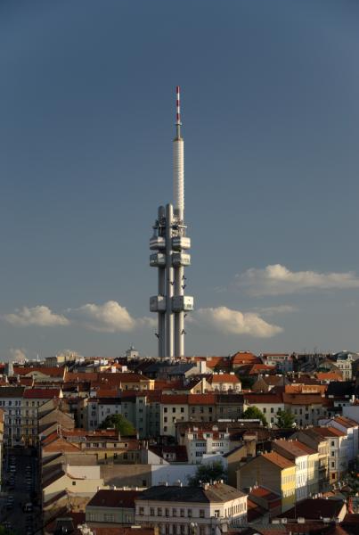
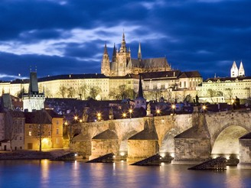
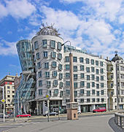
Main sights
Prague is the sixth-most-visited European city
contains one of the world's most pristine and varied collections of architecture
most of the most popular sights are in Old Town, Lesser Town or Hradčany.
Examples:
  Prague Castle with the St. Vitus Cathedral
  Charles Bridge
  Petřín Hill with Petřín Lookout Tower
  The Astronomical Clock (Orloj) on Old Town City Hall
  Wenceslas Square
  The Dancing House Žižkov Television Tower
  Vyšehrad Castle

Slide 12
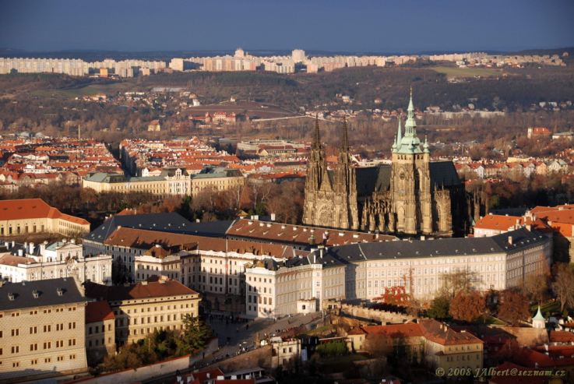
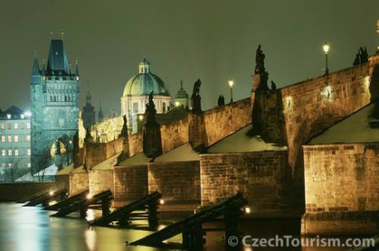
Prague castle
seat of Czech kings, now seat of the President
Charles bridge
Charles Bridge with 30 mostly baroque statues

Slide 13
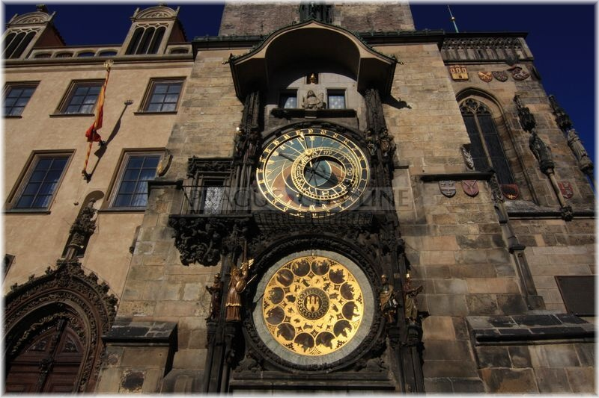
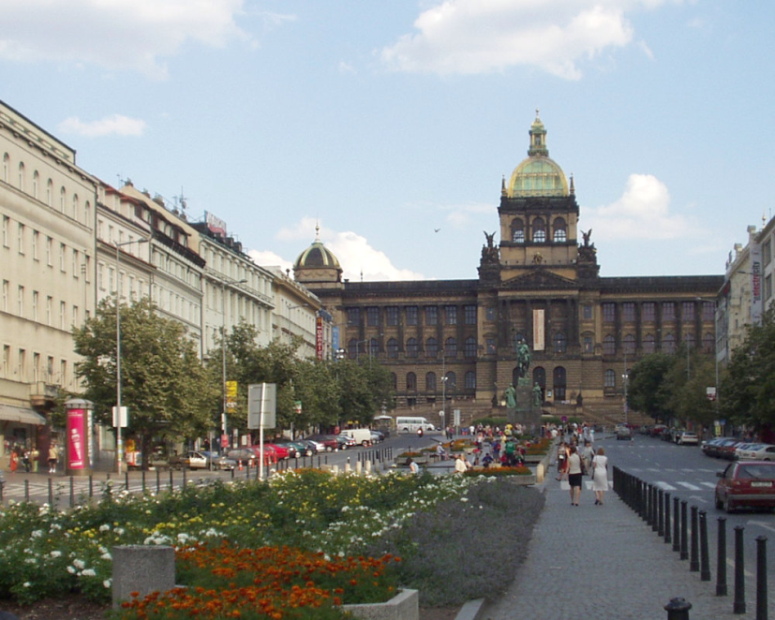
The Astronomical Clock (Orloj)
on Old Town City Hall
Wenceslas Square
With Czech National museum

Slide 14
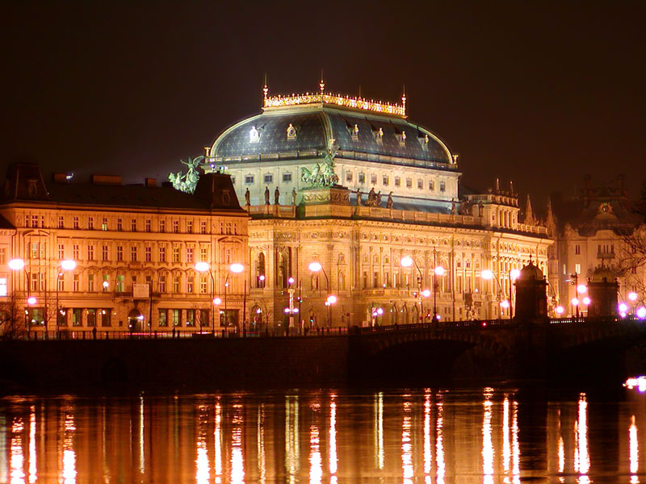
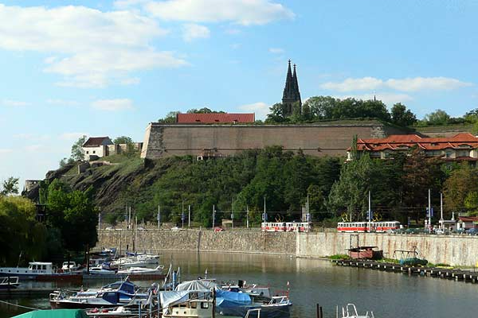
The National Theatre
a neo-Renaissance building with golden roof
Vyšehrad castle
with Vyšehrad cemetery and Prague oldest Rotunda of St. Martin

Slide 15
Lukáš chvátal
Zdroje:
http://cs.wikipedia.org/wiki/Praha
http://en.wikipedia.org/wiki/Prague

