Slide 1
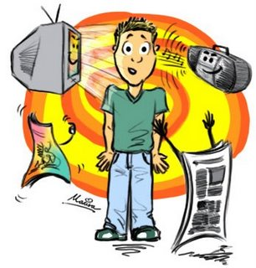
MASS MEDIA

Slide 2
GENERAL INFORMATION
The means of communicating with large numbers of people
Magazines, newspapers, radio, television, internet
Big influence on public opinion
At this time there are many TV and radio stations, a lots of different kinds of newspaper; the quality of the programs and articles is not always good

Slide 3

PRESS
Readable materials (about political situation, culture events, results of sport matches,…)
Dividing:
  Serious (broadsheets) x tabloid periodical
  National x regional newspapers
Magazines – published once a week/month
- of general interest or aimed at st.
People can buy newspapers every day or subscribe it

Slide 4
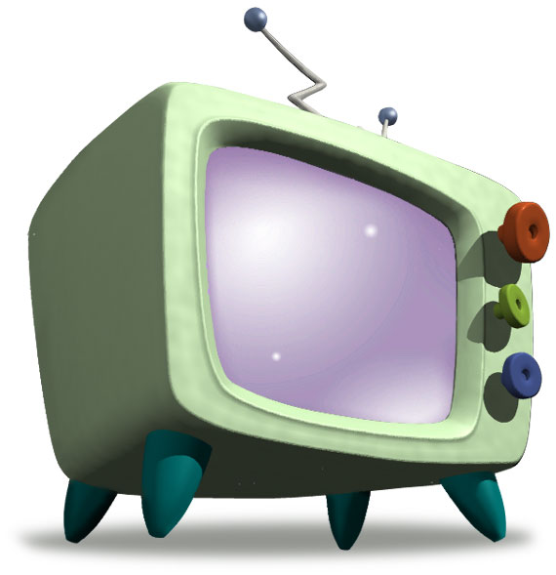
TELEVISION
Invited in 1926 by John
Logie Baird
People can see the news
Programme – quite different from radio (the news, weather forecast, sport matches, political discussions – like on radio; moreover soap opera, talkshow, competitions,…)
state channels (ČT) x private or commercial channel (Nova, Prima) – a lot of channels paid

Slide 5
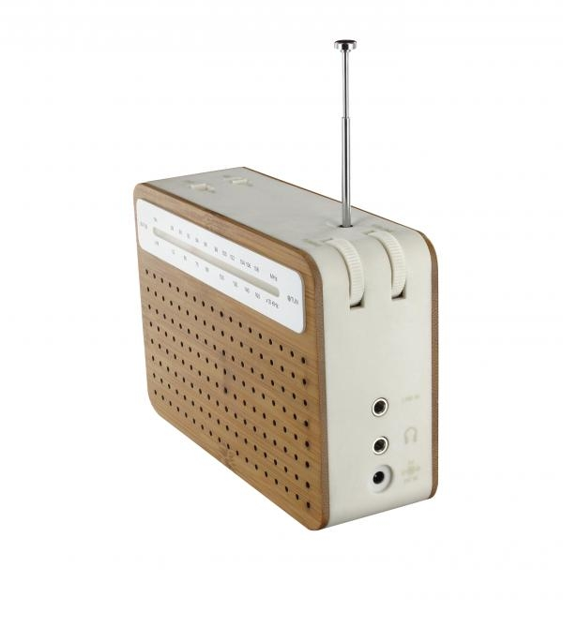
RADIO
the existence of radio waves had already been demonstrated in 1886, by an German physicist, Heinrich Herty, later, when the microphone was invented, great improvements were made, Radio could be used to transmit and receive the spoken world and even music
Regular news, listen to music, programmes on various topics, weather forecast, programme of cinemas and theatres, discussions with famous characters
Listening to radio – combined with many other activities (driving a car, tidying, working,…)

Slide 6
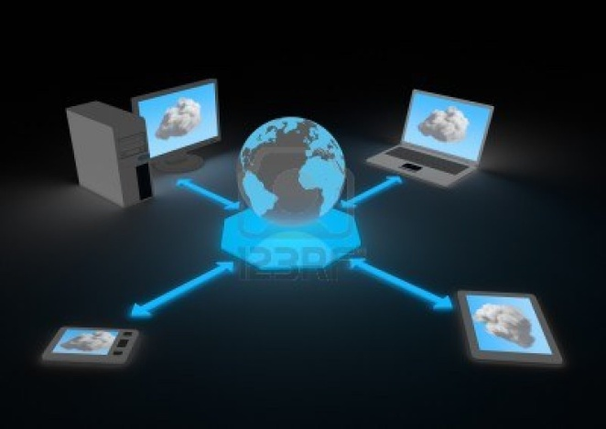
INTERNET
has been developed quite recently (about 20 years ago) but it has become very fast the most important source of information
Information can be found easy and quickly
You can contact your friends from the other side of the Earth thanks to e-mail, use chat to find new friends, shop on-line…
We must pay attention to our personal data, it can be misused

Slide 7
What kind of mass media do you use most often? Why?
What do you think about children watching TV?
How much time do you spend at the computer?

Slide 8
THANK YOU FOR YOUR ATTENTION
MADE BY: Žaneta Holková

