Slide 1
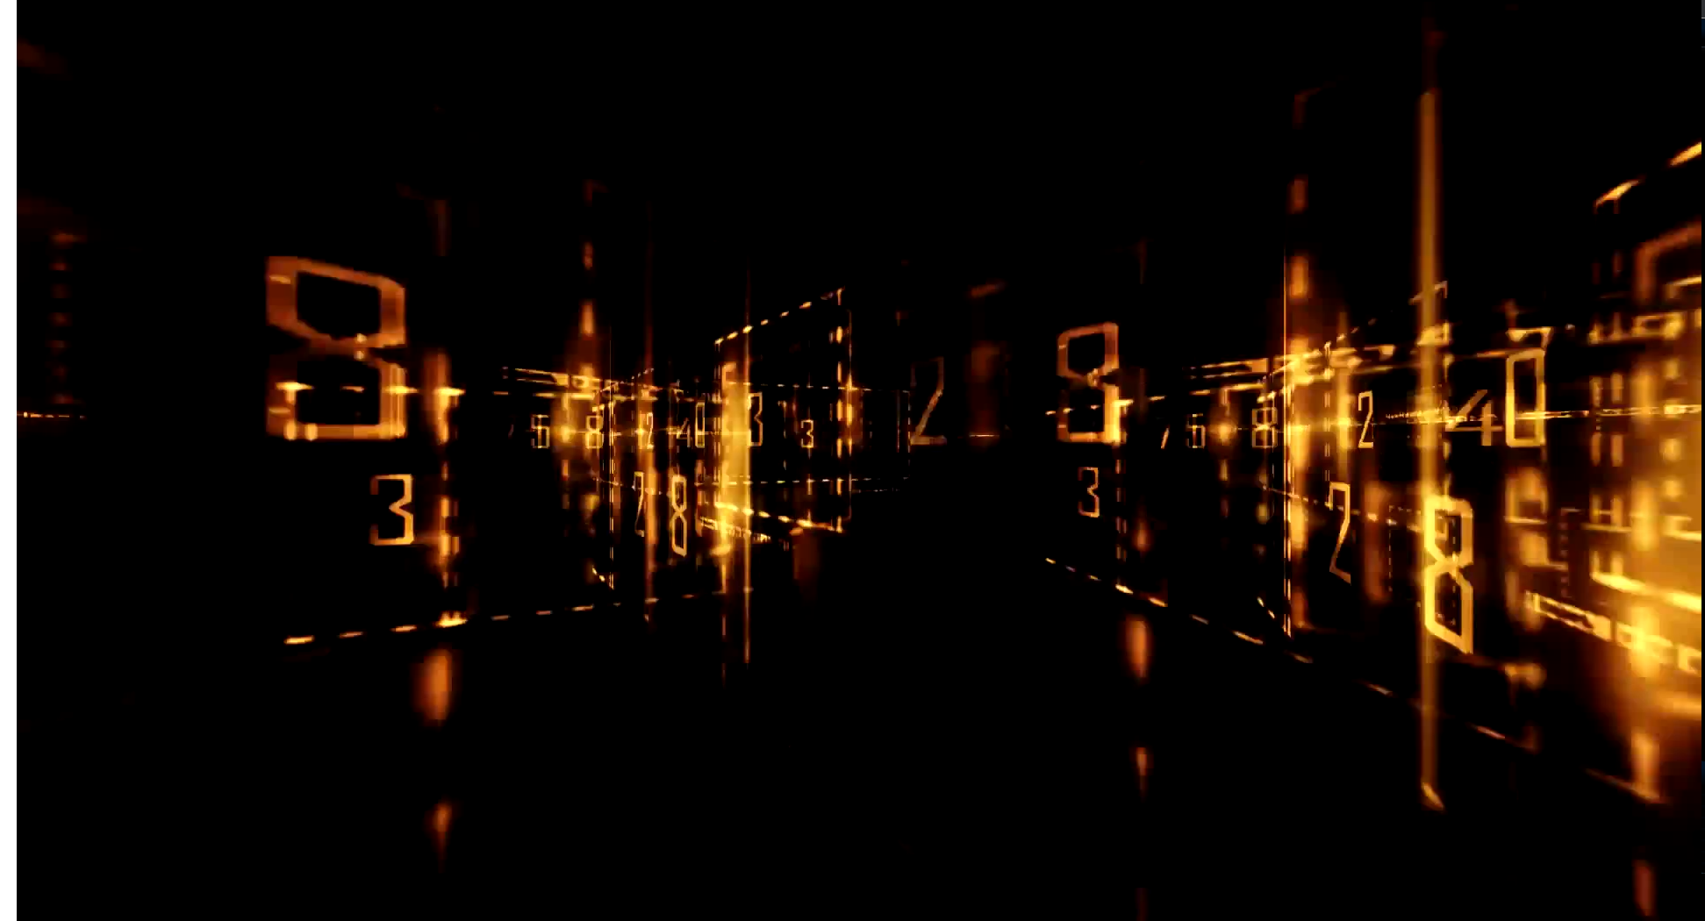
Science and technology

Slide 2
Questions (science)
What happened during the scientific revolution in 20th century?
How is the science connected with technology?
How is science limited?

Slide 3
Definition of science and technology
Science is a systematic enterprise that builds and organizes knowledge in the form of testable explanations and predictions about the universe. In a closely related meaning, "science" refers to the body of reliable knowledge itself, of the type that can be logically and rationally explained.
The word technology refers to the making, modification, usage, and knowledge of tools, machines, techniques, crafts, systems, and methods of organization, in order to solve a problem, improve
a pre-existing solution to a problem, achieve a goal, handle an applied input/output relation or perform a specific function.

Slide 4
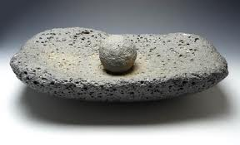
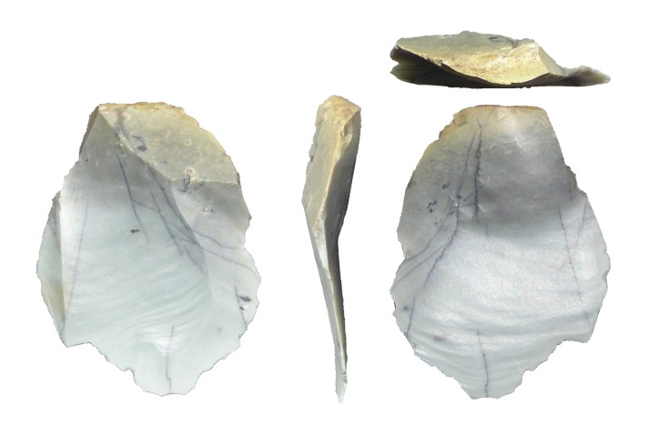
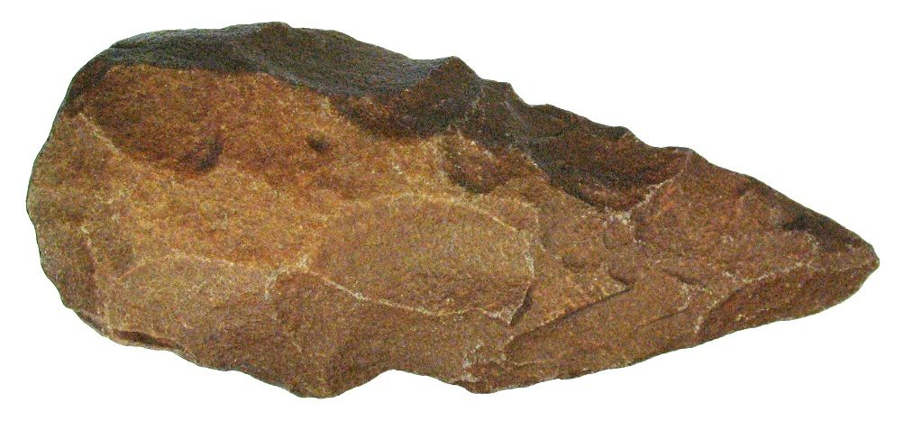
Stone age – 2.6 mya – 3500 BC
Grinder
Tools / weapons
  sharpened stones
  hand axe
  bow and arrow
  spear
  grinder
Agriculture
Ceramic
  art objects - Venus of Dolní Věstonice
  vessel
Weaving
  linen, wool
Lithic flake
Hand axe

Slide 5
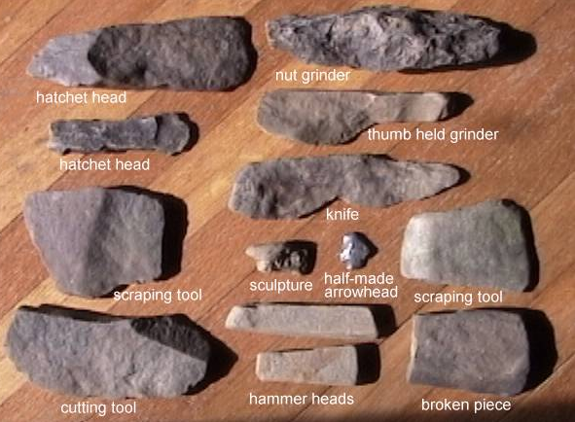
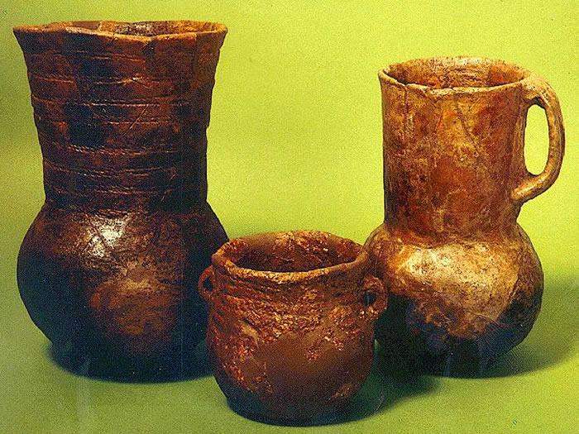
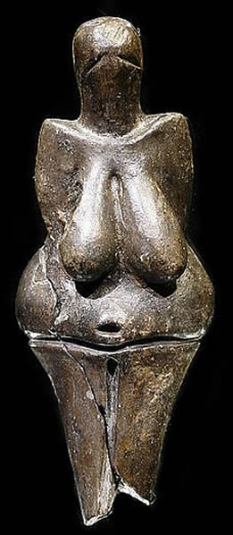

Slide 6
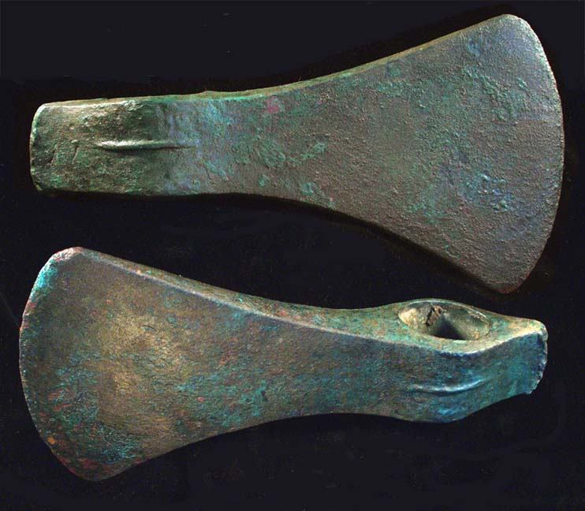
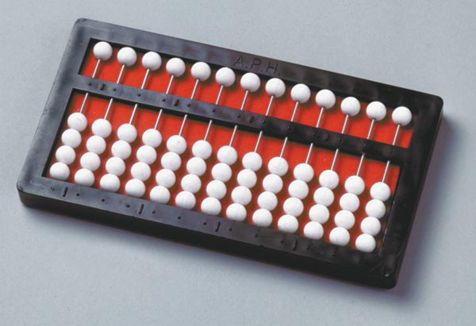
Bronze Age (3500 BC – 1200 BC) / Ancient history
Bronze – alloy of copper and tin
  swords, axes, hoes, helmets
Wheel
  carts
Salt
  cloth dyeing
  food preservation
Abacus
  forerunner of computer

Slide 7
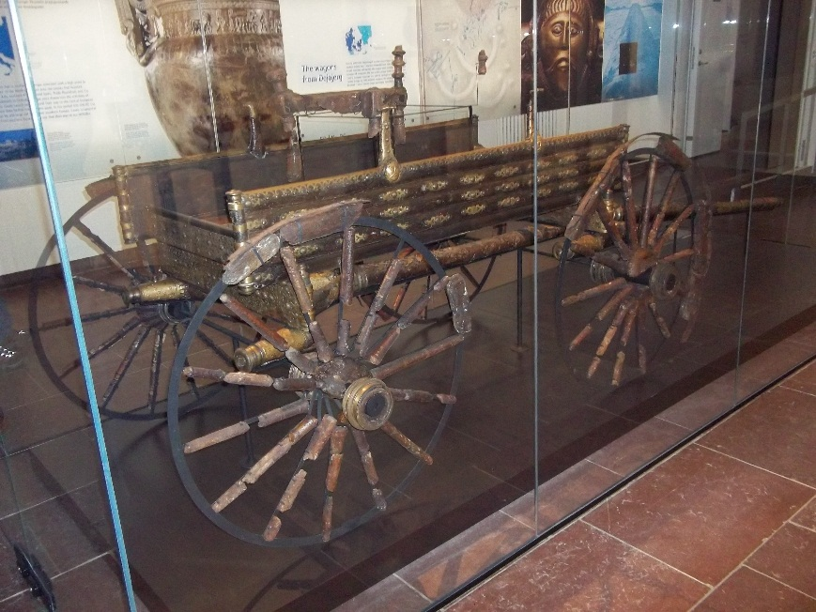
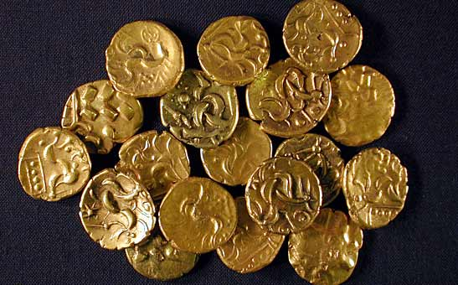
Iron Age (1300 BC – 200 BC); Ancient and medieval technology
Tools improvement
  wagons
    road building
  catapults
  coins
Chinese: matches, paper, compass, crossbow, gunpowder
mechanical clock, windmills
Dejbjerg wagon

Slide 8
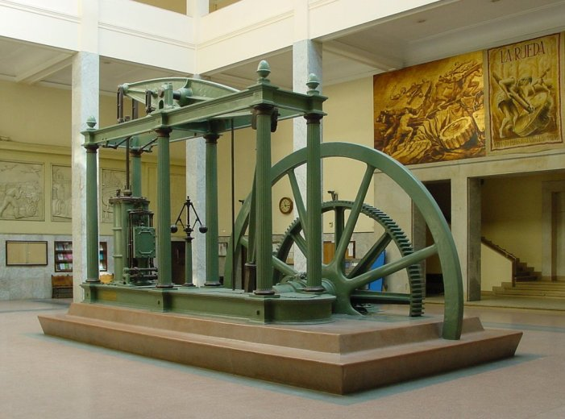
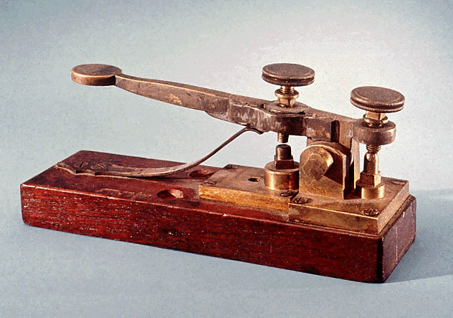
Industrial revolution (1760-1840)
Steam engine
  steamboat, rocket locomotive, pump
  telegraph, Morse code

Slide 9
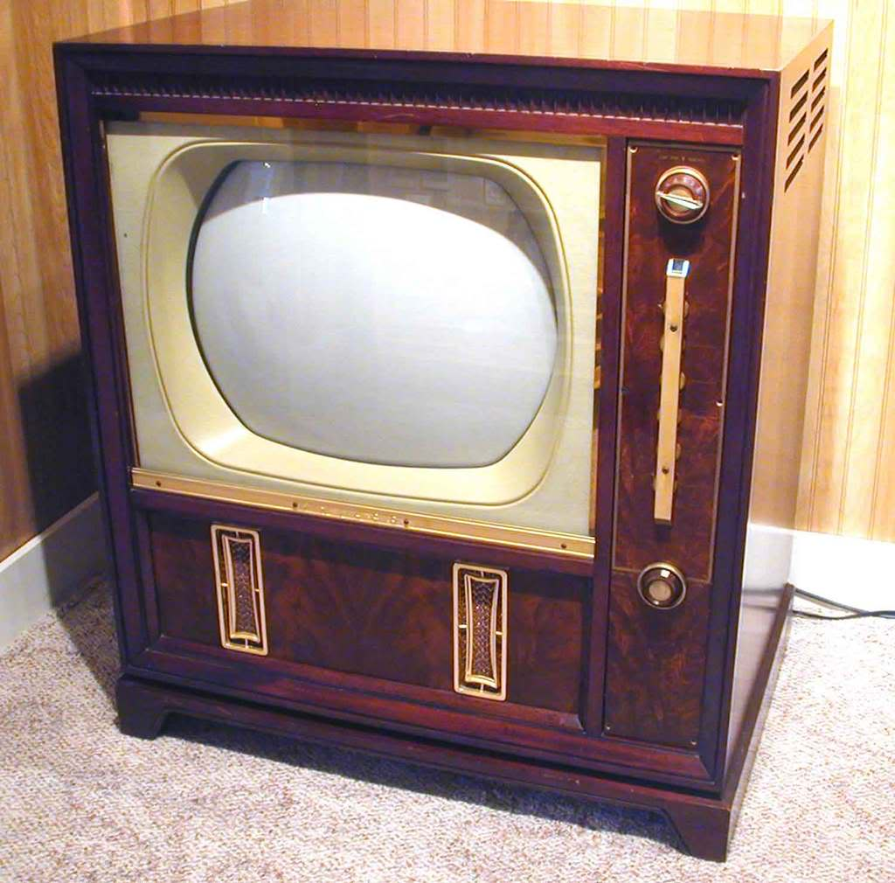
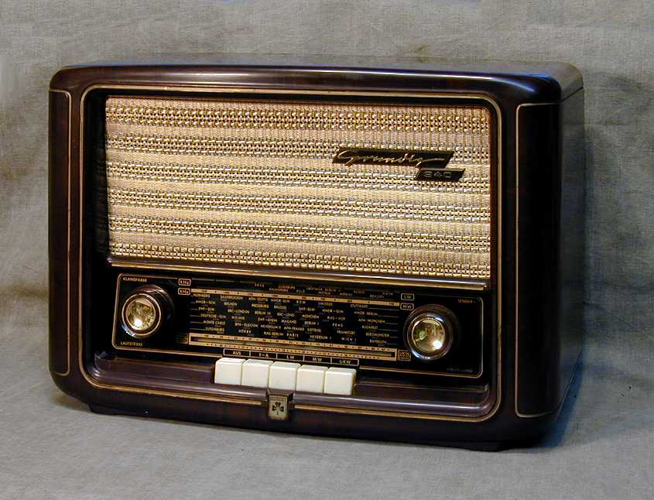
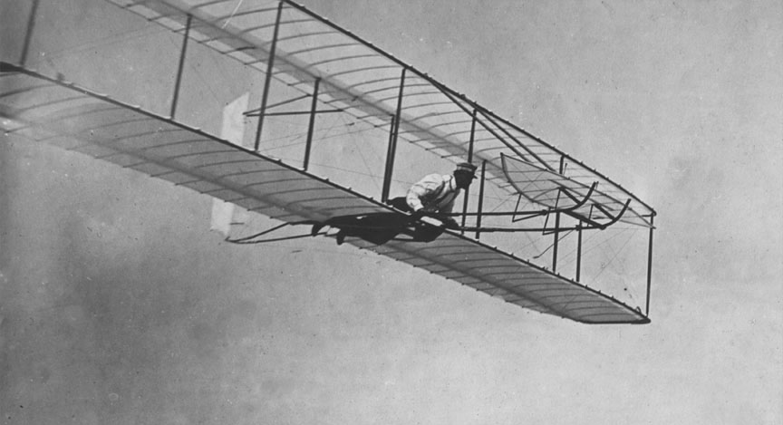
Second industrial revolution (1860-1945)
electricity
electric bulb
film / TV
radio
car
plane

Slide 10
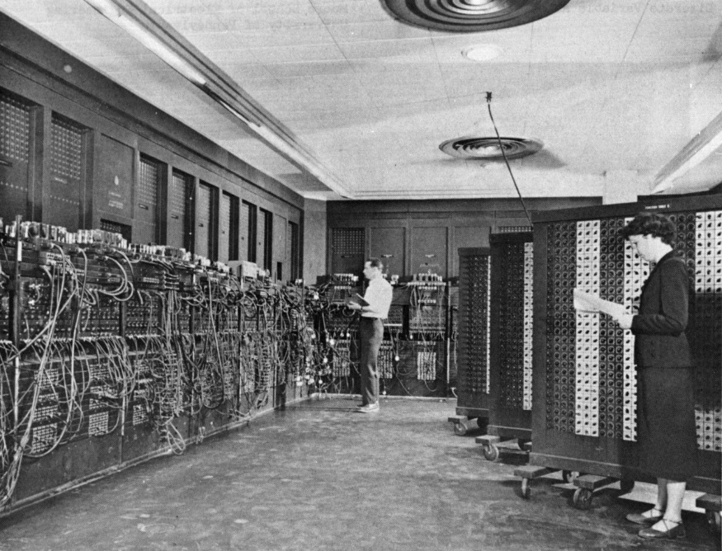
Computers
first generation of computers appeared during the World War II.
  unreliable, slow, heavy, couldn‘t be used for hard mathematical calculations
second generation
  more reliable because of transistors
third generation
  Integrated circuits, smaller units, first calculators
fourth generation
  current generation
Eniac

Slide 11
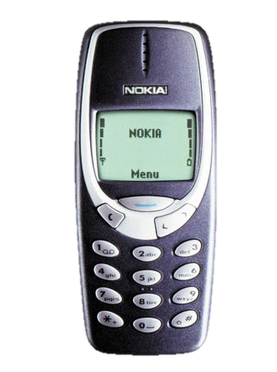
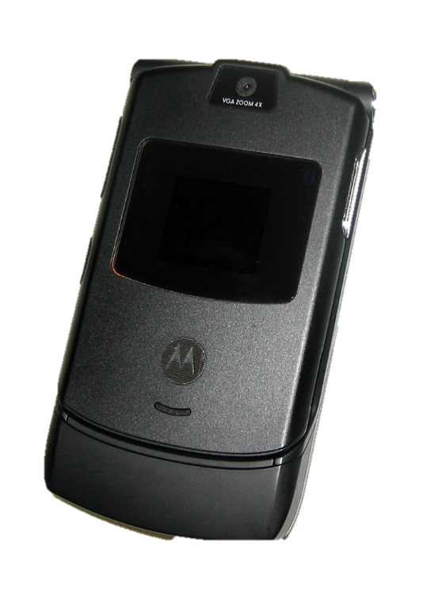

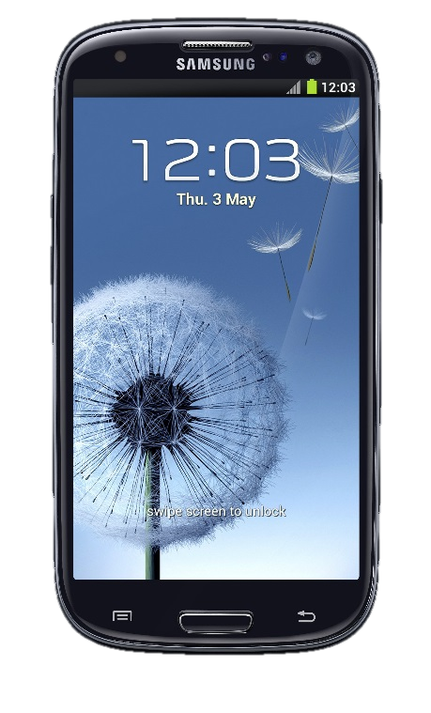
Mobile phones
boom started around 1980 in the USA
since 1990 in the Czech Republic
used to be only for sending SMS or calling
now multifunctional
Nokia 3310
Motorola RAZR V3
Apple iPhone 3G
Samsung Galaxy S III

Slide 12
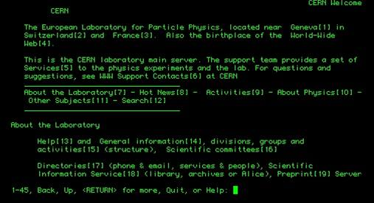
Internet
first network – ARPANET (U.S. Army) in 1960s
  ARPANET expansion – universities joined (1969)
  CSNET (in Czech Rep. CESNET) – universities and scientists sharing their work
  first Internet in the Czech republic in 1990
  since 1995 first dial-up (48-56kbit/s)
  since 2003 first DSL

Slide 13
The most common use of PC/Mobile phones
office / school work
entertainment
  playing games
  chatting with friends
  watching videos
  listening to music / radio
  reading news / articles
  browsing the Internet

Slide 14

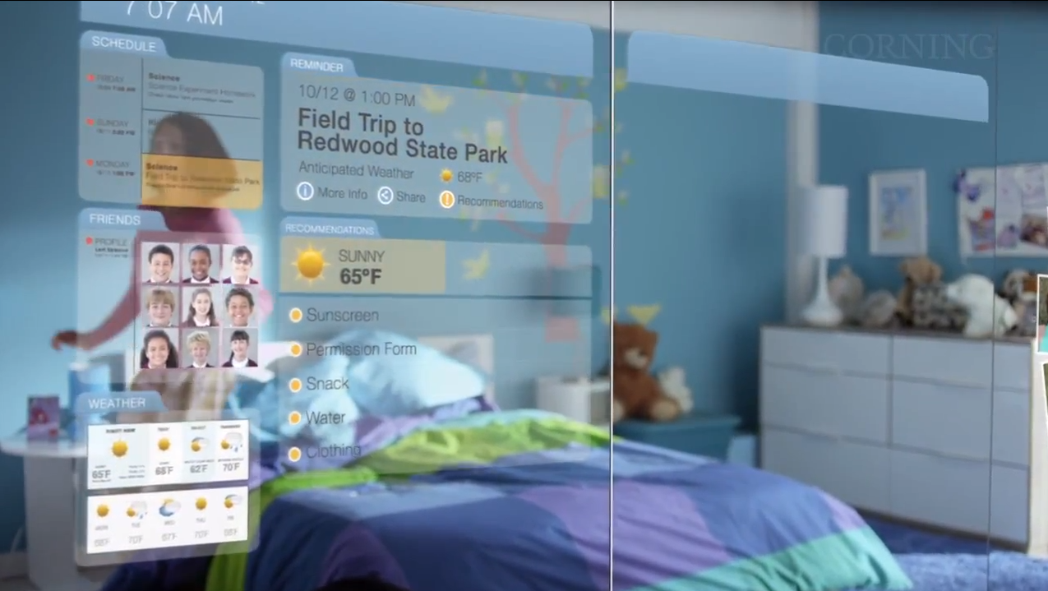
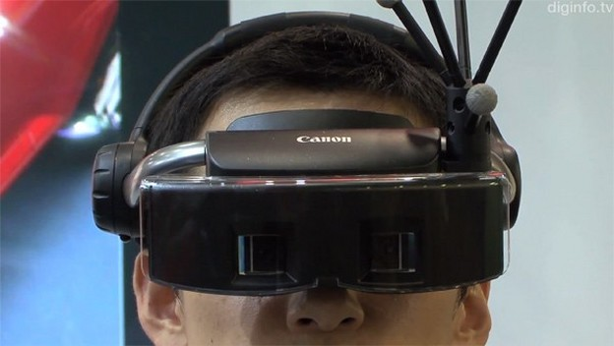
Future of technology
augmented reality
touch screens / goggles

Slide 15
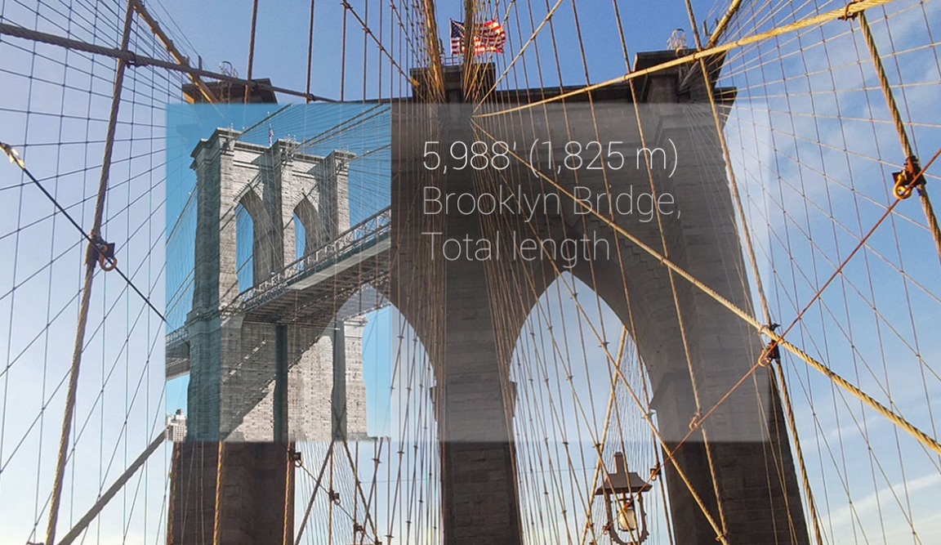

Slide 16
What do you think about this statement?
„Technological progress is like an axe in the hands of a pathological criminal“
  Albert Einstein

Slide 17
Sources (24.2.2013)
  http://en.wikipedia.org/wiki/Stone_Age
  http://en.wikipedia.org/wiki/Bronze_Age
  http://en.wikipedia.org/wiki/History_of_technology
  http://en.wikipedia.org/wiki/Medieval_technology
  http://en.wikipedia.org/wiki/Ancient_technology
  http://en.wikipedia.org/wiki/Hand_axe
  http://en.wikipedia.org/wiki/Gunpowder
  http://www.docstoc.com/docs/31173014/Technology-Timeline---DOC
  http://www.victorianweb.org/science/science.html
  http://www.bridge-online.cz/aitom/upload/maturita/temata/38_science_and_technology.pdf
  http://en.wikipedia.org/wiki/Wheel
  http://en.wikipedia.org/wiki/Trapping_pit
  http://en.wikipedia.org/wiki/Agriculture
  Age of Empires I, II manual
  http://en.wikipedia.org/wiki/Rocket_locomotive
  http://en.wikipedia.org/wiki/History_of_science
  http://en.wikipedia.org/wiki/Augmented_reality
  http://en.wikipedia.org/wiki/Computer
  http://en.wikipedia.org/wiki/Mobile_phone
  http://en.wikipedia.org/wiki/Internet
Pictures
  http://www.ele.net/flake/fig1.jpg
  http://francobarbeite.com/wp-content/uploads/2012/04/hand-axe.jpg
  http://3.bp.blogspot.com/_mImt6SBX5KM/TIn_TTeis9I/AAAAAAAAADg/XDyem0maYqM/s1600/stone.jpg
  http://allamazingfacts.com/pictures/Intere_339_moz-screenshot-7.png
  http://www.ancienttouch.com/1181.jpg
  http://en.wikipedia.org/wiki/File:Dejbjerg_wagon,_Nationalmuseet_Copenhagen.jpg
  http://upload.wikimedia.org/wikipedia/commons/9/9e/Maquina_vapor_Watt_ETSIIM.jpg
  http://1.bp.blogspot.com/-ED9wPhEqApE/UScfm7uFk0I/AAAAAAAAnVo/efSXwG6r_mo/s1600/ENIAC.jpg
  http://www.gizbot.com/img/2013/01/02-1357138434-nokia3310.jpg
  http://upload.wikimedia.org/wikipedia/commons/3/31/Black-RAZRV3-closed.jpg
  http://upload.wikimedia.org/wikipedia/commons/7/73/IPhone_3G.png
  http://cdn3.pcadvisor.co.uk/cmsdata/features/3380543/Samsung_Galaxy_S3_sapphire_black.jpg
  http://www.vidi.hr/var/ezflow_site/storage/images/pop-tech/video-mixed-reality-mijesa-stvarni-i-virtualni-svijet/98544-1-cro-HR/Video-Mixed-Reality-mijesa-stvarni-i-virtualni-svijet_VIDIClanakNaslovna.jpg
  http://wallpaphd.com/wp-content/uploads/2013/02/Shiny-Kiosk-google-glasses.jpg
  http://www.youtube.com/watch?v=jZkHpNnXLB0
  http://www.zive.cz/uploadedfiles/845354035.jpg

