Slide 1
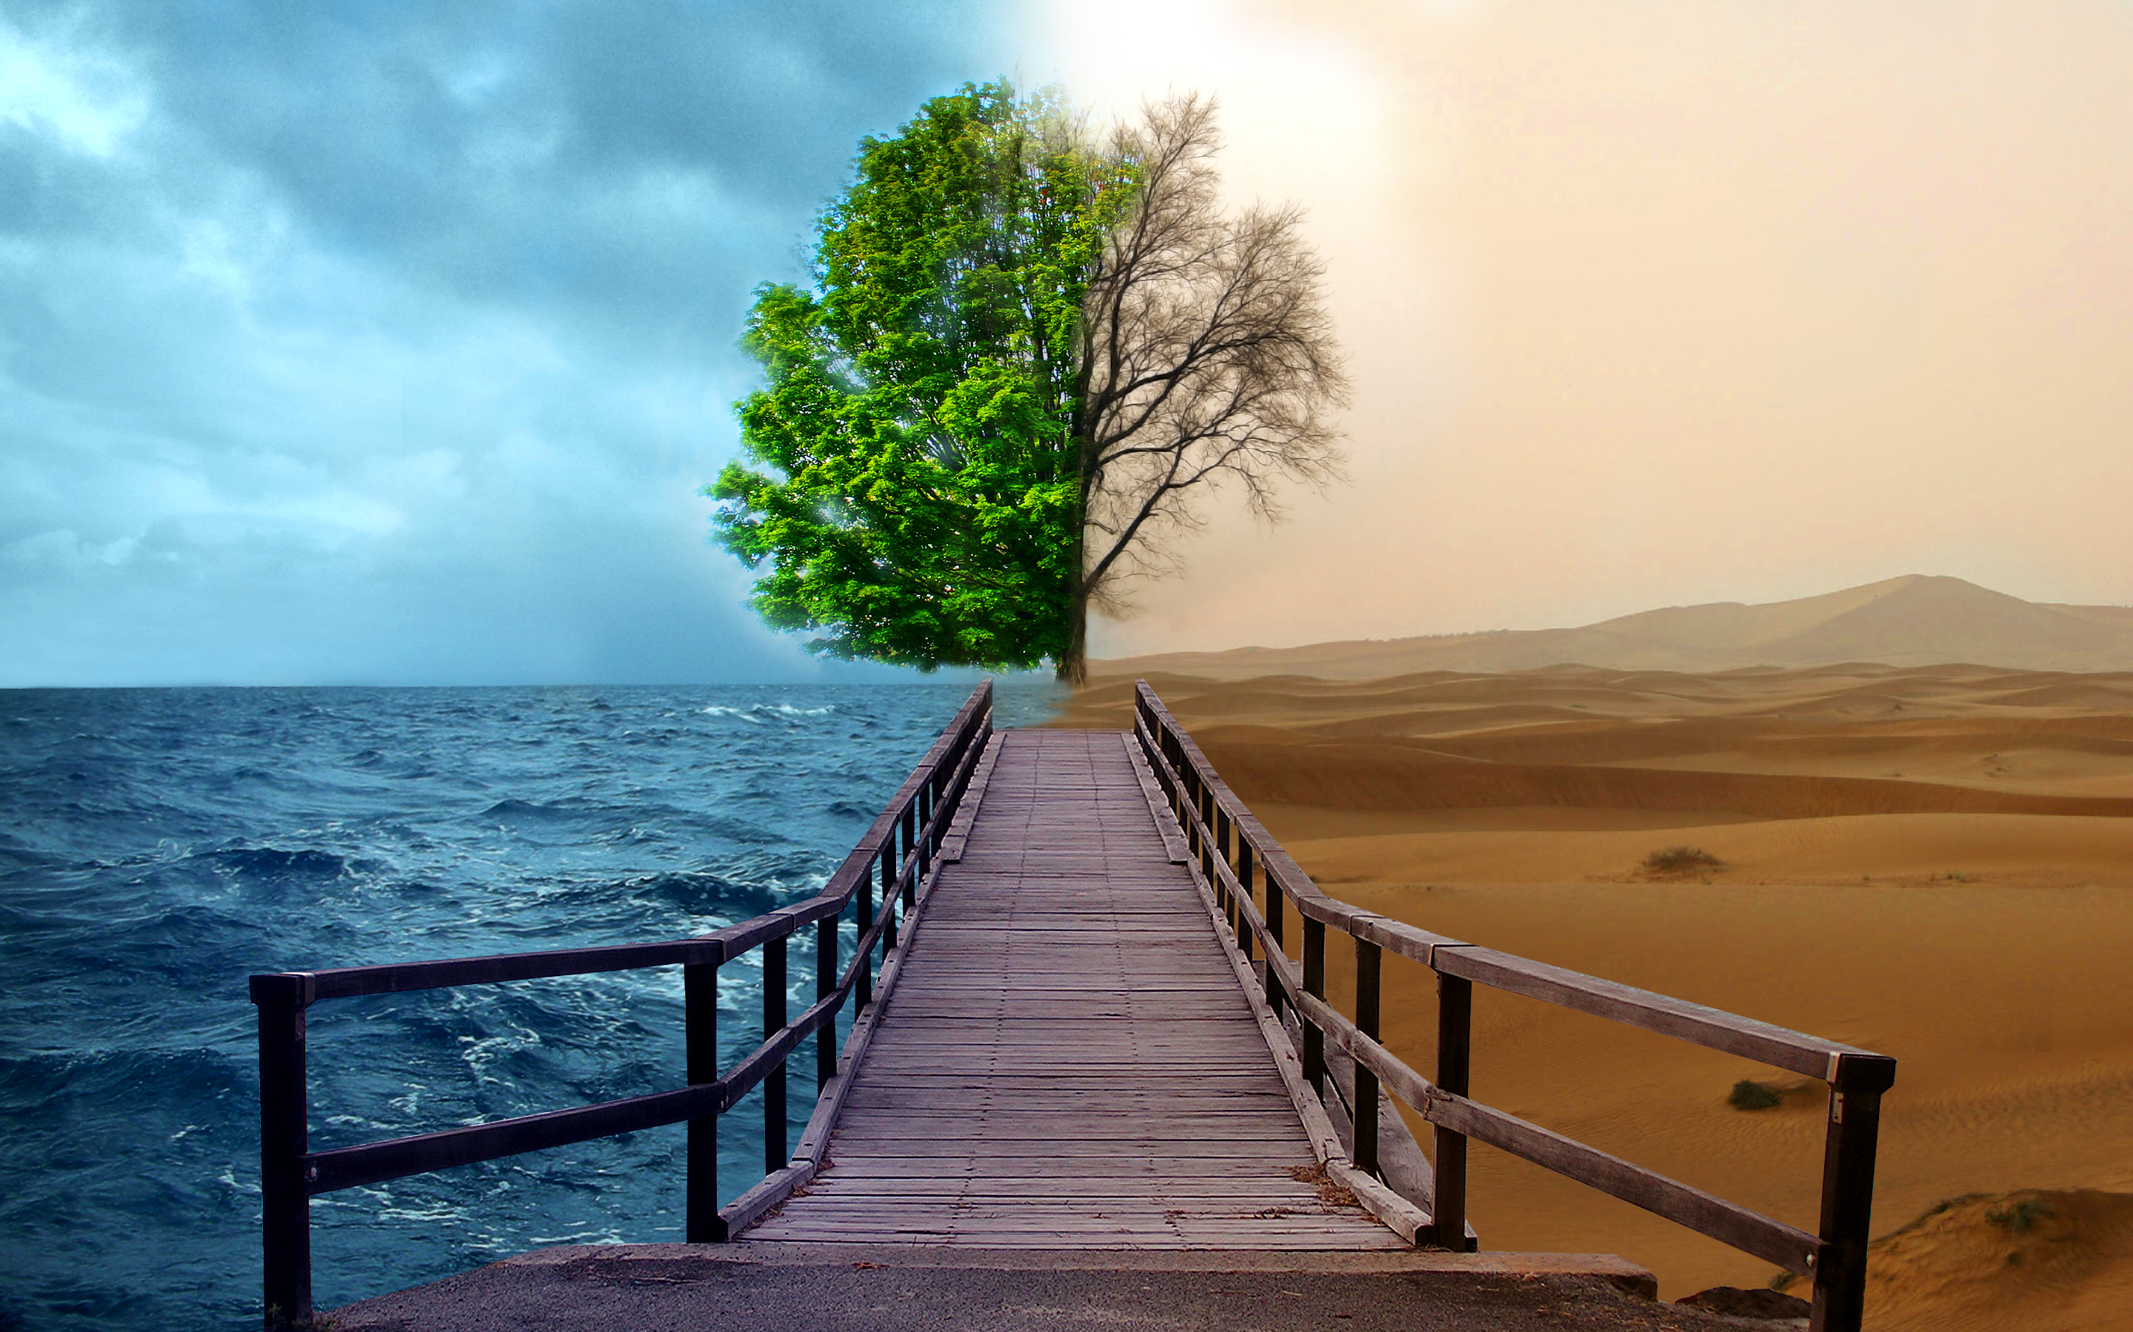
Weather and environment

Slide 2
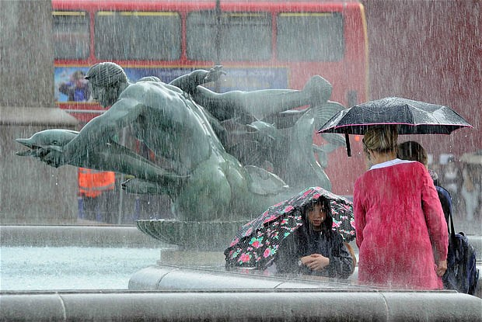
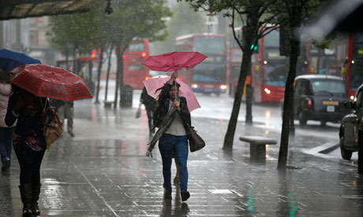
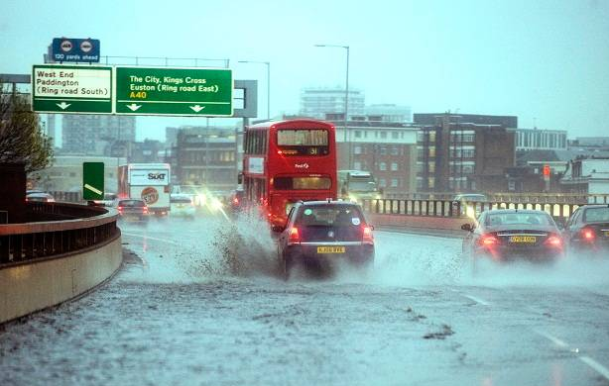
WEATHER - UK
windy and rainy
influenced by the Gulf Stream
changeable

Slide 3
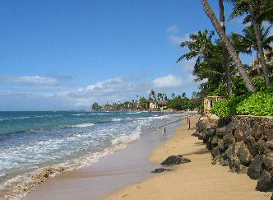
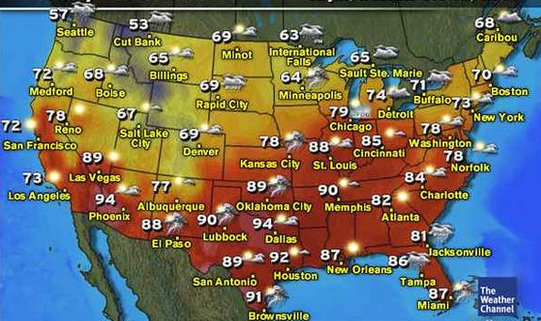
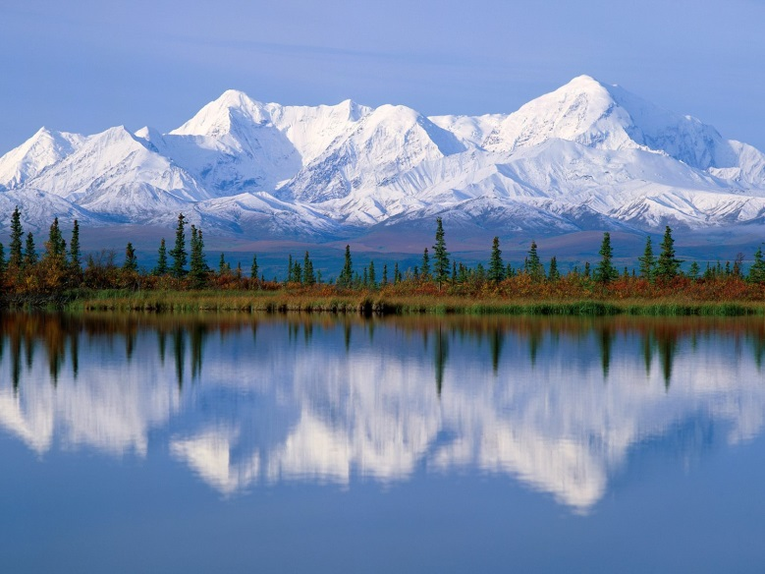
WEATHER - USA
Generally: mild climate, extremes in Alaska (arctic climate) and Hawaii (tropical climate)
hurricanes and tornadoes
November 2012 – superstorm Sandy

Slide 4
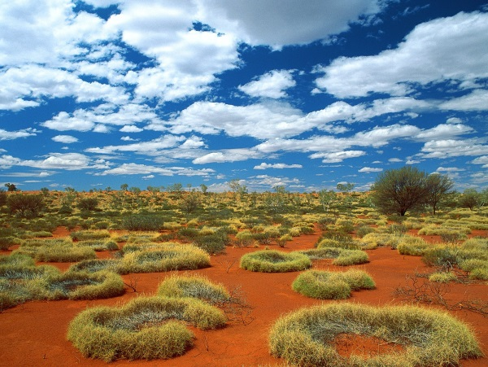
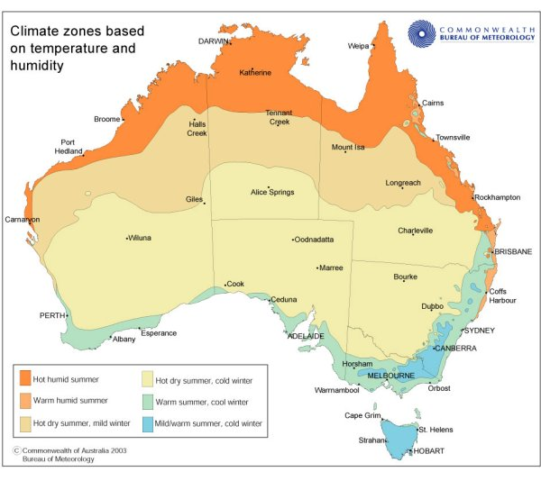
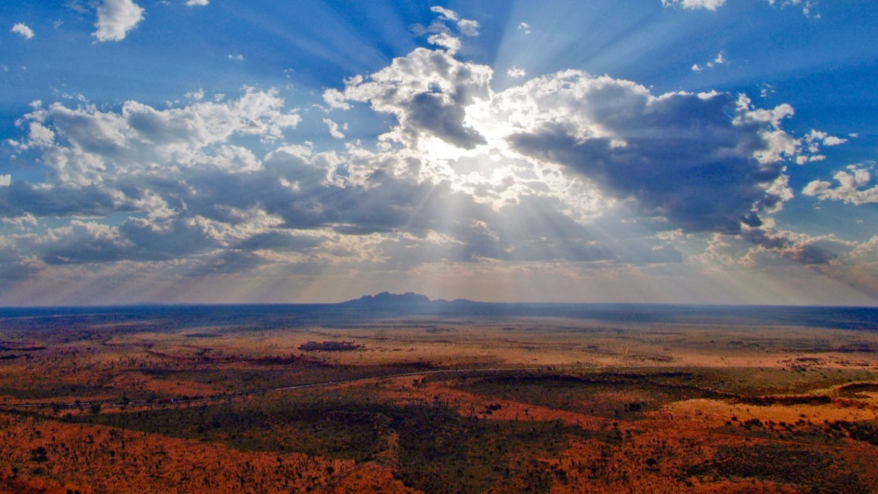
WEATHER - Australia
many different climates
the north - 2 seasons – Rainy and Dry
the south - cooler with 4 seasons
  summers - very hot

Slide 5

4 seasons
21st March
nature wakes up after the winter
April - changeable
21st June
the temperatures above 25 °C
summer storms
23rd September
leaves get yellow, brown
time of harvest
rainfalls
21st December
snowfalls
the temperatures below zero

Slide 6
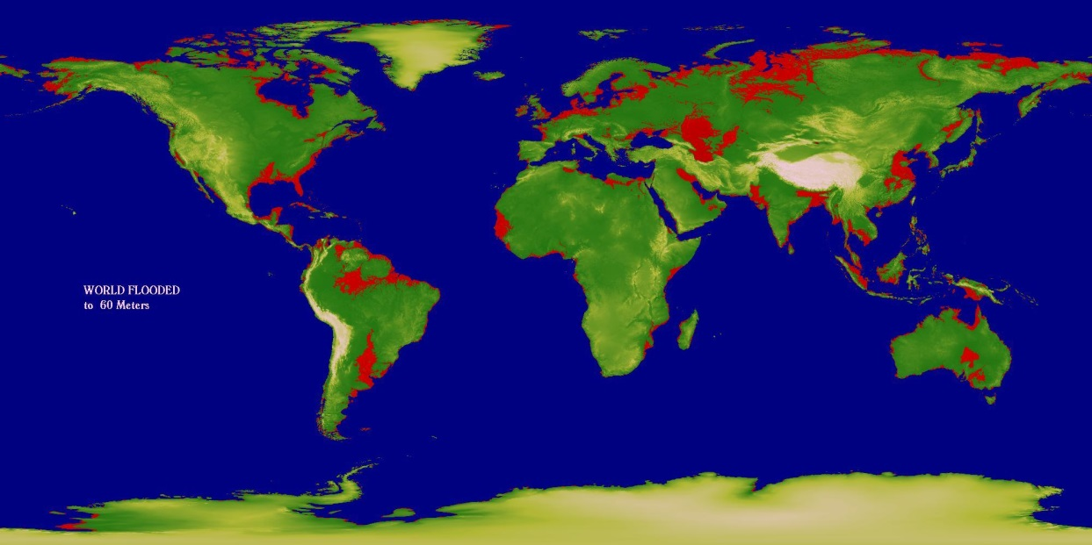
ENVIRONMENT
Monitoring shows that since 1993, sea levels have risen at a rate of 3mm per year. The red area is the projection of land loses if the current trend is to continue.

Slide 7
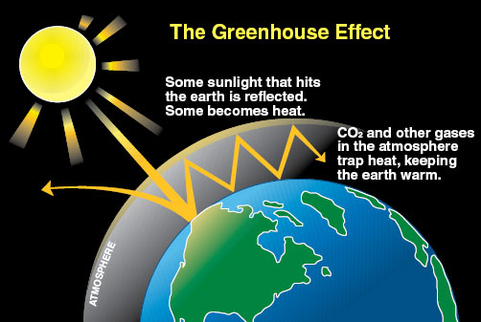
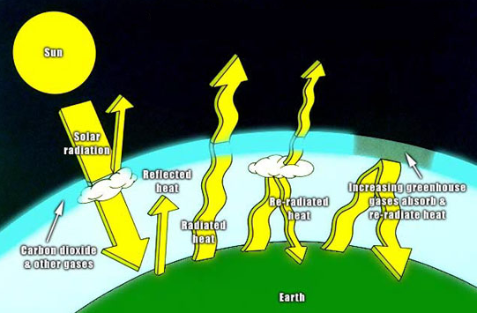
The Greenhouse Effect
the atmosphere – thin layer of gases
- keeps the surface of the Earth warm
The main greenhouse gases:
  carbon dioxide
  water vapour
  methane

Slide 8
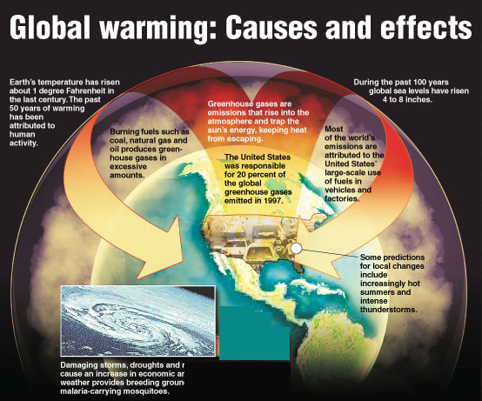
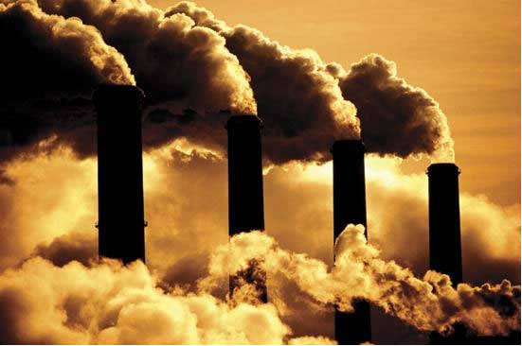
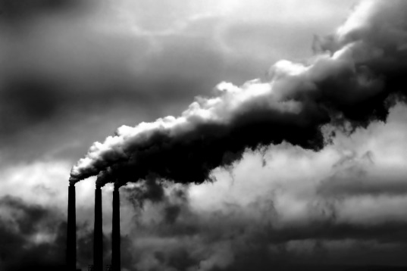
Global warming
burning of fossil fuels → CO2 → more heat gets trapped and the temperature of the planet rises

Slide 9
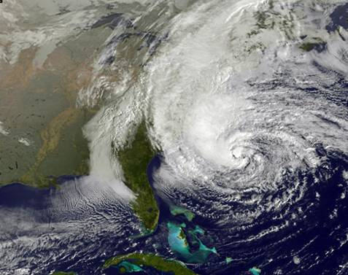
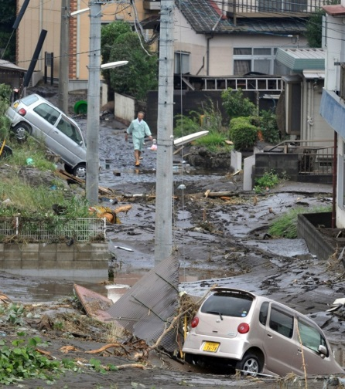
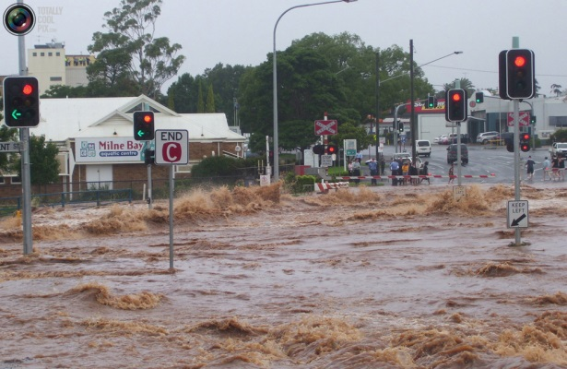
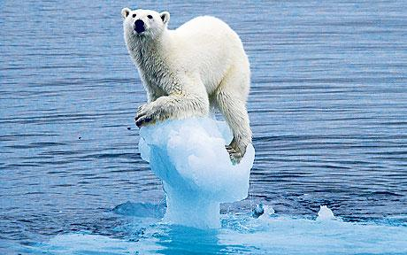
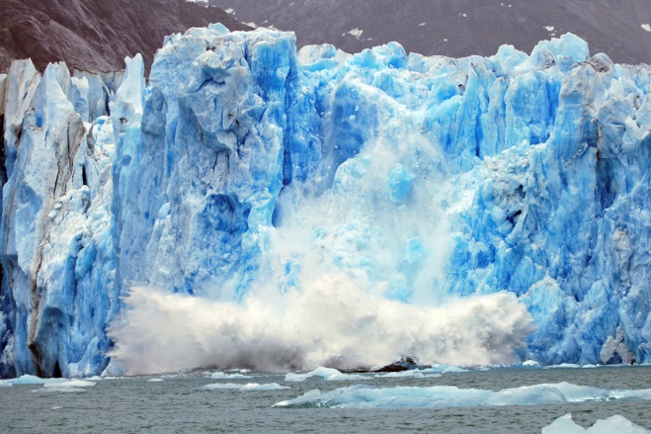
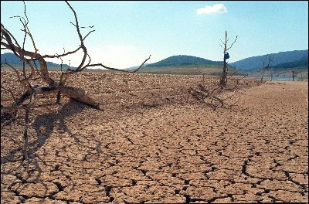
Climate change
Global warming is changing the climate.
drought x hurricanes and floods
Ice is melting
animals have moved to cooler areas

Slide 10
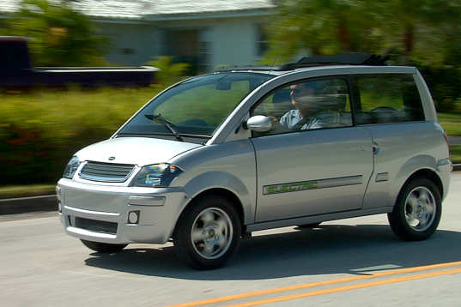
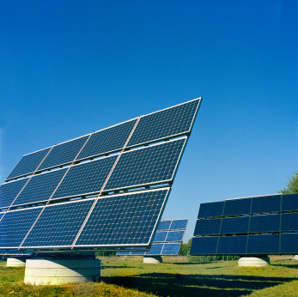
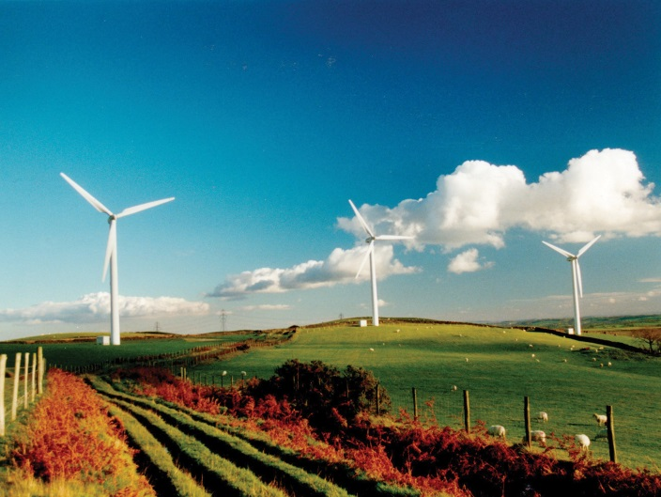
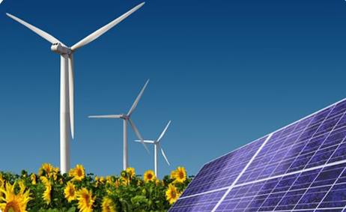
Solutions
renewable sources of energy
cut down the carbon
emissions across the
world
filters for factories
cars → hybrid vehicles

Slide 11

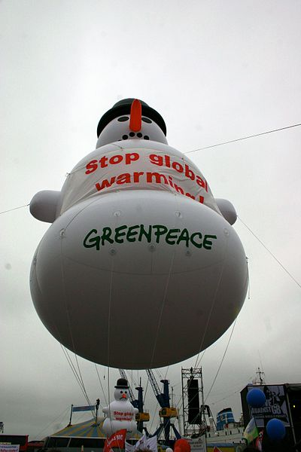
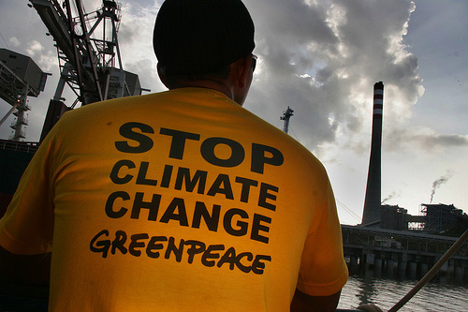
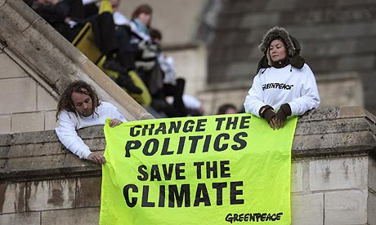
international non-governmental environmental organization
global warming, deforestation, overfishing, and anti-nuclear issues
2.9 million supporters

