Slide 1
Culture and entertainment
„Without culture, and the relative freedom it implies, society, even when perfect, is but a jungle. This is why any authentic creation is a gift to the future.“
(Albert Camus ; 1913-1960)

Slide 2
Culture
can be characterized as the patterns of behaviour and thinking that people learn, create and share
distinguishes one group of people from others
includes: beliefs, rules of behaviour, language, rituals, art, technology, fashion, ways of producing and cooking food, religion, political and economical systems, …

Slide 3
History
as everything, culture changes with time – not only because of that we can find out a lot of information about ancient nations from learning their culture
Gladiatorial games
gladiators entertained audiences in the Roman Empire in violent confrontations with other gladiators, wild animals or condemned criminals
some gladiators were volunteers, but most of them were slaves
Hunting
used to be one of the most favourite entertainment of nobility
nowadays it still exists but in smaller extent and more for money than for fun (= poaching)
Notes:
A gladiator (Latin: gladiator, "swordsman", from gladius, "sword") was an armed combatant who entertained audiences in the Roman Republic and Roman Empire in violent confrontations with other gladiators, wild animals, and condemned criminals. Some gladiators were volunteers who risked their legal and social standing and their lives by appearing in the arena. Most were despised as slaves, schooled under harsh conditions, socially marginalized, and segregated even in death.

Slide 4
Literature
art of written work
main types of literature:
  prose
    novels, essays, short stories, …
    famous writers:
      CZ: Jaroslav Hašek – „The good soldier Schweik“
      UK: George Orwell – „1984“, „Animal farm“
      USA: Ernest Hemingway – „The old man and the sea“
  poetry
    poem, elegy, …
    famous poets:
      CZ: Karel Jaromír Erben – „Bouquet“
      UK: Geoffrey Chaucer – „The Canterbury tales“
      USA: Edgar Allan Poe – „The Raven“
  drama
    drama, opera, …
    famous playwrights:
      CZ: Karel Čapek – „R.U.R.“
      UK: George Bernard Shaw – „Pygmalion“
      USA: Edward Albee – „The American dream“
fiction x non-fiction
book: hardback x paperback
Notes:
e-books

Slide 5
Visual art
includes: paintings, sculptures, photos, mosaic, tapestry, sketch, mural, …
types of paintings: landscape, oil painting, portrait, abstract art, watercolour, still life, …
famous artists:
  USA: James Coleman
  CZ: Alfons Mucha, Josef Václav Myslbek, Jan Saudek
Notes:
UK:
Jack Vettriano – scottish painter – „The singing Butler“
USA:
James Coleman – american painter, who has worked for Disney on numerous animated features
CZ:
Alfons Mucha – painter - „Dancer“
Josef Václav Myslbek – sculptor - „The statue of st. Wenceslas on Wenceslas square“
Jan Saudek – photographer

Slide 6
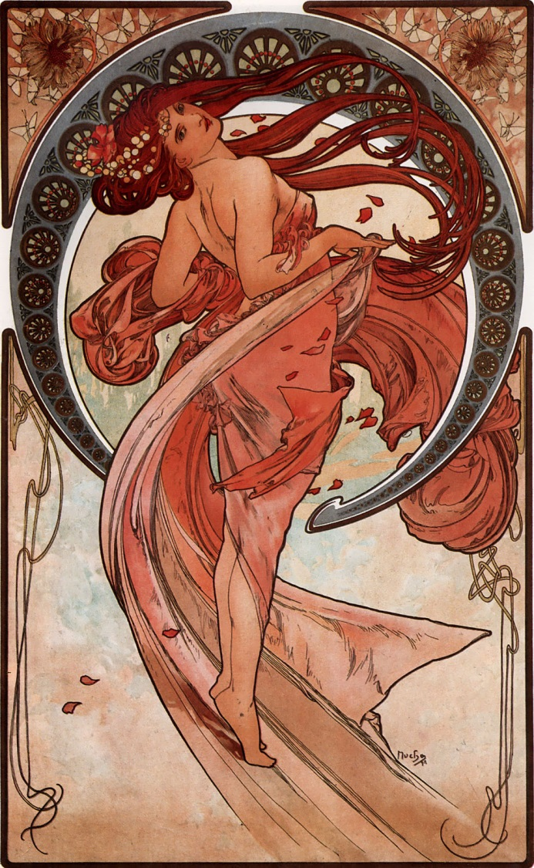
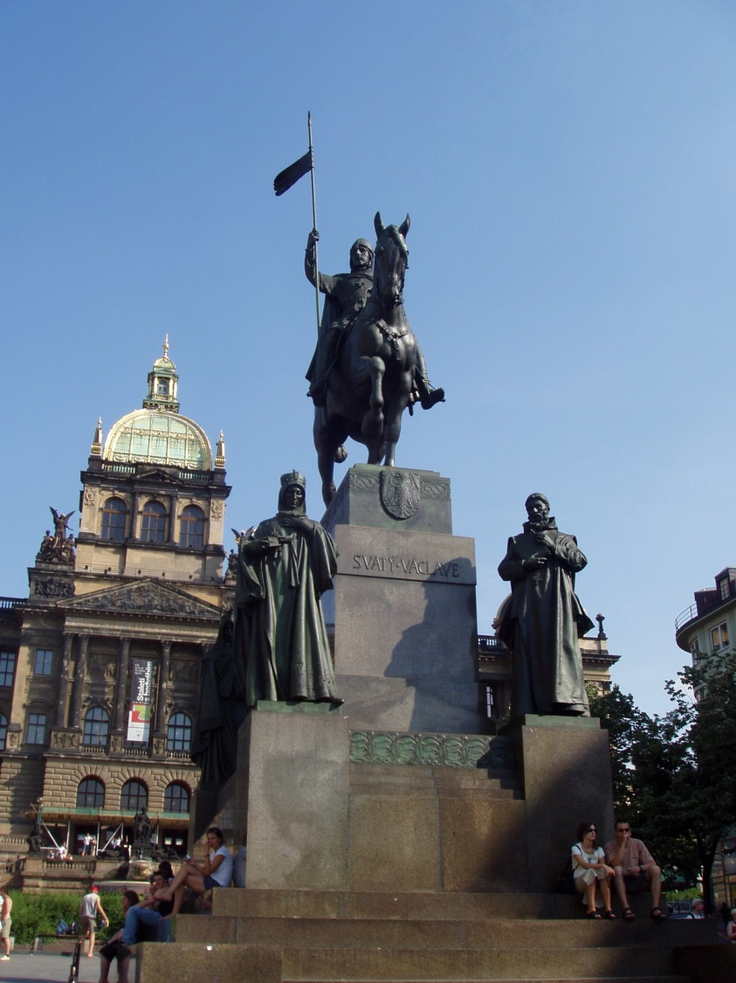
Art - pictures
Notes:
1) Alfons Mucha – Dancer ; 2) Josef Václav Myslbek – „The statue of st. Wenceslas on Wenceslas square“

Slide 7
Architecture
process of planning, designing and constructing of historical as well as modern buildings all around the world
we divide architecture according to the era, in which the building has been built:
  for example gothic, renaissance, baroque, neoclassical, modern or post-modern architecture
we can also divide it according to the geography:
  Asian, Islamic etc.

Slide 8
Music
types of music: classical, pop, rock, rap, disco, ska, punk, jazz, folk, reggae, country, heavy metal, techno, hardstyle, dubstep, electronic etc..
places to listen to music: home, concerts, clubs, …
used also for music therapies to improve or maintain health
sometimes music also influences fashion
famous solo musicians:
  UK: Jimmy Crawford, …
  USA: Michael Jackson, Madonna, Sonny John Moore (Skrillex), …
  CZ: Jaromír Nohavica, Marpo, …
famous bands:
  UK: Queen , The Beatles, …
  USA: Linkin Park, …
  CZ: Kabát, …
MTV Awards
Notes:
Solo musicians (singers, DJs, etc.) x bands
An MTV Video Music Award (commonly abbreviated as a VMA) is an award presented by the cable channel MTV to honor the best in the music video medium.

Slide 9
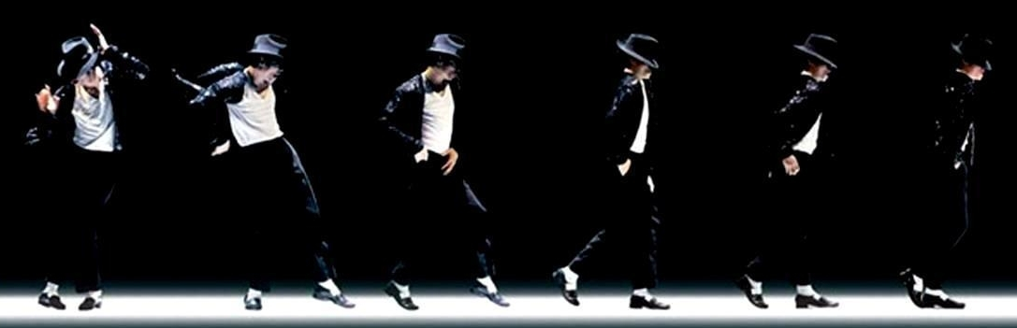
Dance
type of art that involves movement of the body to the music
it is performed as a form of emotional expression, social interaction or exercise
we have many forms of dance:
  classical ones such as waltz, tango, rumba or salsa
  modern ones such as hip-hop
  special „dances“ such as Michael Jackson's „Moonwalk“

Slide 10
Film
series of still images, that creates illusion of moving images
invented at the end of the 19th century
famous directors:
  UK: Alfred Hitchcock, …
  USA: Woody Allen, Steven Spielberg, …
  CZ: Miloš Forman, Jiří Menzel, …
famous actors in the Czech republic:
  Zdeněk Svěrák, Ladislav Smoljak, Rudolf Hrušinský, …

Slide 11
Entertainment
Places where we can go, activities that we can do…
Notes:
The other part is also connected to culture, but it is more about where you can „see the culture on your own“ and where you can entertain yourself, so we divided it from the first part and called it (as you can see) „Entertainment“.

Slide 12
Why do we need entertainment?
it is well known thing among people that we should divide our day into three parts – time to sleep, work and relax
without entertainment our lives would be grey – we would be scowling workaholics without any joy from life
we can be with our friends and family
we learn new things, meet new people
we get energy, we become refreshed
it enriches us in spiritual way
Notes:
It’s obvious that we can’t only work all day. And if so, we soon become ill or depressed.

Slide 13
What can we do?
sport
go to cinema/theatre/gallery/museum/club
go on concert/opera/ballet
watch TV
read books, newspapers
go to restaurant
go shopping
visit a castle/chateau
play games
…

Slide 14
Museums
contain collections of artefacts and other objects of scientific, artistic, cultural or historical importance
in most countries for entry fee, but in some countries are the state museums donated by the government and they are free of charge
UK:
  The British museum, Natural history museum (London)
USA:
  The national museum of natural history (Washington DC.)
CZ:
  The national museum (Prague)
Notes:
Institution that cares for a collection of artefacts and other objects of scientific, artistic, cultural or historical importance and makes them available for public viewing through exhibits that may be permanent or temporary.

Slide 15
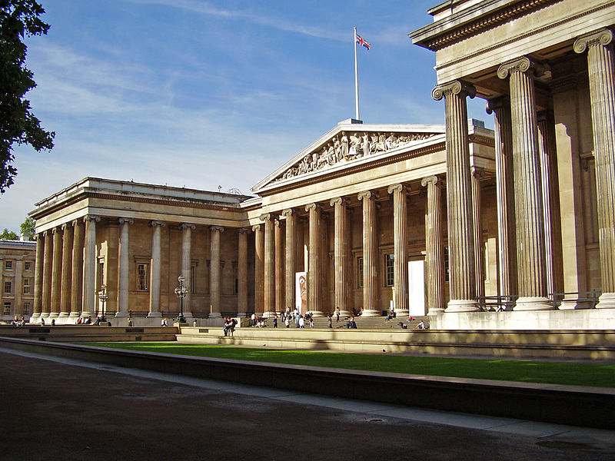
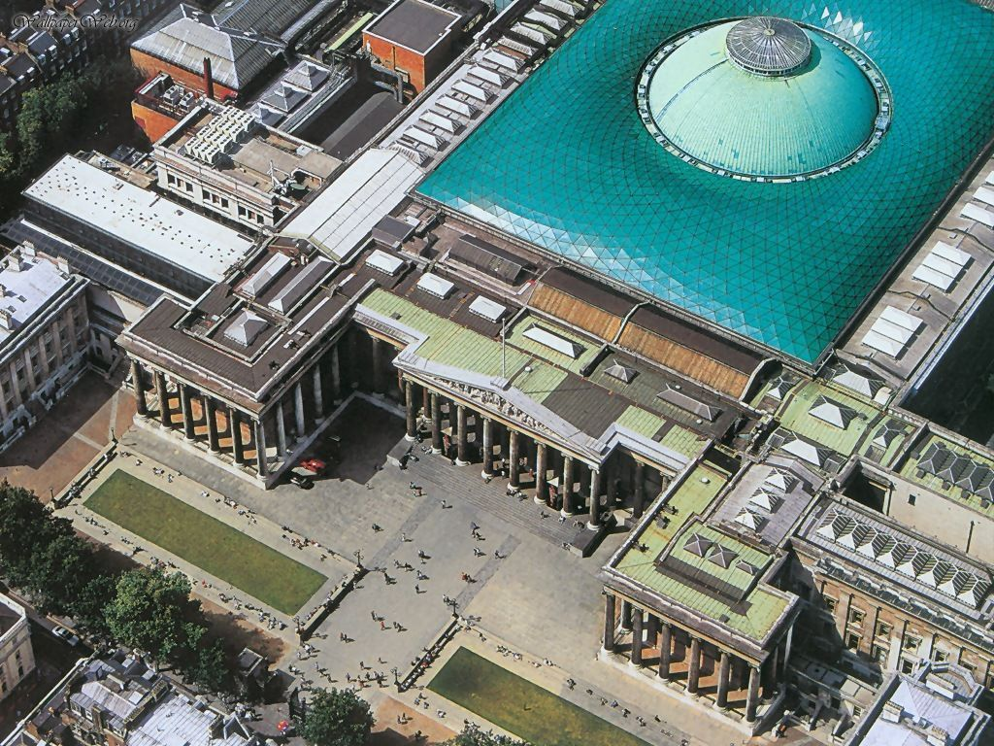
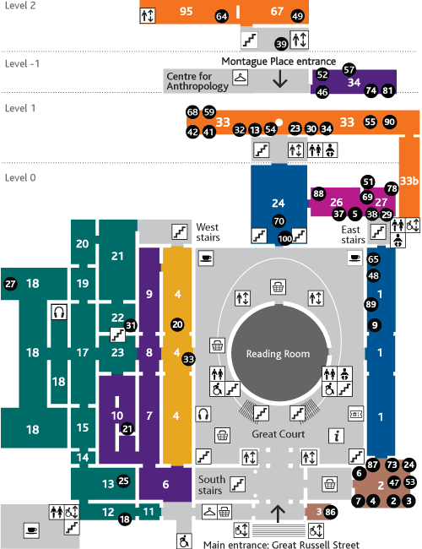
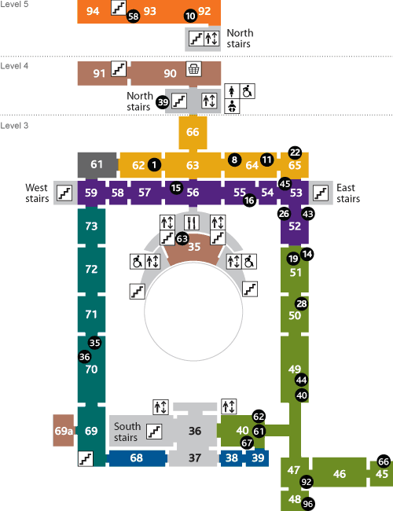
Museums - pictures
Notes:
It includes the Museum and the British Library with more than 11 million volumes of printed books and manuscripts. The museum contains outstanding displays of antiquities from Egypt, South and South - East Asia, China, Greece, Rome and the East. Notable exhibits include the Magna Carta which limited the king's powers in 1215, Shakespeare's folio published in 1623, Egyptian mummies, a Gutenberg Bible, authors original manuscripts (Dickens, Lennon, Alexander Flemming, da Vinci etc.)
http://www.britishmuseum.org/
http://www.planetware.com/i/map/ENG/british-museum-upper-floor-map.jpg

Slide 16
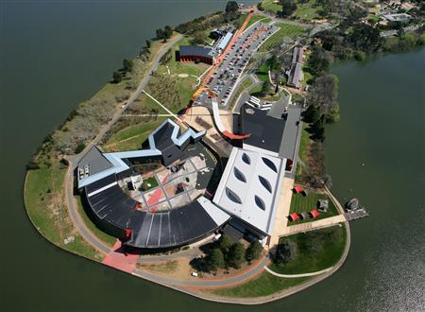
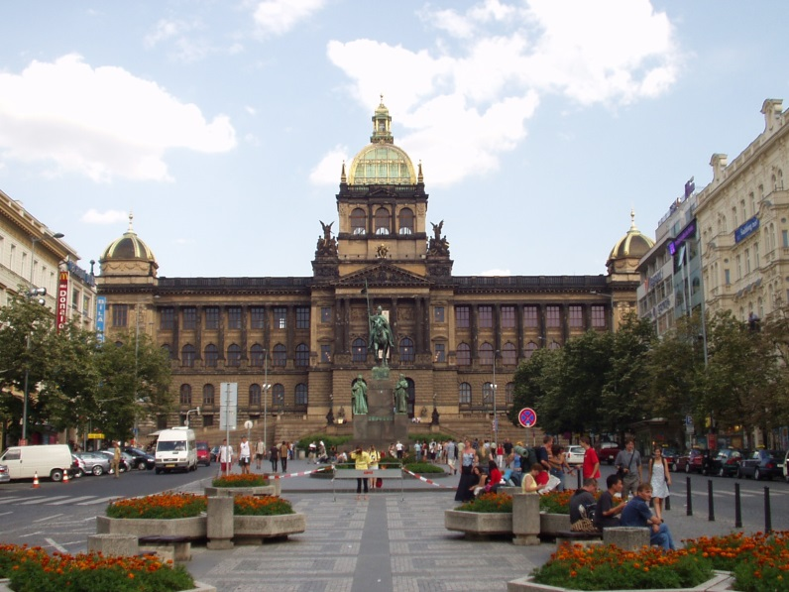
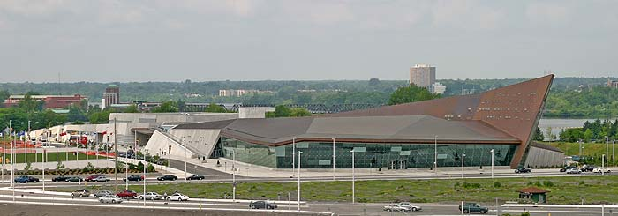
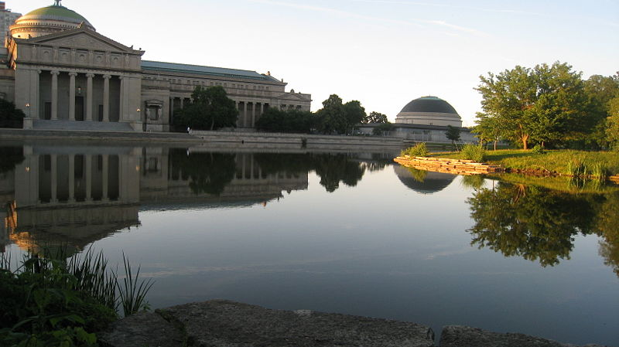
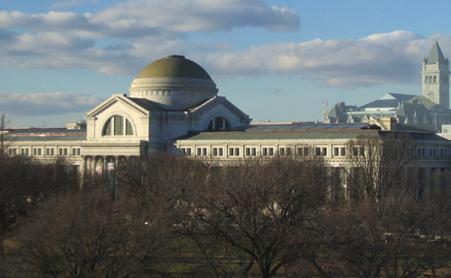
Notes:
The national museum of Australia in Canberra 2) The national museum in Prague
3) Canadian war museum in Ottawa
4) The museum of science and industry in Chicago 5) The national museum of natural history in Washington DC.

Slide 17
Galleries
art museums
paintings, sculptures, decorative arts, furniture, textiles, costumes, drawings, pastels, watercolours, collages, prints, artists' book, photographs, …
UK:
  The national gallery (London)
  Tate modern (London)
USA:
  National gallery of Art (Washington DC.)
CZ:
  The national gallery (Prague)
Notes:
http://www.nationalgallery.org.uk/paintings/

Slide 18
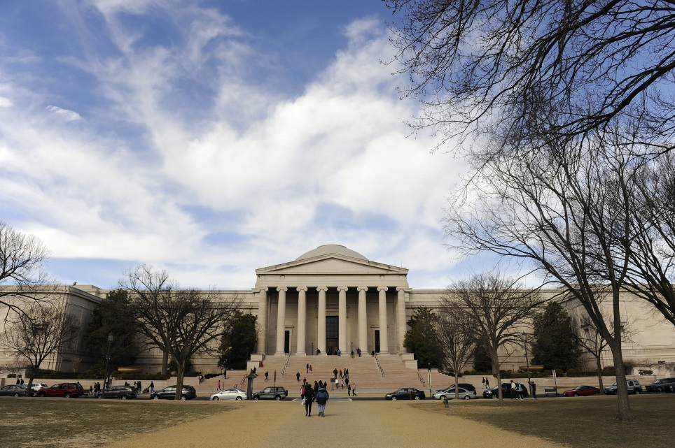
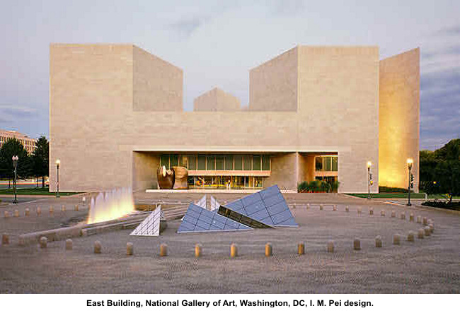
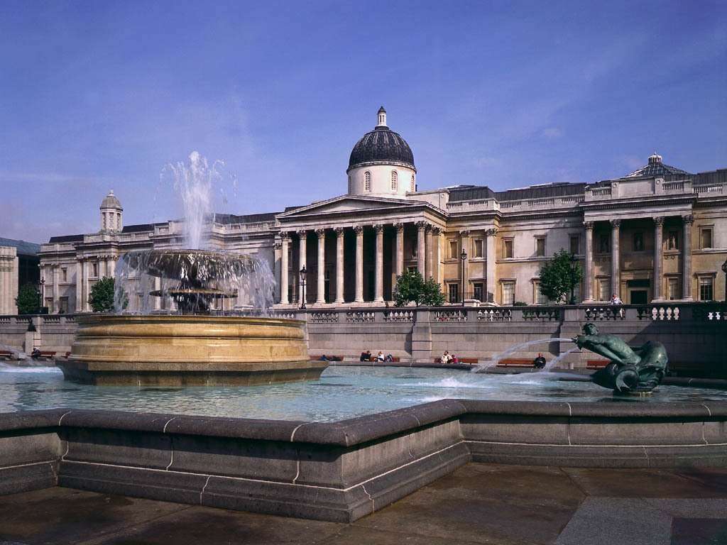
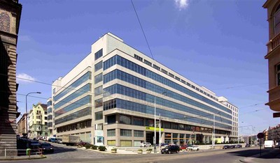
Galleries - pictures
Notes:
National gallery of Art (Washington DC.) 2) East building of National gallery of Art (Washington DC.)
3) The national gallery (Prague) 4) The national gallery (London)

Slide 19
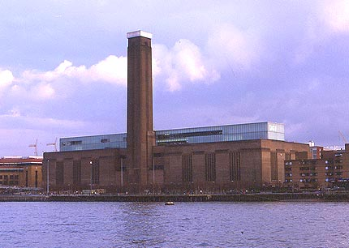
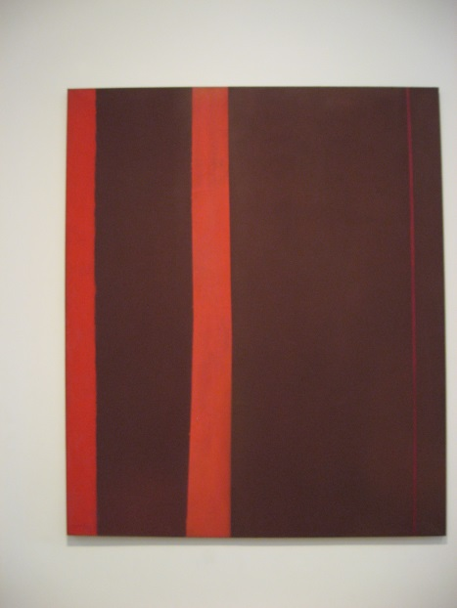
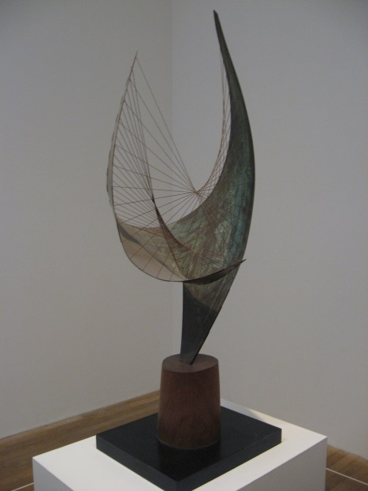
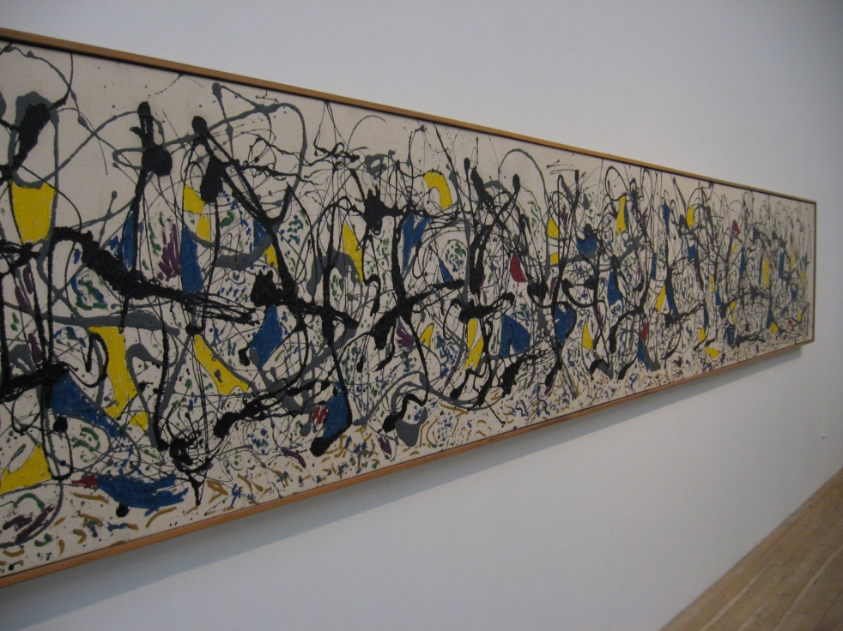
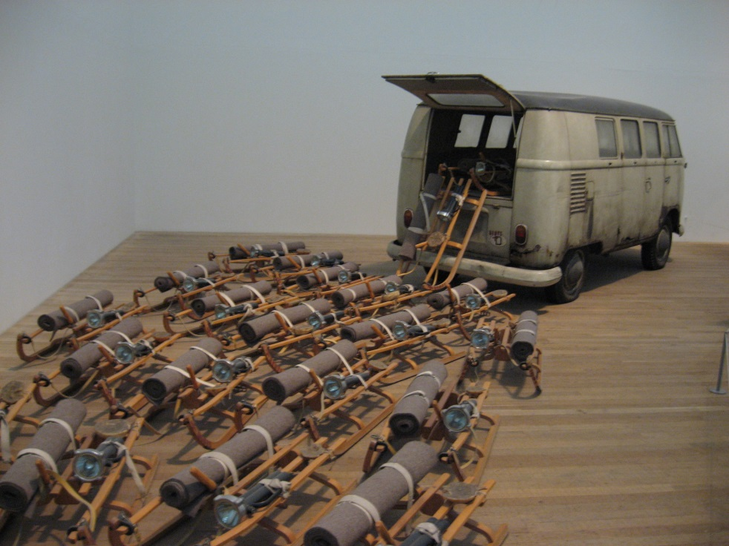
Notes:
Tate modern (London)

Slide 20
Libraries
organised collection of information resources made accessible to a community for reference or borrowing
it provides physical or digital access to material
can include books, periodicals, newspapers, manuscripts, maps, documents and more…
public x private
in Prague we have network of public libraries, so called „City libraries of Prague“ (www.mlp.cz)

Slide 21
Theatres
places where drama is performed
comedy x tragedy
musicals: Carmen, Cats, Mamma mia!, …
famous dramatist and playwrights:
  UK: William Shakespeare, Samuel Beckett, …
  USA: Tennessee Williams, …
  CZ: Karel Čapek, …
famous theatres:
  UK: Shakespeare's Globe, The royal national theatre, …
  USA: Broadway, …
  CZ: The National theatre, Vinohrady theatre, …

Slide 22
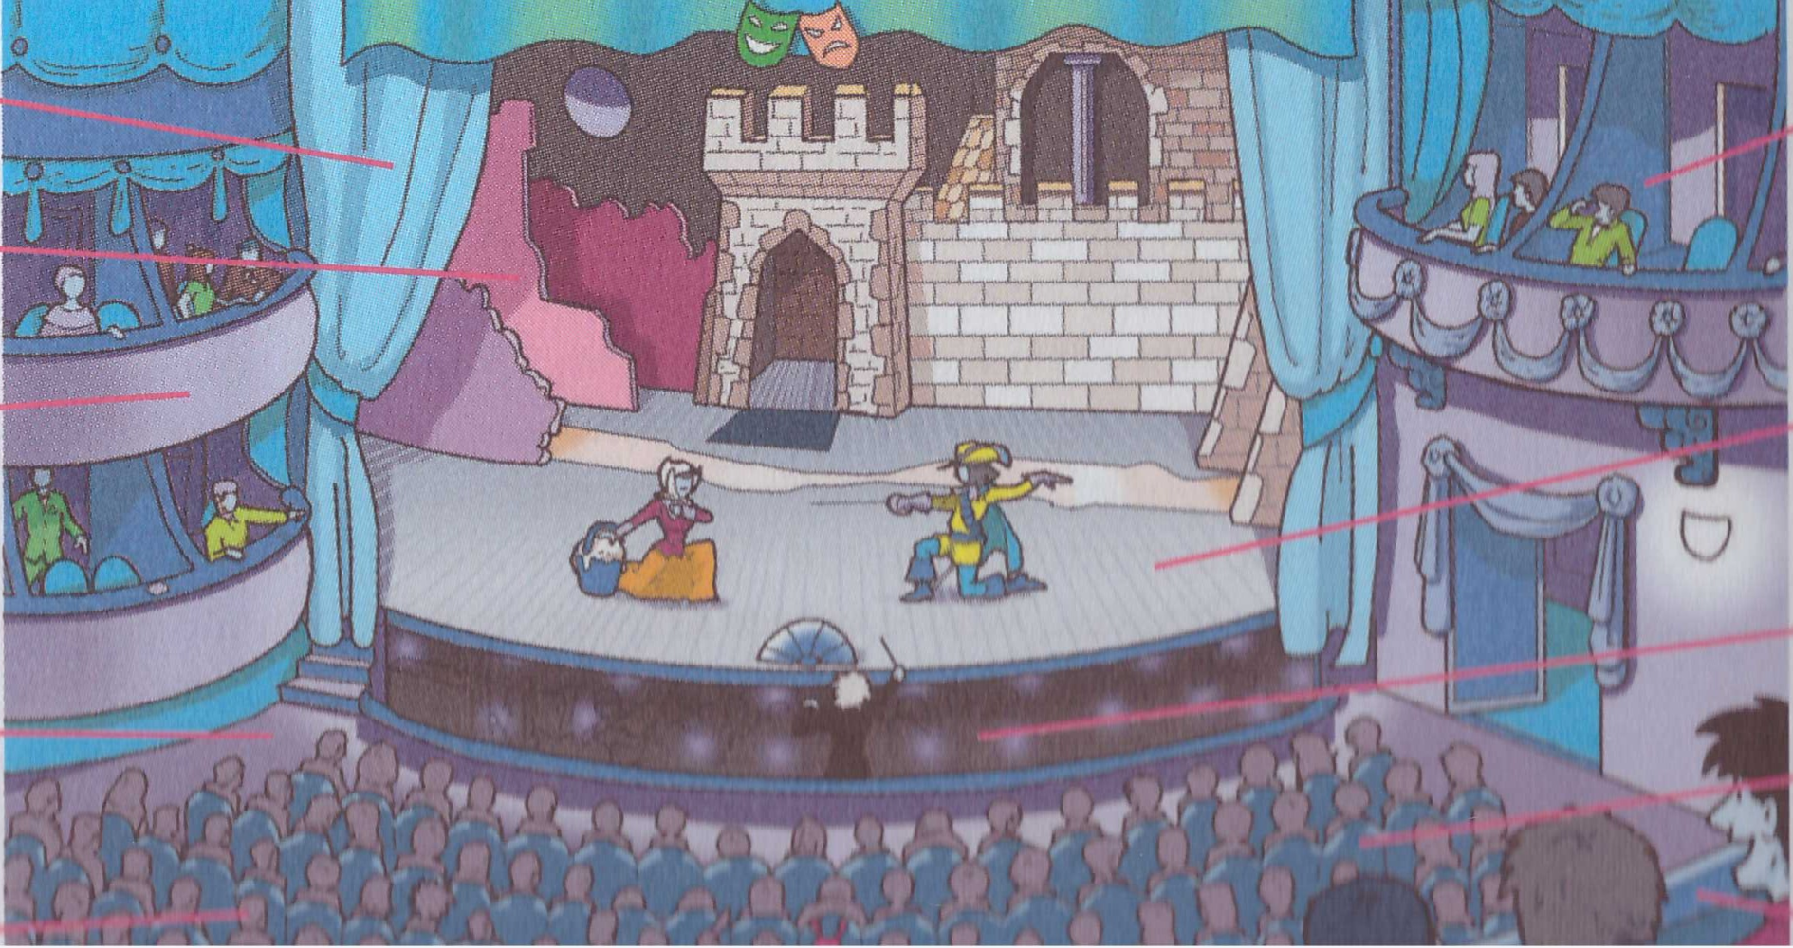
Theatre
1)
6)
2)
3)
7)
8)
4)
9)
5)
10)
curtain 4) aisle 6) box 8) orchestra pit
set/scene 5) audience 7) stage 9) stalls
gallery 10) circle
Notes:
You buy your tickets at the box office.
The part of the theatre where the audience sits is called the stalls.
The actors perform on the stage.
At the beginning of the performance the curtain rises.
In the interval you can leave your seat to stretch your legs or have a drink.
The actors wear costumes and also make up, so you can see their faces better.
The furniture, walls and other things that represent the place where the story is taking place are called the set/scene.
Swords, guns, umbrellas and anything else actors use on stage are called props.
At the end of the performance the audience applauds.
The best place to meet before the performance is the foyer.

Slide 23
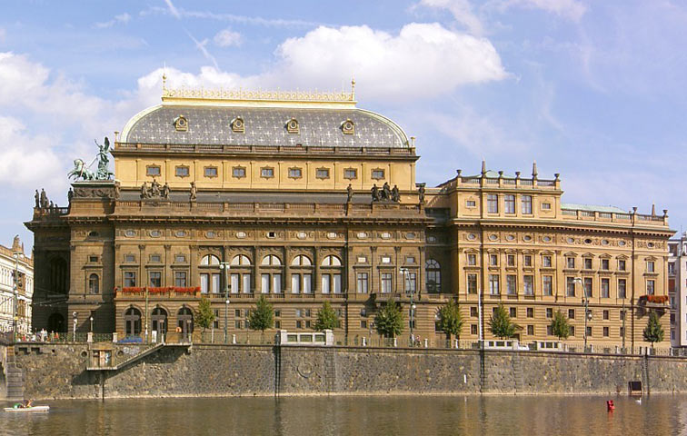
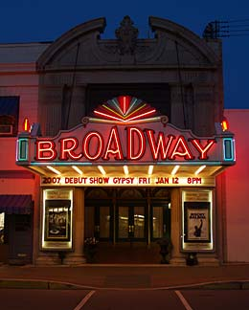
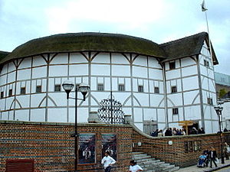
Theatres - pictures
Notes:
The National theatre (Prague) 2) Broadway (New York)
3) Shakespeare's Globe theatre

Slide 24
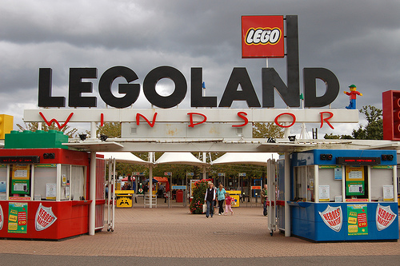
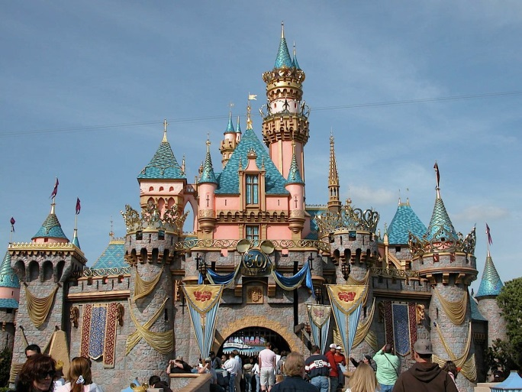
Amusement parks
„parks“ with a lot of attractions, roller coasters and other events
sometimes are themed to a certain subject or group
examples:
  Legoland (Windsor, UK)
  Disneyland (California, USA)
  Canada's Wonderland (Vaughan, Canada)

Slide 25
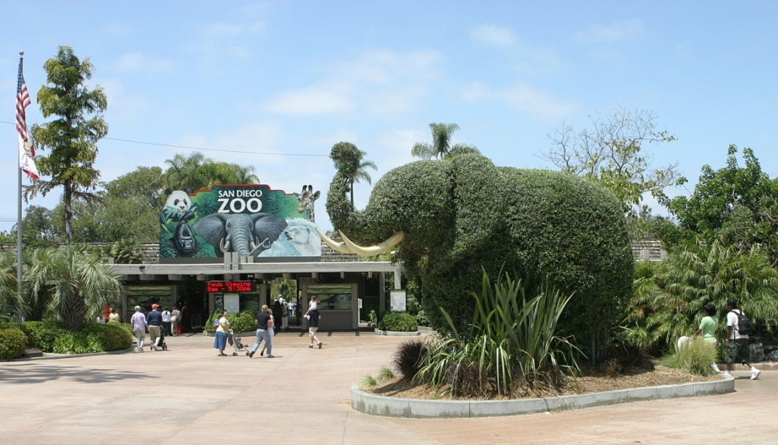

Zoos
facilities in which are kept animals to show them to the public
zoos typically house more wild animals than domesticated ones
can also help to save endangered species
almost in every large city

Slide 26
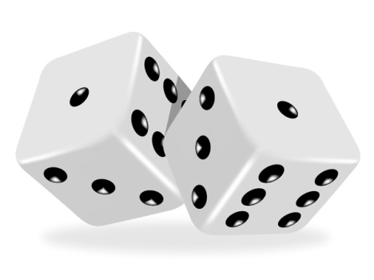
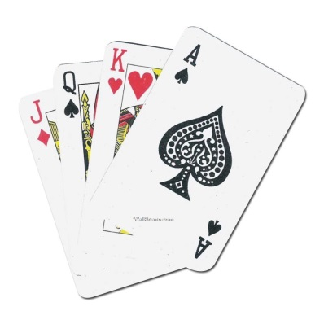
Games
a game is structured playing, usually undertaken for enjoyment and sometimes used as an educational tool
games generally involve mental or physical stimulation, often both
many games help to develop practical skills or serve as a form of exercise
Types of games:
sports
table-top games
  board games, card games, dice games, guess games
video games

Slide 27
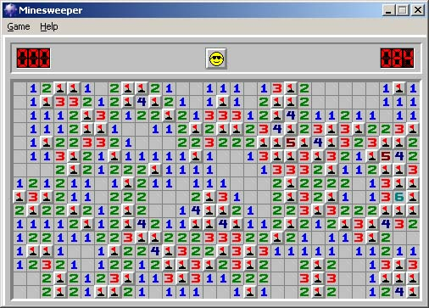

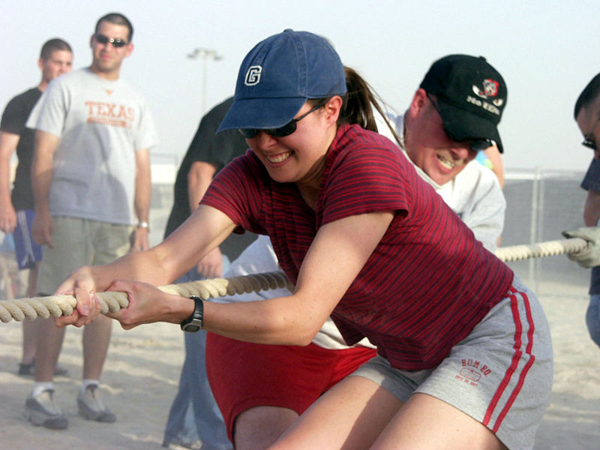
Games
another way how to divide games:
  single-player games
  multi-player games
special types:
  role-playing games
  simulation games
  business games
Notes:
1) Minesweeper
2) Tug-of-war 3) a sort of Nintendo characters
Business games:
The purpose of these games is to link to some aspect of organizational performance and to generate discussions about business improvement. Many business games focus on organizational behaviors. Some of these are computer simulations while others are simple designs for play and debriefing. Team building is a common focus of such activities.

Slide 28
Mind map
description
  what, where, who
  if they are divided: how?
Culture and entertainment
Culture - definition
History
Types of entertainment (activities)
Entertainment – basic information
Types (literature, music, dance, visual arts, film…)

Slide 29
Questions
Is culture a part of your life? If yes, what do you do?
Do you think that cinemas and theatres will still exist in the next 20 years or they will be replaced by something new?
What styles of music do you like? What you don't like? Why?
Have you got any favourite artists or places connected to culture? Why do you like them?

Slide 30
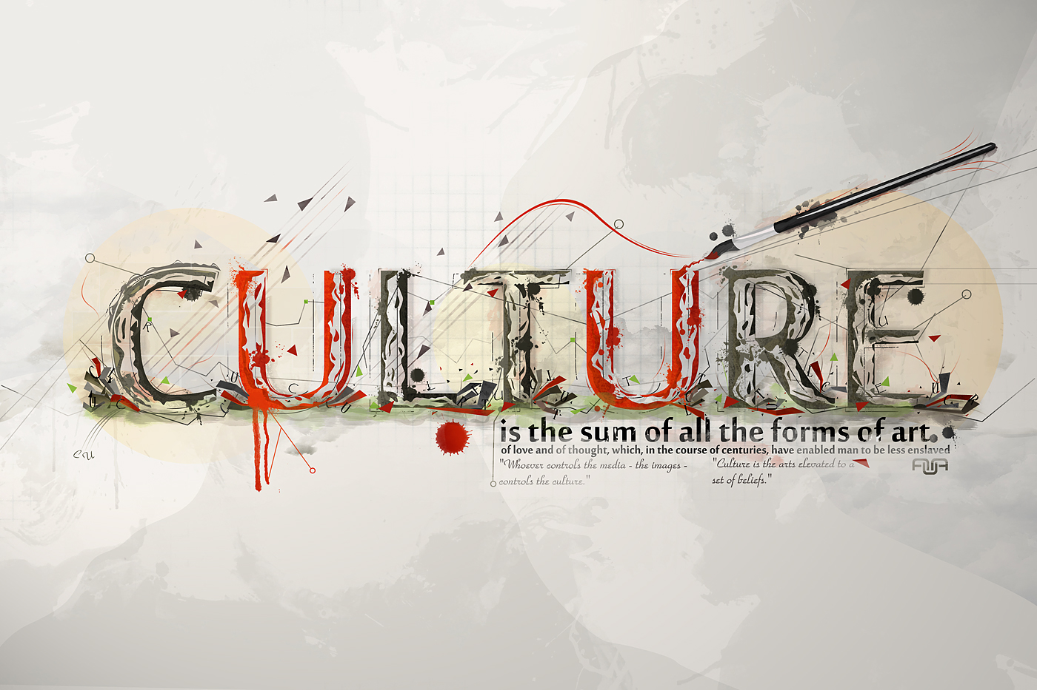
Thank you for your attention…
…hope, you've enjoyed it and learned something. ☺
(If you have a question, don't be afraid to ask..)

