Slide 1
HOUSING

Slide 2
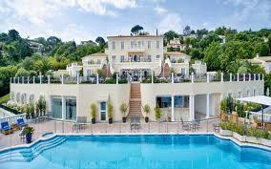
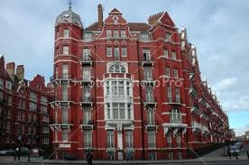
Specification
Housing generally secures some basic human needs, such as shelter,
safety and privacy.
Permanent housing is also a condition for involvement into modern society.
Usually people own or rent some property.

Slide 3
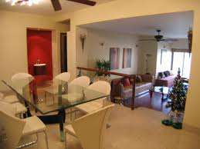
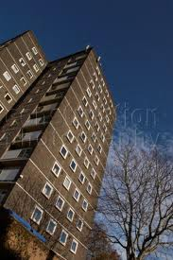
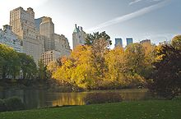
Types of housing
A flat is a self-contained housing unit that occupies only part of a building. We can find flats mainly in blocks of flats or tower blocks.
Apartments may be owned by an owner/occupier or rented by tenants.
Main types- studio flat, maisonette, garden apartment,…

Slide 4
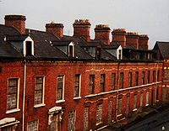
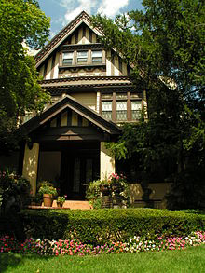
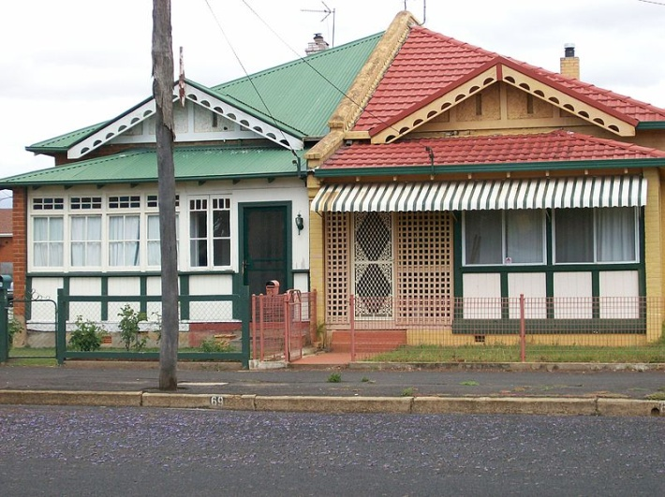
A house is a home, building, or structure that functions as a habitat for human beings. The term house includes many kinds of dwellings.
The social unit that lives in a house is known as a household. Most commonly, a household is a family.
Types- detached, semi-detached, terraced house

Slide 5
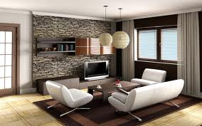
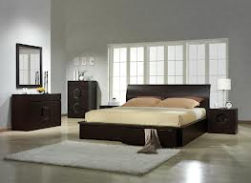
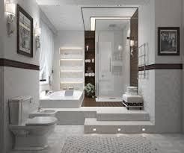
Rooms
A room is place in a house or flat where people are living. Usually, room is separated from other spaces by interior walls.
Human dwellings consists of rooms.
  Living room- is a room for relaxing and socializing.
  Bedroom- is a room where people usually sleep for
  the night or relax during the day.
  Bathroom- is a room for personal hygiene, generally containing a bathtub or a shower, and possibly also a bidet.

Slide 6
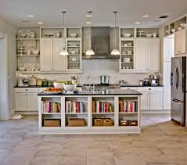
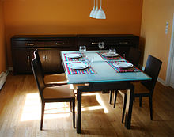
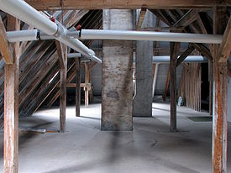
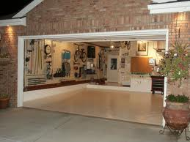
  Kitchen- it is a main place for cooking and food
  preparation.
  Dining room is a room for consuming food. Today
  it is usual that people use kitchen as dining room.
  Utility and storage rooms- attic, basement, cloakroom,
  utility room, garage, etc.

Slide 7
The End
Stanislav Shcherbina
6XB

