Slide 1

HEALTH

Slide 2

HEALTH
GENERAL
(Healthy life, Vaccine)
DISEASE
(Division, Doctor)
INJURY
MEDICAL CARE
(The CR, UK, USA)

Slide 3

World Health Organization:
„Health is a state of complete physical, mental, and social well-being and not merely the absence of disease"

Slide 4


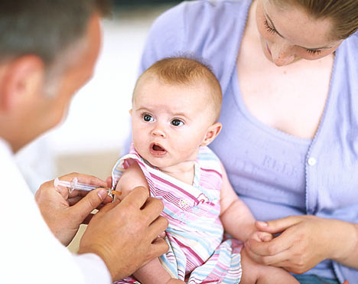
What to do to keep yourself healthy?
We should:
  practise, do some sports
  eat healthy
  avoid fat and junk food from fast-foods, eat more fruit and vegetables, eat regularly
  sleep sufficiently
  eight to nine hours of sleep for adult
  be in the fresh air
  avoid stress, cigarettes, drugs and so on
Vaccine - an antigenic preparation used to establish immunity to a disease

Slide 5
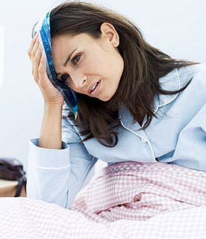
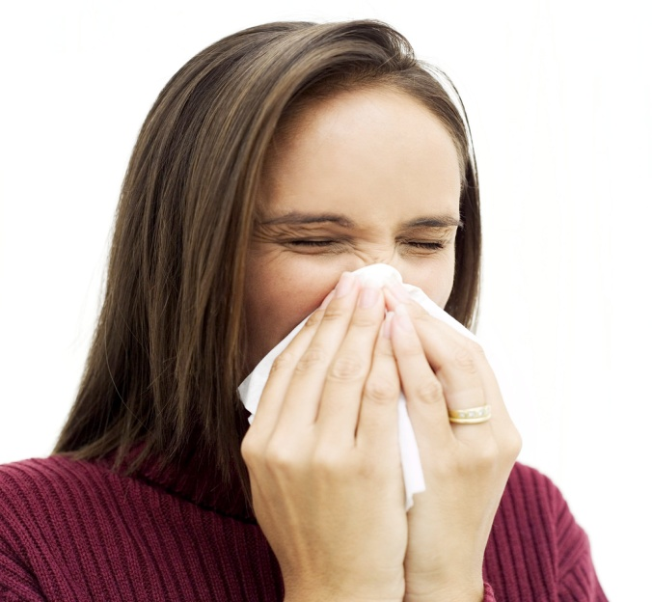
Disease
Medical condition is an abnormality of the body or mind that causes pain and discomfort, dysfunction or distress to the person
Common illnesses - flu, cold, headache, toothache or tonsillitis
  Symptoms - temperature, stuffy nose, scratchy throat, perspiration or pains
Serious diseases - migraines, leukaemia, AIDS, heart attacks, cancer
Others: Sneezing, diabetes or stroke
→ visit our doctor

Slide 6


At a doctor
A general practitioner, a dentist, a psychiatrist, a cardiologist, a neurologist, a surgeon
Things a doctor does:
  examines the body
  takes your temperature
  looks into your throat or ears
  listens to your heart
  checks your lungs and listens to you breath
  checks your blood pressure and pulse
  prescribes a medicine

Slide 7
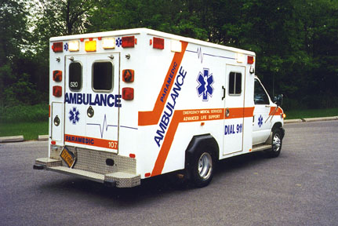
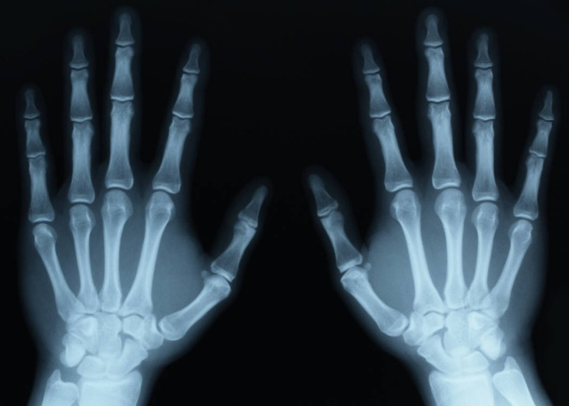
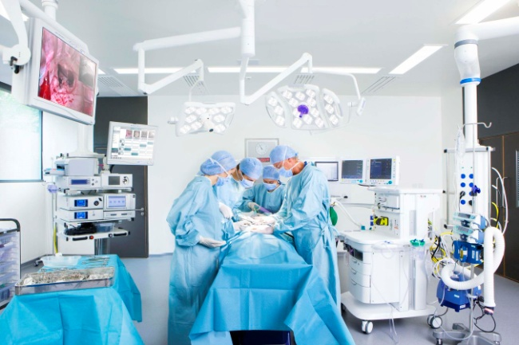
Injury
Lots of injuries happen at home, in car crashes and dangerous sports.
Injured person might be taken to hospital by an ambulance or by a special helicopter
Operations:
  Out-patient operations are for small easy things, and mean you do not stay overnight in the hospital.
  In-patient operations are for more serious problems and mean you will be staying in the hospital for at least a couple of days.
Departments – surgery, dental department, eye department, dermatology department, ear and throat department (ORL) and maternity hospital.

Slide 8


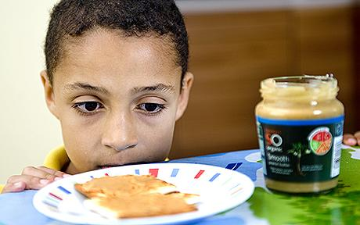
Allergy
We can be allergic to animals, dust, sun, flowers and trees in bloom.
Symptoms - skin rash, red eyes, we sneeze and cough
Allergic people must take pills or be vaccinated

Slide 9

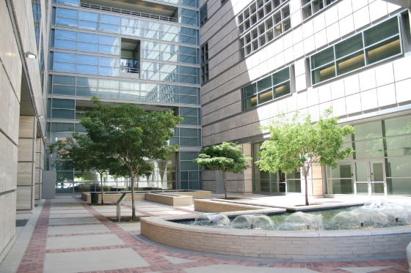

Medical care
The Czech Republic
  Public health service is not as free of charge
  We have to pay a small charge, for prescriptions, stay in hospitals and medicines
The United Kingdom
  NHS (National Health Service) which provides cheap or free treatment for everybody.
  You can use the private doctor or private hospital but you have to pay.
The USA
  Expensive
  If one is poor, the government will pay the doctor for treatment

Slide 10
Questions:
1) When do you need to go to visit the dentist?
2) What happens when you break a bone?
3) What are some medical specialists?
4) What are some common diseases?
5) What would you do if someone had a stomachache?

Slide 11
Written by:
Michal Singer
6.XB
Information sources:
www.bridge-online.cz
www.helpforenglish.cz

