Slide 1
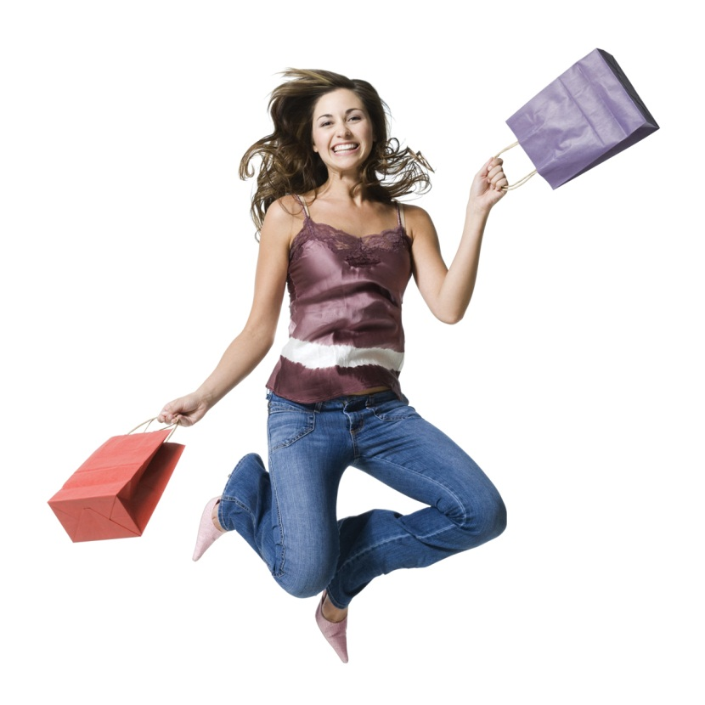
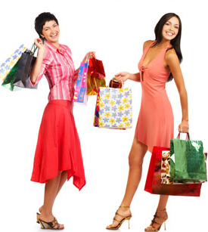
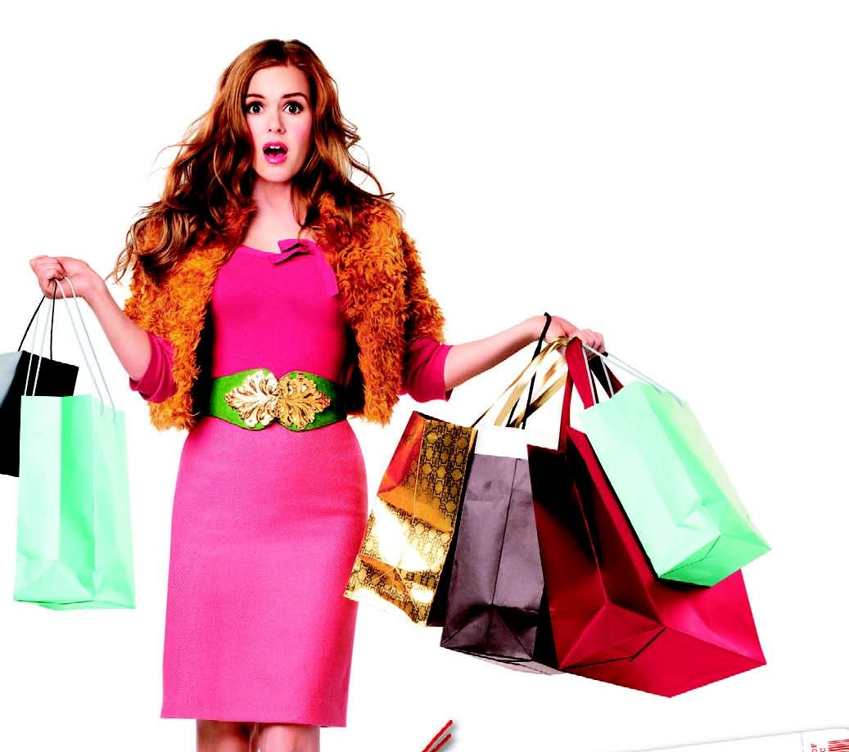
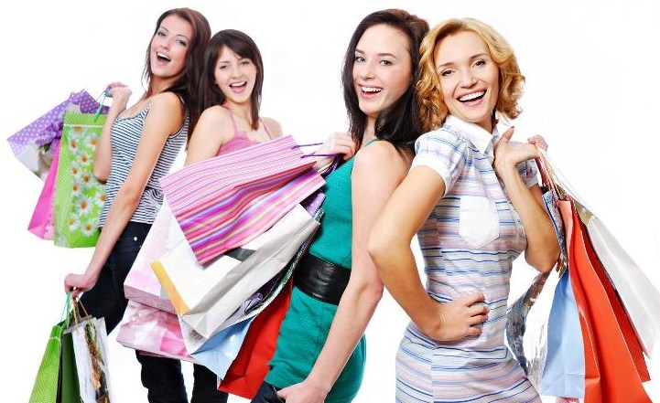
SHOPPING

Slide 2
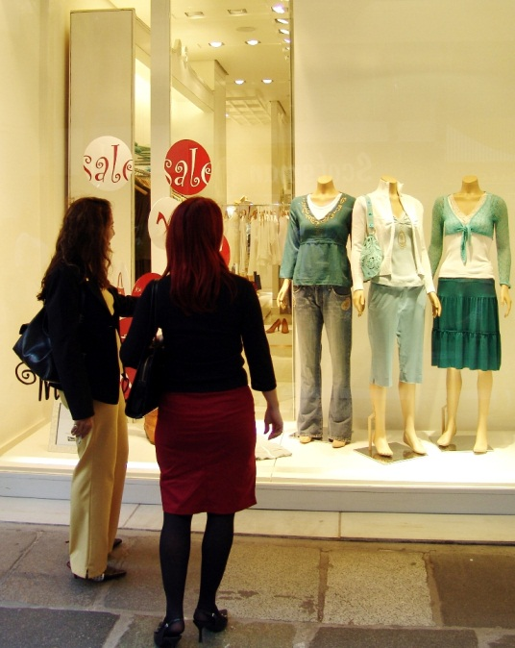
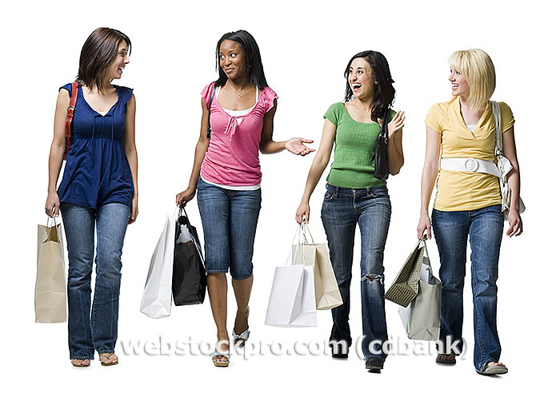
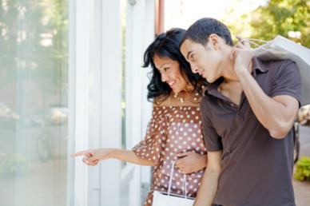
Shopping is an activity that is for our life very important because it help us obtain food and other essential items. Nowadays, shopping has become a hobby of modern people.
Especially women spent a lot of time shopping.
Negatives: It can be stressful – long queues, impolite customers, overcrowded shops (Christmas) – pickpockets; problems if you are not satisfied with the goods…

Slide 3
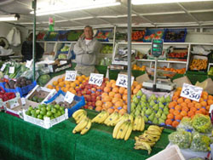
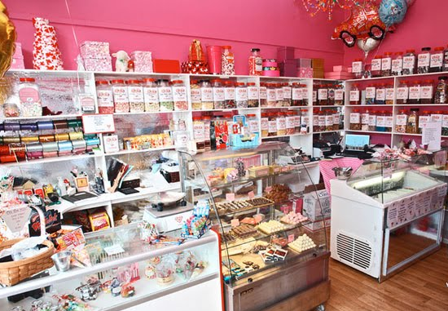
When we go shopping we can go either to a big department store or to the shop which specializes in some extra goods:
At a greengrocer's - vegetables and fruit
At a butcher's- meat and sausages
At a bakery - bread, rolls, and cakes
At a sweetshop (confectionery) - chocolate,
candies and cakes
At a florist's - flowers
At a chemist's – toiletries, medicines
At a stationary – paper, envelopes, pens
At a dairy – milk
At a ironmonger's –metal tools
At a watchmaker's –to repair watch
Toy shops, Shoe shop, Bookshop = bookseller's, sport shops, healthy food shops, travel agencies, optics…

Slide 4
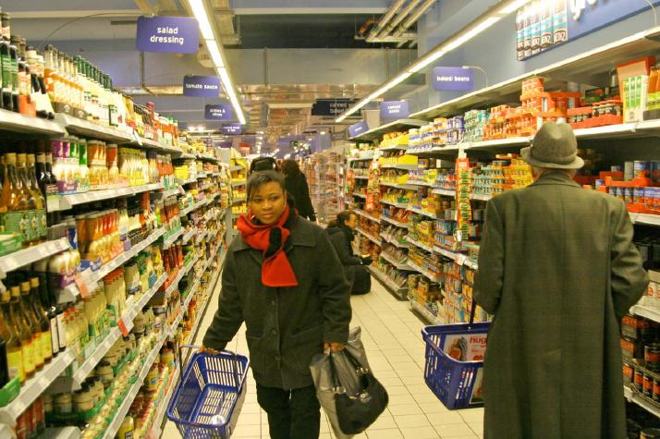
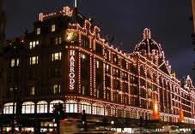
The most favourite is a department store (shopping mall). Equipped with lifts, escalators, many floors. It has different sections where we can buy various goods – clothes for women, men and children, shoes, electronics, books, furniture, perfumes, cosmetics and of course food.
Example: Harrod’s (London)
Supermarkets - Huge buildings where we can buy everything from food, fruit, vegetables, something from chemist and sometimes clothes.
There is a wide choice of goods, cheaper prices and we can buy everything what we need on one place. Often there are some sales. Disadvantage: It’s sometimes overcrowded
Examples of supermarkets in the UK: Sainsbury's, Tesco

Slide 5
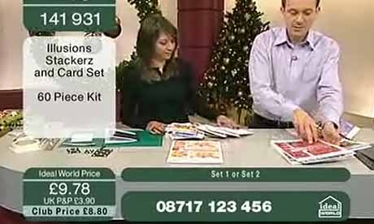
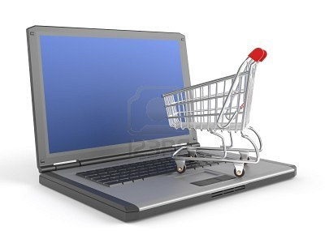
Other possibilities of shopping
TV shopping – adverts on TV, you can phone and they will send you the goods by post
We can use a catalogue for choosing things and buy them by ordering form and getting them by post
Online shopping - is a form of electronic commerce where consumers directly buy goods or service over the Internet . Online shopping is usually available 24 hours a day, fast and comfortable; we usually send money from our bank account

Slide 6
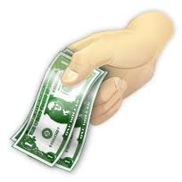
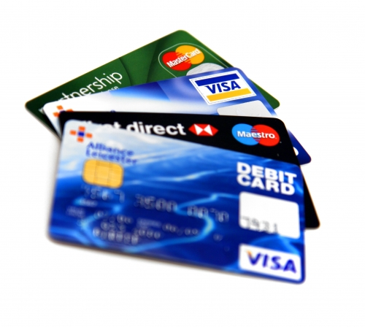
Methods of payment
By credit card – widely used, it can limit the amount
of spent money and limit the pickpockets.
To pay in cash – we use banknotes or coins
In the CR – 1 crown (100 hellers - not used anymore)
in the UK – 1 british pound (GBP) = 100 pennies – 30 crowns
in the USA – 1 american dollar (USD) = 100 cents – 20 crowns
By cheque
To take out a loan
Payment in kind - payment, where no money is involved; exchange of goods or services for other goods or services
Mortgage - A loan to finance the purchase of
property, usually with specified payment
periods and interest rates

Slide 7
Shopping in the Czech Republic
After revolution in 1989 → more possibilities for private shops
Foreigner companies discovered our market for their business, we can meet with many foreigner shops (Makro, Bauhaus, IKEA)
Our businessmen have to count with a big competition from abroad. It could be good for customers, because the shopkeepers must keep the prices low.
Famous shopping places: Pařízská street – expensive shops
Shopping in the Great Britain
Harrod’s (London)– department store for very rich people, you don’t see prizes, staff is very polite, dressed in special costumes, it has got long tradition, you have to be well dressed to get in
Fish and chips – very popular
One pound shop – very popular in GB, bad quality
Other: Selfridges in Oxford Street

Slide 8
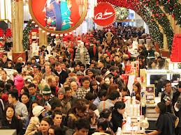
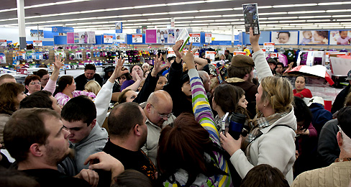
Shopping in the USA
Black Friday is the day after Thanksgiving Day (fourth Thursday in November), often regarded as the beginning of the Christmas shopping season.
On the day called Black Friday retailers attract
shoppers with many sales and offers - endless queues.
This day is the busiest shopping day of the year.
Black Friday is not an official holiday, but many employees and schools have both Thanksgiving and the day after off.
Traditionally the best month for retailers is December. In December the shopping spree reaches a peak.
Notes:
Especially in the USA we can see real shopping spree after the Thanksgiving holiday, on the day called Black Friday - retailers attract shoppers with what many sales and offers. People are willing to stand stand in endless queue.
Traditionally the best months for retailers december. In December the shopping spree reaches a peak.

Slide 9
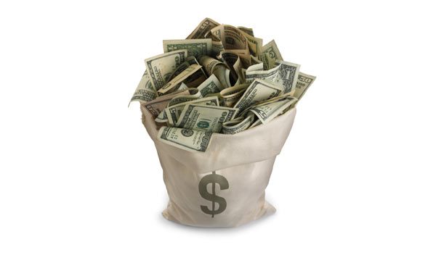
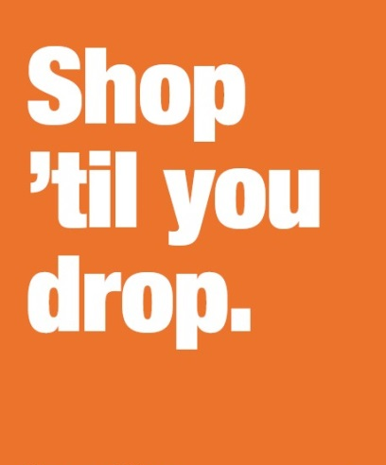
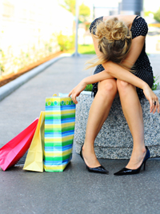
SHOPAHOLICS
Shopaholics – people who consider
themselves as addicted to shopping
Shopaholism is very similar to drug or alcohol addiction
REASONS: A woman feels bad - lonely, worthless, angry or lacking love. So she goes out and buys things - not only to give herself love, but also to prove to the world that she's 'worth it'.
Shopping gives her a high
The more expensive goods she buys, the better she feels
After the shopping: She feels even worse, guilty, scared of the consequences, angry with herself, she regrets... There's only one way out - shop again-> addiction
Notes:
For up to 10% of women worldwide, shopping doesn't just lead to a bit of overspending. They're SHOPAHOLICS.
Shopaholic – this world has come into existence in the recent years and it is a term used to describe person who consider themselves as addicted to shopping.
Shopaholism - or oniomania as it's called by psychiatrists – is very similar to drug or alcohol addiction.
Women suffer from this addiction more often than men
REASONS: A woman feels bad - lonely, worthless, angry or lacking love.
Next reasons can be relationship crises, problems at work, depression or some deeper problem from childhood.
Addicted person should find out some counsellor.
So she goes out and buys things - not only to give herself love, but also to prove to the world at large that she's 'worth it'.
Shopping gives her a high - so she does it again... and again... and again. The more expensive the goods she buys, the better she feels
After the shopping, woman realises it was a bad idea., she feels even more bad, guilty, scared of the consequences, angry with herself, she regrets... There's only one way out - shop again

Slide 10
Consumer society
Consumerism - way of life if you buy more than you need
Typical for western civilizations - mainly after the Second world war
After Velvet Revolution came consumerism from West to a Czech society
After the Velvet Revolution the czech economy changed from the planned economy into market economy
Nowadays – Consumer society divides people into social classes.
Material possession help people to identify themselves in society
Negatives of consumer society
It has negative effect on relationships between people → they kill each other for money
People see values in material things and not in interpersonal relations
Consumerism damage the environment:
More sold goods means more pollution → It means worse environment for life

Slide 11
QUESTIONS
Name at least 4 specialized kinds of shops.
Name 3 methods of payment.
What is Black Friday? When is it?

Slide 12
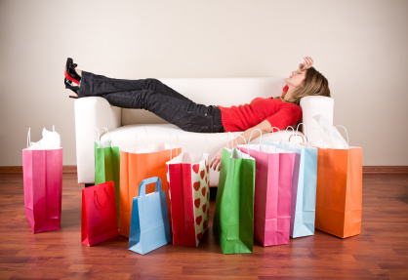
THE END
Marie Jindrová
6XB

