Slide 1



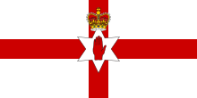
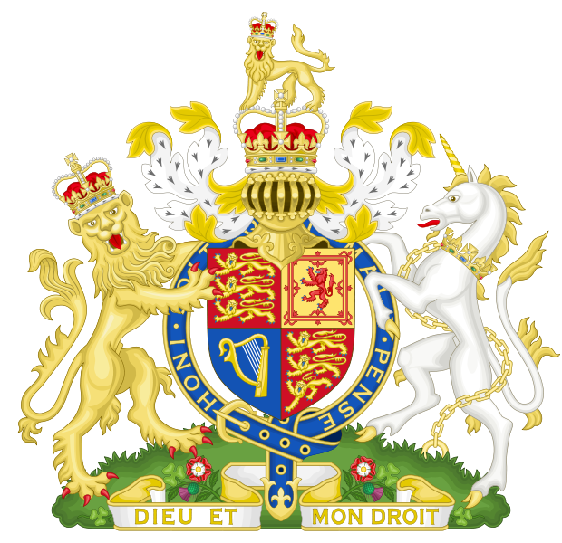
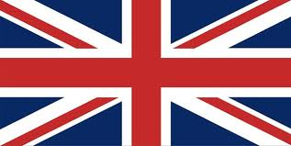
United Kingdom of Great Britain and Northern Ireland

Slide 2
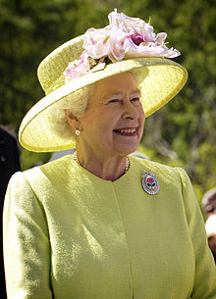
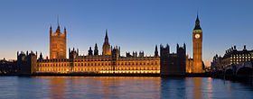
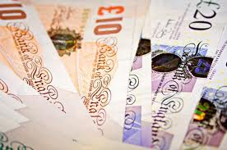
General information
Political system- unitary parlamentary constitutional monarchy
Monarch- Queen Elizabeth II
Capital- London
Official language- English
Currency- Pound sterling
National anthem- God Save the Queen
Total area- 243,610 km²
Population- 62,262,000 inhabitants
International organizations- United Nations, European Union, Commonwealth of Nations, Council of Europe,
G7, G8, G20, NATO and WTO

Slide 3
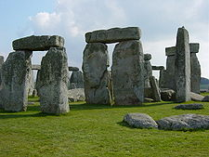
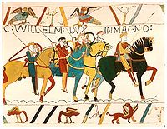
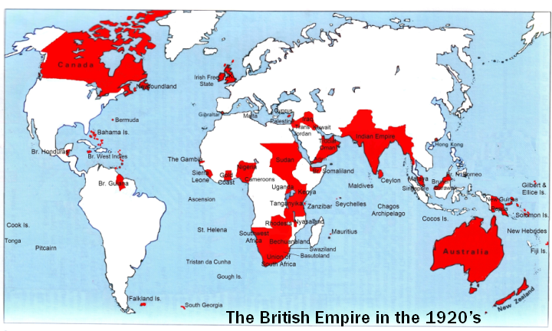
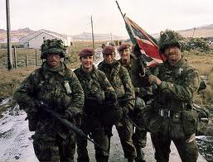
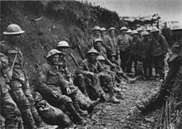
History
First modern humans appeared 30000 years ago
Conquered by Romans in 43 AD
From 5th till 10th centuries- rule of Anglo-Saxons
11th century- England was conquered by Normans
Hundred years war
English Civil War and the Glorious Revolution
18th – 19th centuries- greatest naval and economical power, biggest empire, industrial revolution
20th century- 1st World War, Great Depression,
2nd World War, Decolonisation, Falklands War,
Good Friday Agreement, War in Afganistan

Slide 4
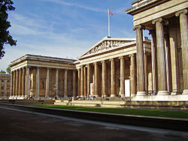
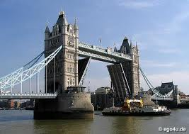
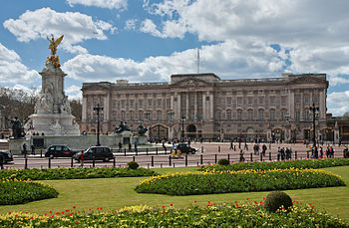
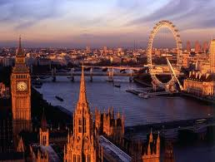
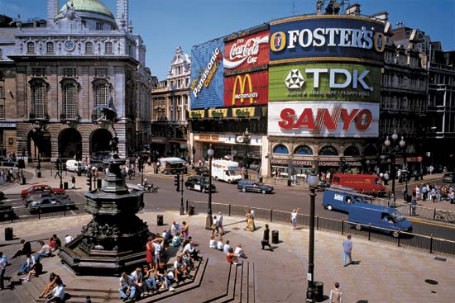
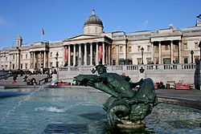
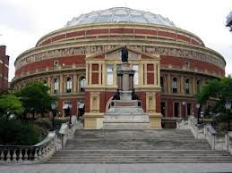
The most important cities
England
London- capital city of United Kingdom and its biggest city. It is the most important financial center in Europe. It has world's largest city airport system. With 8,278,251 inhabitants it is the most populous city in Europe. Important center of culture.

Slide 5
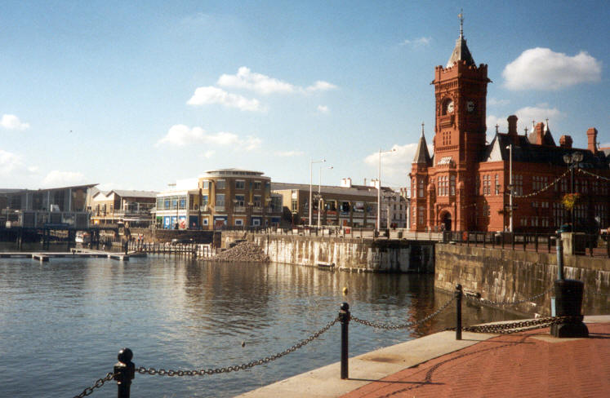
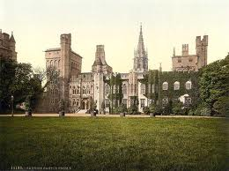
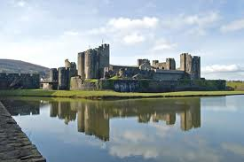
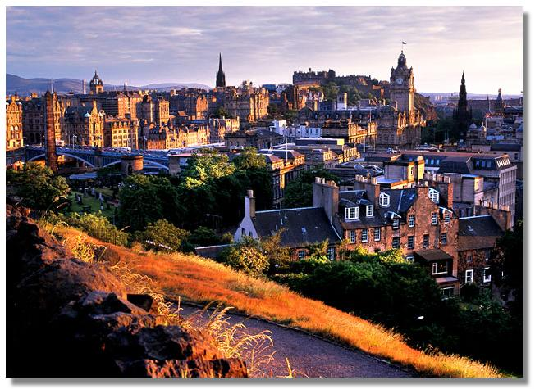
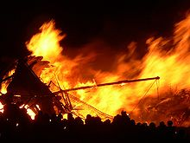
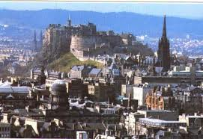
Wales
Cardiff- capital city of Wales. Population is 861400 inhabitants. It is the largest media centre in the UK outside the London. BBC drama village is located in Cardiff.
Scotland
Edinburgh-capital city of Scotland. Population is 495360 people. Great number of festivals takes place here. Industrial center of Scotland.

Slide 6
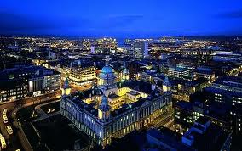
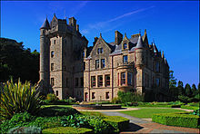
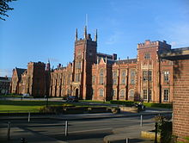
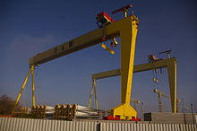
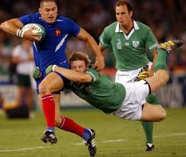
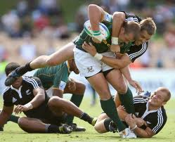
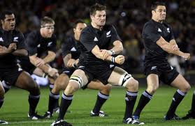
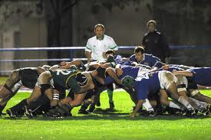
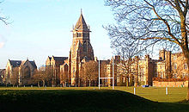
Northern Ireland
Belfast- capital of Northern Ireland, with total population of
641638 inhabitants. Belfast is a centre of industry, arts, higher education and business, a legal centre and is the economic centre of Northern Ireland.
Sports
Rugby-Rugby football was developed from a version of football played at Rugby School and was originally one of several versions of football played at English public schools during the 19th century. Now it is one of the most popular sports in UK and it is known all over the world.

Slide 7
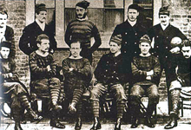
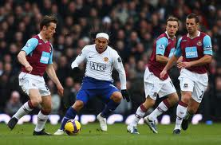
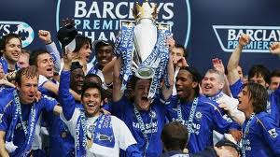
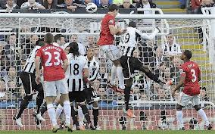
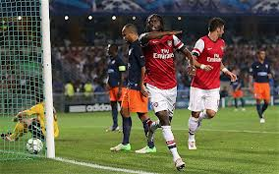
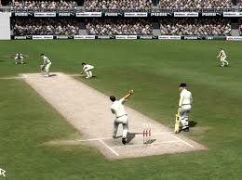
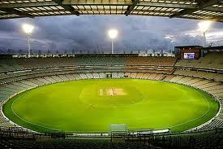
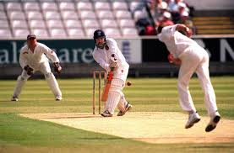
Football-
Football is a national sport in England. The first modern set of rules were established in 1863 in London, but the game itself is older, it appeared in the 14th century. Today England's Premier League is the most popular football league in the world.
Cricket-
Cricket is another national british sport. It is very popular in United Kingdom, Australia, New Zeeland, India and Southern Africa.

Slide 8
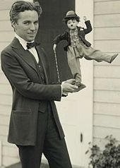
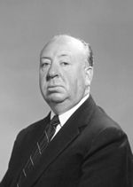
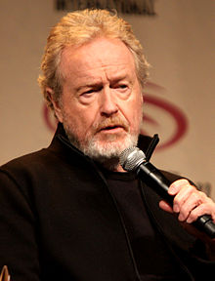
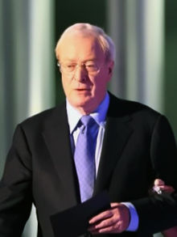
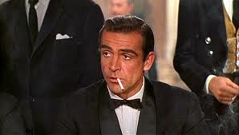
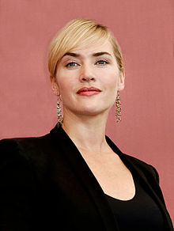
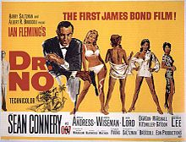
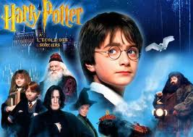
Culture
Cinema
Cinema has a long history in Britain. The first moving pictures developed on celluloid film were made in Hyde Park, London in 1889 by William Friese Greene. The most famous and successful British movies are James Bond and Harry Potter series.

Slide 9
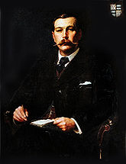









Literature- British literature is one of the greatest literatures in the world. The most important writers are William Shakespeare, John Milton, Daniel Defoe, sir Walther Scott, lord George Gordon Byron, Charles Dickens, Arthur Conan Doyle etc.
Music
British music is primarily known for its popular music. United Kingdom is homeland for many talented musicians, and British music influences music all over the world.

Slide 10











Made by- Stanislav Shcherbina
Sources- Wikipedia
Google

