Slide 1
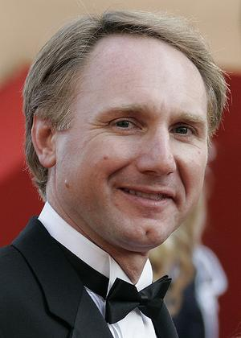
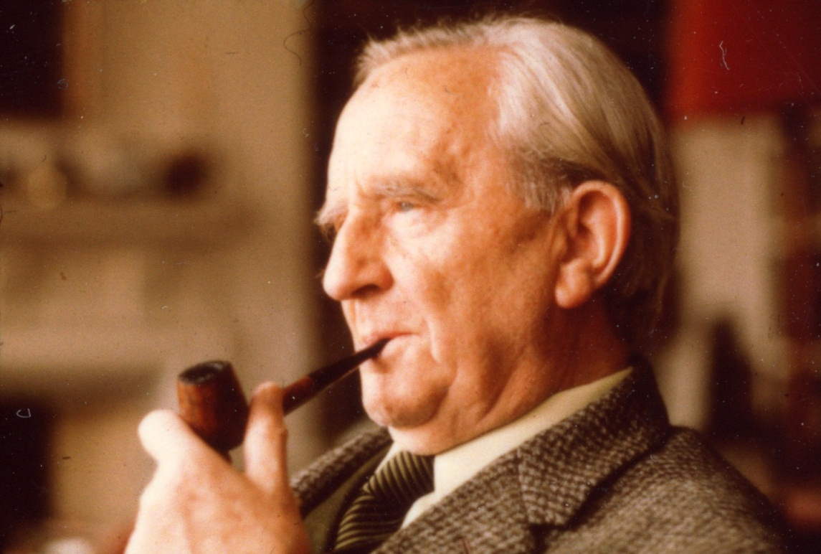
MY FAVOURITE BRITISH AND AMERICAN AUTHOR
Dan Brown
J.R.R. Tolkien

Slide 2

British author: John ronald reuel tolkien
(3 January 1892 – 2 September 1973)
English writer, poet, philologist, university professor
Author of the high fantasy works (The Hobbit, The Lord of the Rings trilogy or The Silmarillion)
German ancestors - tolkkühn („bloodhardy“) → Tolkien
Born in South Africa (Bloemfontein), parents Arthur and Mabel, younger brother Hilary
Accident with a spider – inspiration, influence?
Father‘s death, moving back to the UK (Birmingham)
Mother‘s death – foster care

Slide 3
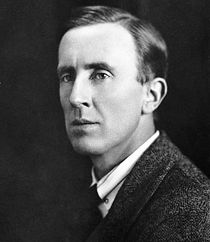
British author: J. r. r. tolkien
Early age – interested in languages, created his own
King Edward‘s School, then Exeter College (English Language and Literature) – graduated with first class honours
World War I – pilot, at the Somme
After War – academic career, Oxford English Dictionary (history and etymology of words of Germanic origin beginning with the letter W), translations (e.g. Sir Gawain and the Green Knight)
Lecture → Beowulf: Monsters and Critics
Internationally respected linguistic expert
Wife Edith Mary Bratt, 4 children (John, Michael, Christopher and Priscilla)

Slide 4
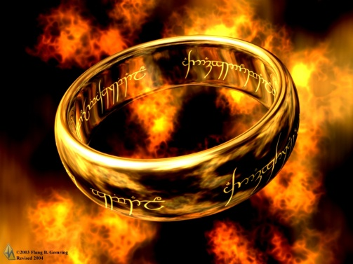
British author: J. r. r. tolkien
The Lord of the Rings
Best-known work, trilogy written 1937-1949, one of the bestselling novels ever
The Fellowship of the Ring, The Two Towers and The Return of the King
Should have been a fictional mythology of England
Also made into films (directed by Peter Jackson)
Epic struggle between Good and Evil, a journey to destroy the One Ring, many characters, complicated plot
Main characters: Frodo Baggins, Gandalf (the Grey/the White), Aragorn, Samwise Gamgee, Gollum …

Slide 5
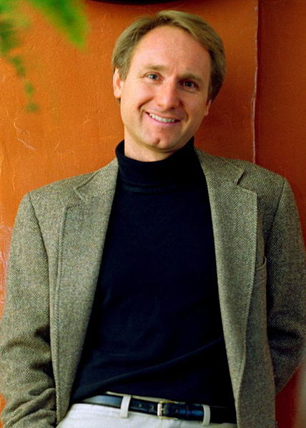
American author: Dan Brown
born June 22, 1964 (age 48), Exeter, New Hampshire, U.S.
American author of thriller fiction
Best known for The Da Vinci Code (the 2003 bestselling novel)
Novels – set in a 24-hour time period, themes: cryptography, keys, symbols conspiracy theories, mystery, wit and humour, strong female characters, interesting locations
His books have been translated into over 40 languages
The Da Vinci Code and Angels & Demons adapted into films

Slide 6
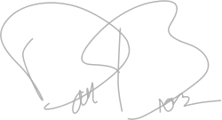
American author: Dan Brown
Born and raised in Exeter, NH, U.S., the eldest of three children
Grew up on the campus of Phillips Exeter Academy
Young Brown spent hours working out anagrams and crosswords puzzzles
After graduationg from Phillips Exeter, he attended Amhers College
Wanted to be a songwriter and pop singer (released a self-titled CD Dan Brown)
On holiday in Tahiti 1993 decided to become a writer
Controversial topics
Digital Fortress, Angels & Demons, Deception Point, The Da Vinci Code, The Lost Symbol

Slide 7
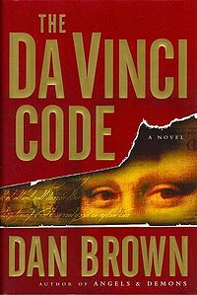
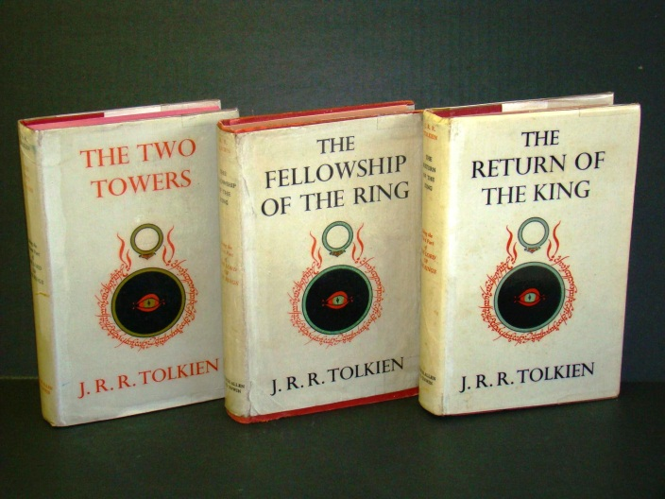
My Favourite brittish (and American) Author
Zpracoval: Marek Kotrč, 6XB
Zdroje: http://en.wikipedia.org/wiki/Tolkien
http://en.wikipedia.org/wiki/Dan_Brown

