Slide 1
THE UNITED STATES OF AMERICA

Slide 2
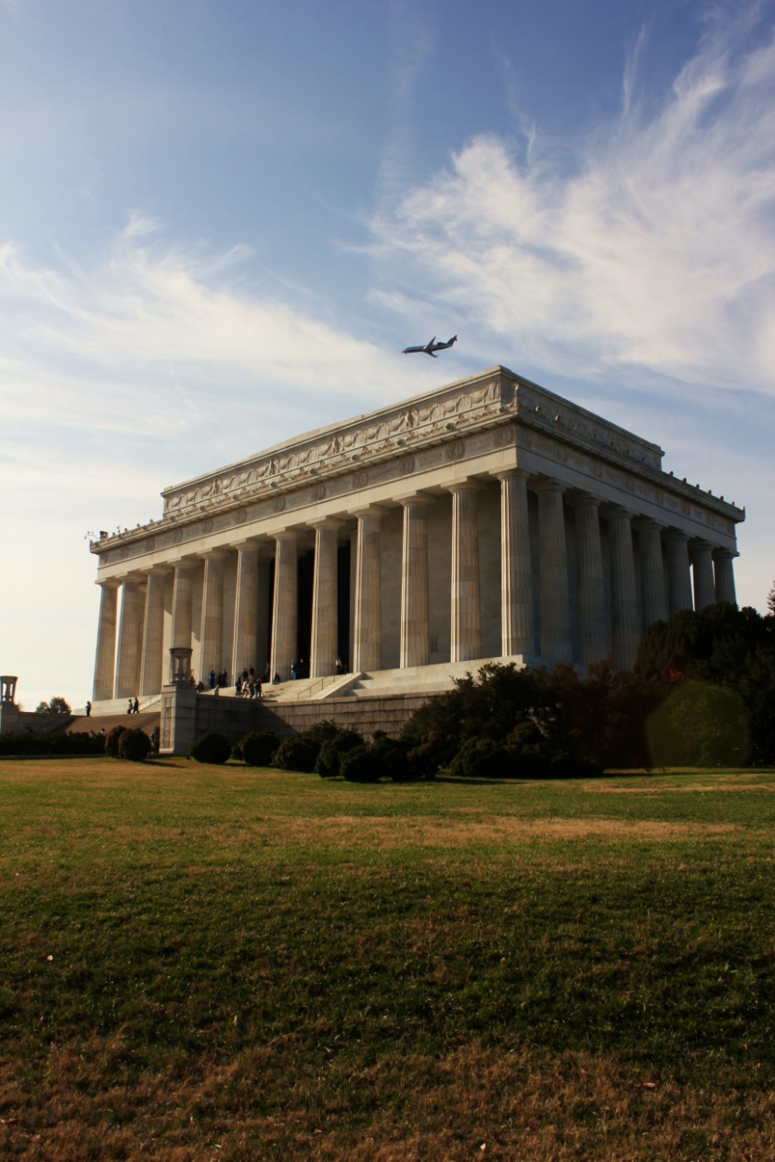
General informations
The USA is a federal constitutional republic, consisting of 50 states and a federal district.
The country is situated mostly in central North America, bordered by Mexico in the south and by Canada in the north. Only the state of Alaska lies in the northwest of the continent, with Canada to the east and Russia to the west.
The capital is Washington D.C.
The only official language is english.

Slide 3
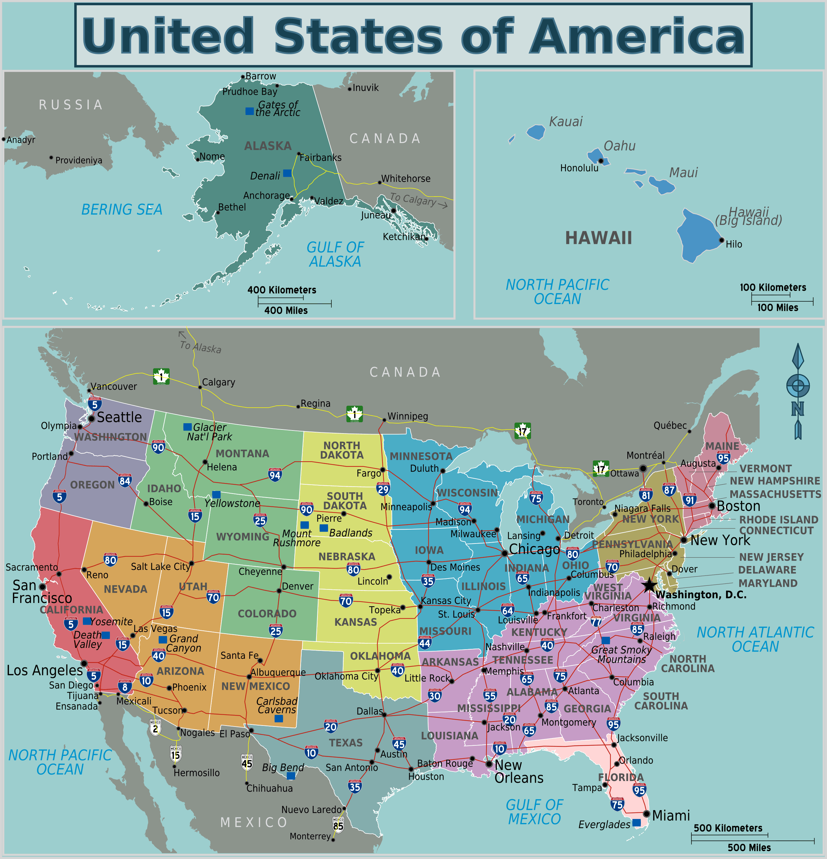
Alabama
Alaska
Arizona
Arkansas
California
Colorado
Connecticut
Delaware
Florida
Georgia
Hawaii
Idaho
Illinois
Indiana
Iowa
Kansas
Kentucky
Louisiana
Maine
Maryland
Massachusetts
Michigan
Minnesota
Mississippi
Missouri
Montana
Nebraska
Nevada
New Hampshire
New Jersey
New Mexico
New York
North Carolina
North Dakota
Ohio
Oklahoma
Oregon
Pennsylvania
Rhode Island
South Carolina
South Dakota
Tennessee
Texas
Utah
Vermont
Virginia
Washington
West Virginia
Wisconsin
Wyoming

Slide 4
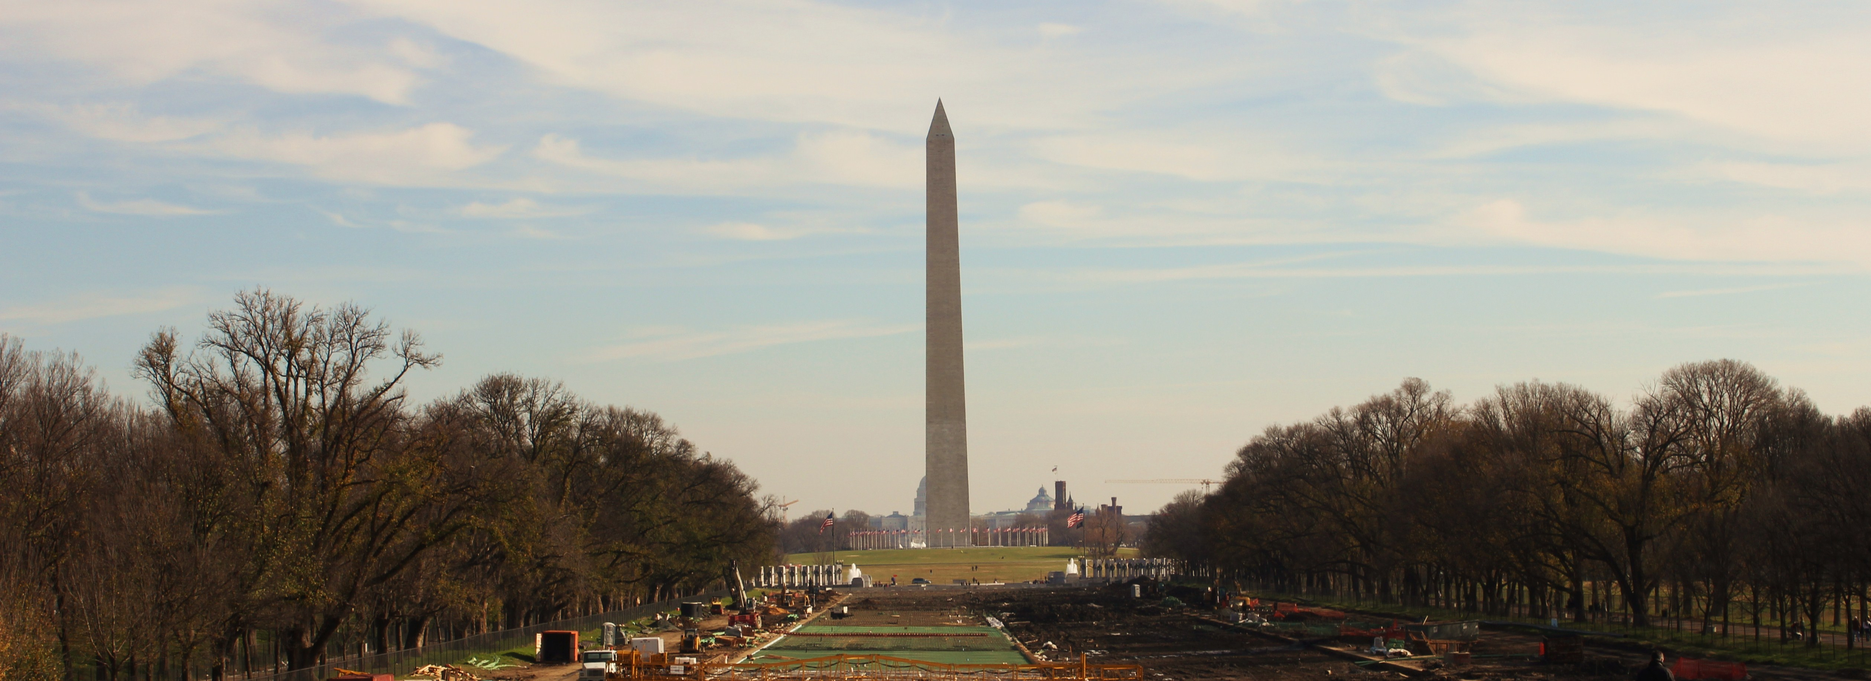
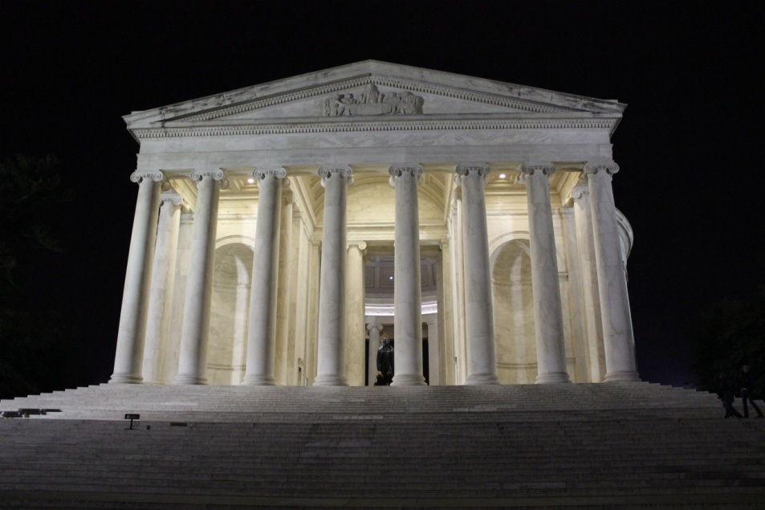
Washington D.C.

Slide 5
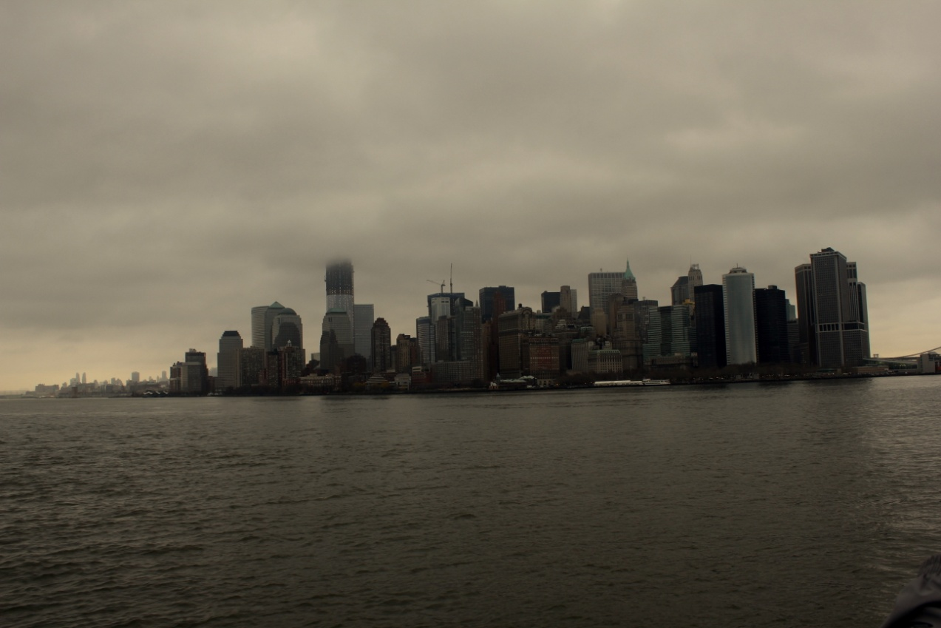
New York

Slide 6
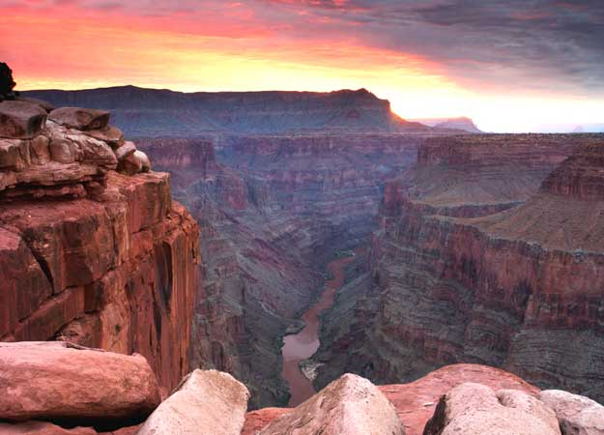
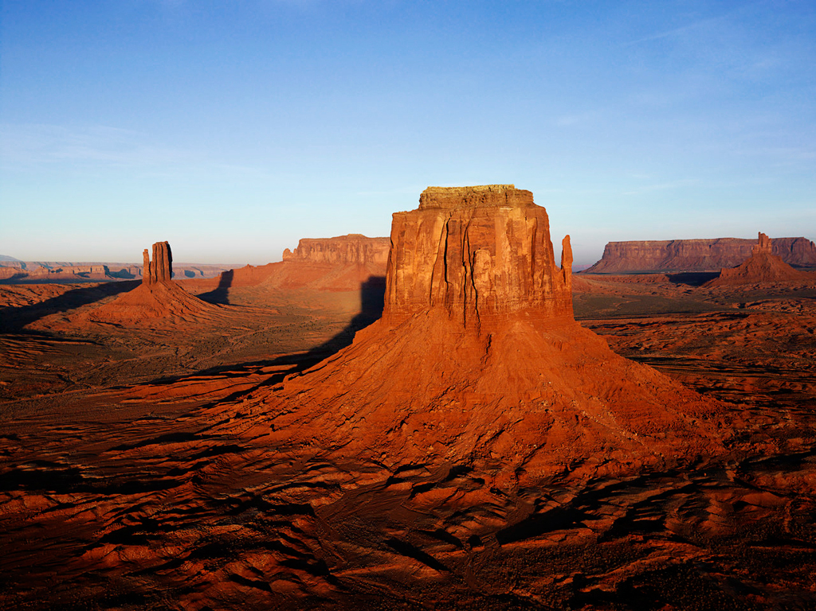
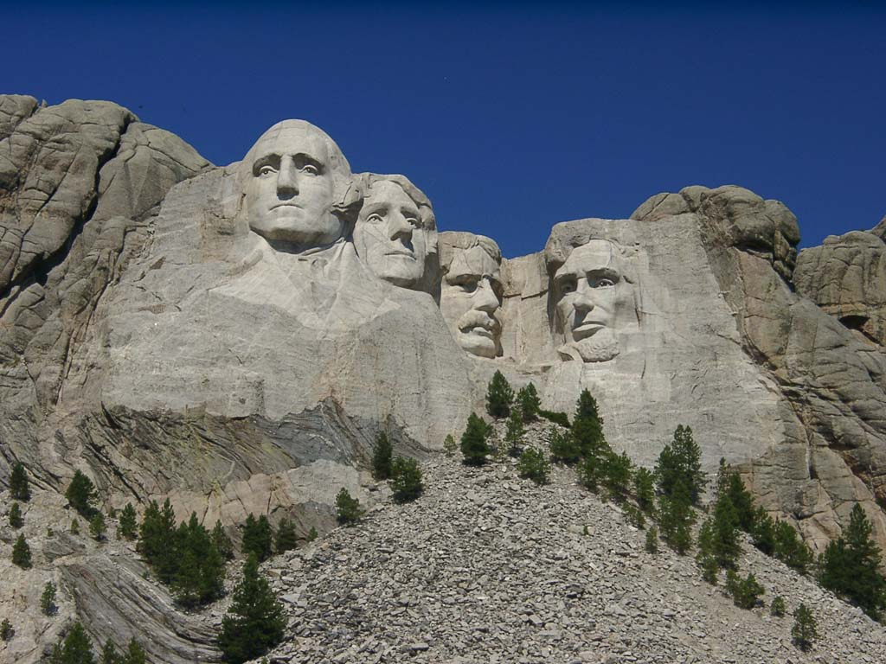

Slide 7
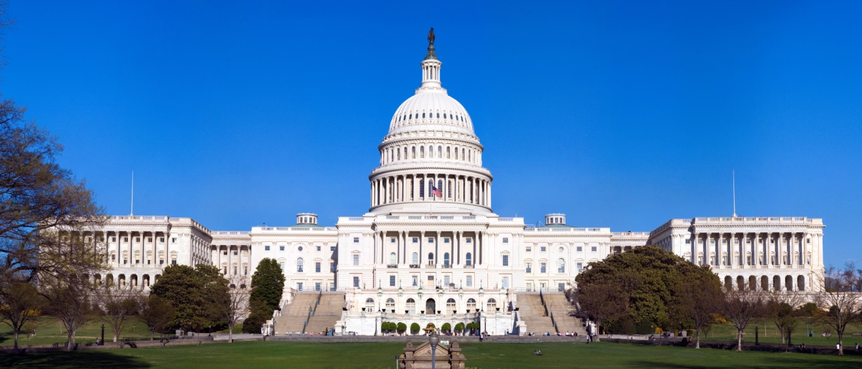
Government
The United States is the world's oldest surviving federation. It is a constitutional republic and representative demokracy, "in which majority rule is tempered by minority rights protected by law".
The government is regulated by a system of checks and balances defined by the U.S. Constitution, which serves as the country's supreme legal document.
3 levels of government:
FEDERAL (3 branches: Legislative power, Executive power and Judicial power)
STATE
LOCAL

Slide 8
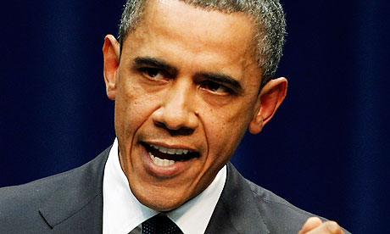
Government
3 branches of the federal government:
Legislative - The bicameral Congress, made up of the Senate and the House of Representatives, makes federal law, declares war, approves treaties, has the power of the purse, and has the power of impeachment, by which it can remove sitting members of the government.
Executive - The president is the commander-in-chief of the military, can veto legislative bills before they become law, and appoints the members of the Cabinet (subject to Senate approval) and other officers, who administer and enforce federal laws and policies. The president serves a four-year term and may be elected to the office no more than twice.
Judicial - The Supreme Court and lower federal courts, whose judges are appointed by the president with Senate approval, interpret laws and overturn those they find unconstitutional.

Slide 9
Geography
The U.S. borders both the North Atlantic and North Pacific Oceans and is situated between Canada and Mexico. It is the third largest country in the world by area and has a varied topography.
The eastern regions consist of hills and low mountains while the central interior is a vast plain (called the Great Plains region) and the west has high rugged mountain ranges (Rocky Mountains).
Alaska also features rugged mountains, as well as river valleys and for example Hawaii's landscape is dominated by volcanic topography.
The United States, with its large size and geographic variety, includes most climate types. The climate ranges from humid continental in the north to humid subtropical in the south. The southern tip of Florida is tropical, as is Hawaii. The Great Plains are semi-arid. Much of the Western mountains are alpine.

Slide 10
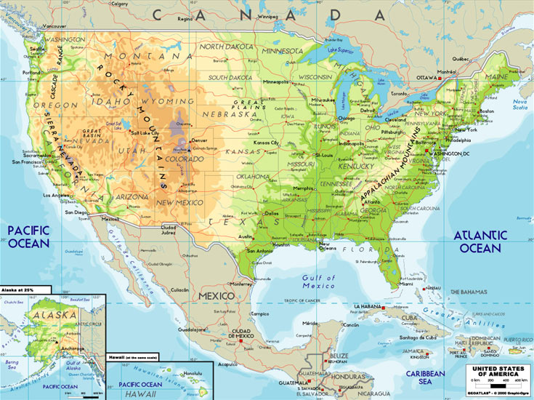

Slide 11
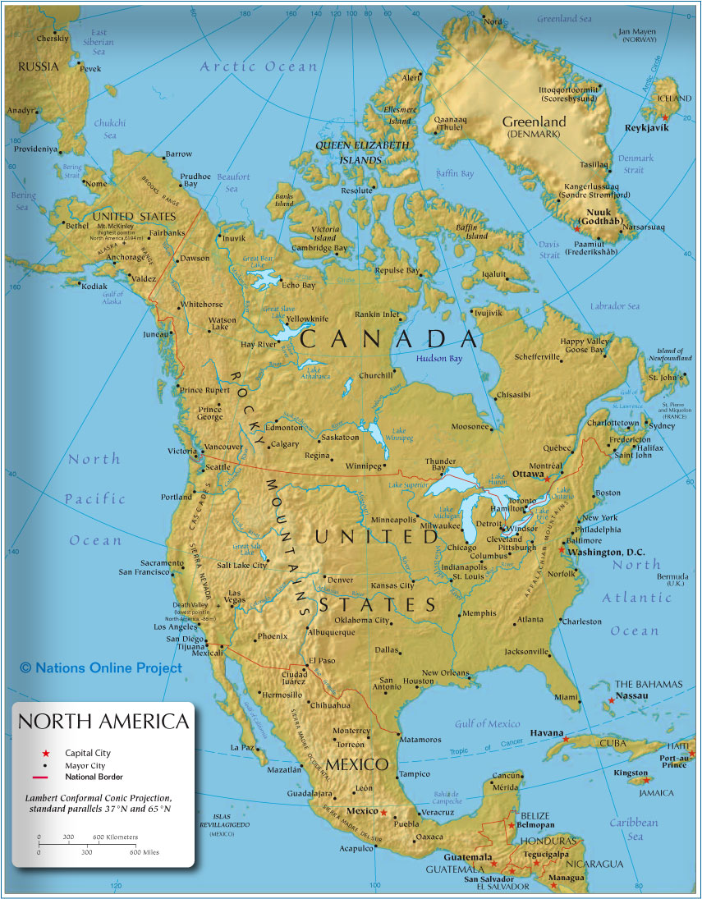
3 Oceans:
Arctic
North Pacific
Atlantic

Slide 12
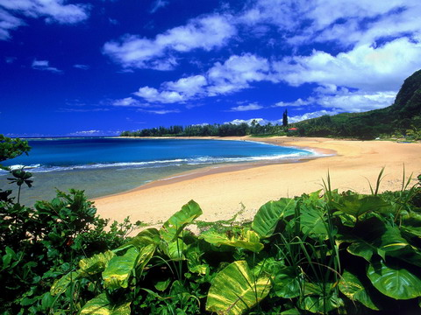
Geography
The U.S. ecology is considered "megadiverse"
The United States is home to more than 400 mammal
750 bird
500 reptile and amphibian species.
About 91,000 insect species

Slide 13
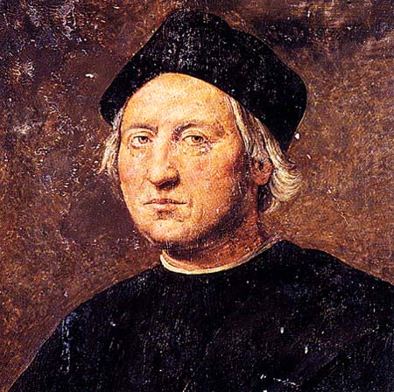
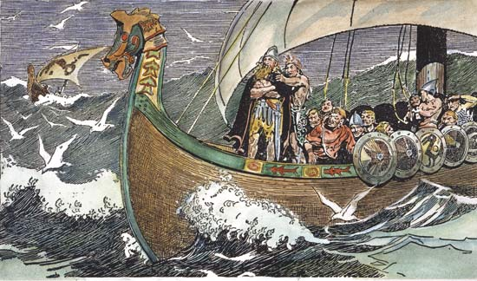
History
The first european sailors, who reached coasts of America were Vikings.
Under the leadership of Leif Eriksson from Greenland
Vikings established a few colonies on the East coast, but soon they have been pushed out by huge predominance of native inhabitants.
On the 12th October 1492 Christopher Columbus
The new era of human history, which helped many european countries, but represented destruction for majority of native american people and their culture, art and lifestyle.

Slide 14
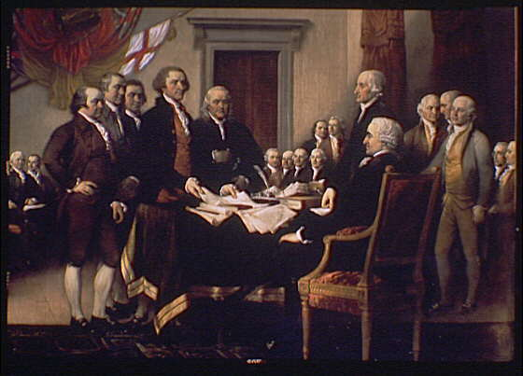
History
The United States began as an independent nation with the Declaration of Independence on July 4, 1776. By the 1770s, the Thirteen Colonies contained two and a half million people. They were prospering, and had developed their own political and legal systems.
The additional efforts at taxation, and the continuous presence of British troops posed a threat to American self-government. Political action in the early 1770s culminated in the Boston Tea Party in December 1773, and led to all-out war in 1775. After fierce debate among the colonies, it was finally agreed to declare their independence from Britain, and in 1776, the Declaration of Independence was signed.
During and after the war, the United States were united under a weak federal government established by the Articles of Confederation. When these became unworkable, a new Constitution was written in 1789, and it became the basis for the United States federal government, with a war hero George Washington as the first president.

Slide 15
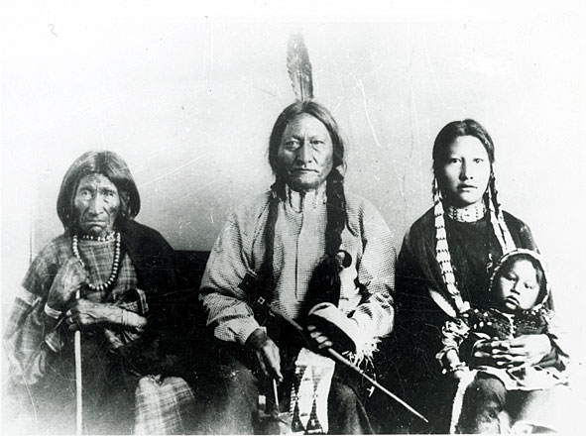
Race and Ethnicity
The United States is a diverse country, racially and also ethnically.
Officialy are recognized 6 races: White
American Indian
Alaska Native
Asian
African American
Native Hawaiian
White Americans are the racial majority, with an 72% share of the U.S. population. Hispanic and Latino Americans compose 15% of the population, making up the largest ethnic minority. Black Americans are the largest racial minority, composing nearly 13% of the population.

Slide 16
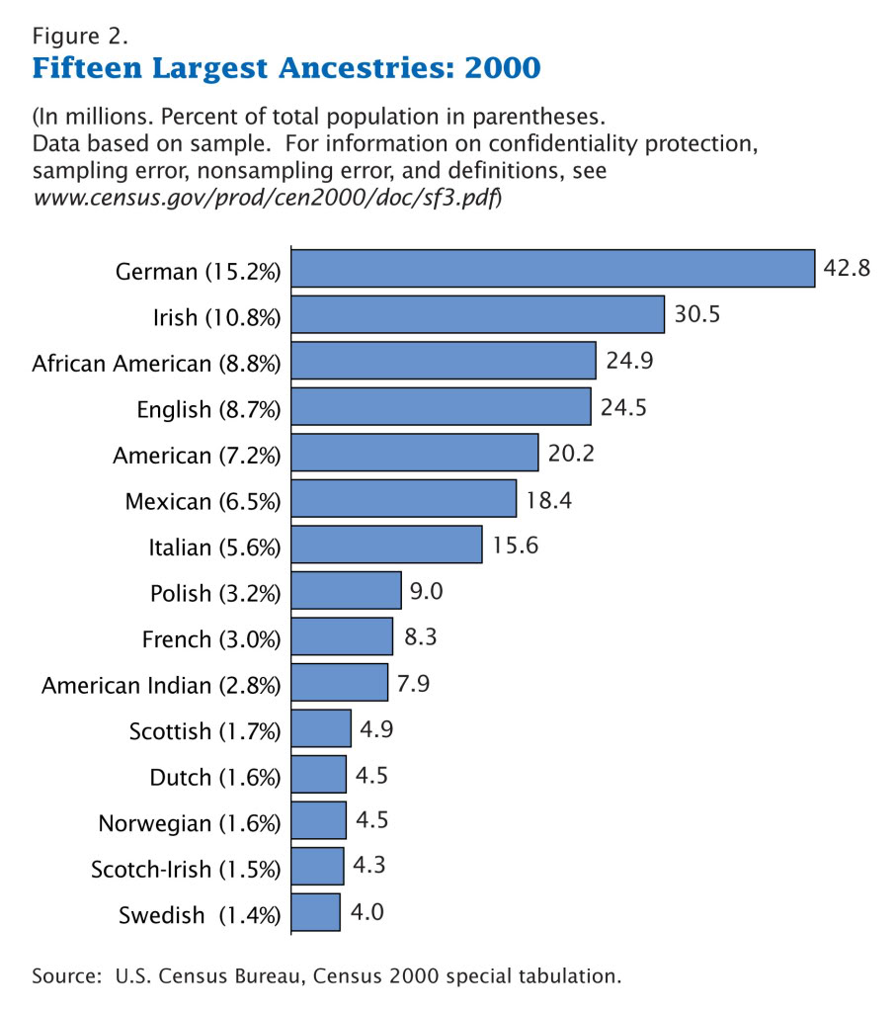
15 largest ancestries for the year 2000

Slide 17
California
California is located on the West Coast. It is by far the most populous U.S. state, and the third biggest (after Alaska and Texas). It is home to the nation's 2nd and 6th largest census metrpolitan areas (Los Angeles metropolitan area and San Francisco Bay Area), and eight of the nation's fifty most populated cities.
The capital city is Sacramento.
California's diverse geography ranges from the Pacific Coast in the west, to the Sierra Nevada mountains in the east – from the Redwood–Douglas-fir forests of the northwest, to the Desert areas in the southeast. The center of the state is dominated by Central Valley, a major agricultural area. California contains both the highest and lowest points in the contiguous United States (Mount Whitney and Death Valley). Earthquakes are a common occurrence due to the state's location along the Pacific Ring of Fire.

Slide 18
Kansas
Kansas is a U.S. state located in the Midwestern United States. It is named after the Kansa Native American tribe, which inhabited the area. The tribe's name is often said to mean "people of the wind" or "people of the south wind." For thousands of years what is now Kansas was home to numerous and diverse Native American tribes.
The capital of Kansas is Topeka, the city population is 127,473.
Today, Kansas is one of the most productive agricultural states, producing high yields of wheat, soyabeans and sunflowers. Kansas is the 15th most extensive and the 33rd most populous of the 50 United States. Kansas is said to be the hey barn of the US.
The western two-thirds of the state, lying in the great central plain of the United States, has a generally flat or undulating surface, while the eastern third has many hills and forests.

Slide 19
Alaska
Alaska is the largest state in the United States by area. It is situated in the northwest of the North American continent, with the international boundary with Canada to the east, the Arctic Ocean to the north, and the Pacific Ocean to the west and south. Alaska is the 4th least populous and the least densely populated of the 50 United States. Approximately half of Alaska's 722,718 residents live within the Anchorage metropolitan area.
Alaska was purchased from Russia on March 30, 1867, for $7.2 million The land went through several administrative changes before becoming an organized territory on May 11, 1912, and the 49th state of the U.S. on January 3, 1959.
The capital city is Juneau
Alaska is well known for its dramatic landscape. Large mountainous, volcanic regions and wilderness. Mount McKinley is the tallest mountain in the U.S. at 20,320 feet.
Alaska has a very cold climate. Alaska is very close to the north pole which dramatically affects its climate and daily calendar. Northern Alaska is often referred to as the "Land of the Midnight Sun" since the sun does not set, providing 24 hours of daylight, from early May to early August. On the other extreme, the Sun does not rise from late November to late January.

Slide 20
Sources
www.wikipedia.org
www.kidport.com
Geography book
Geography atlas

