Slide 1
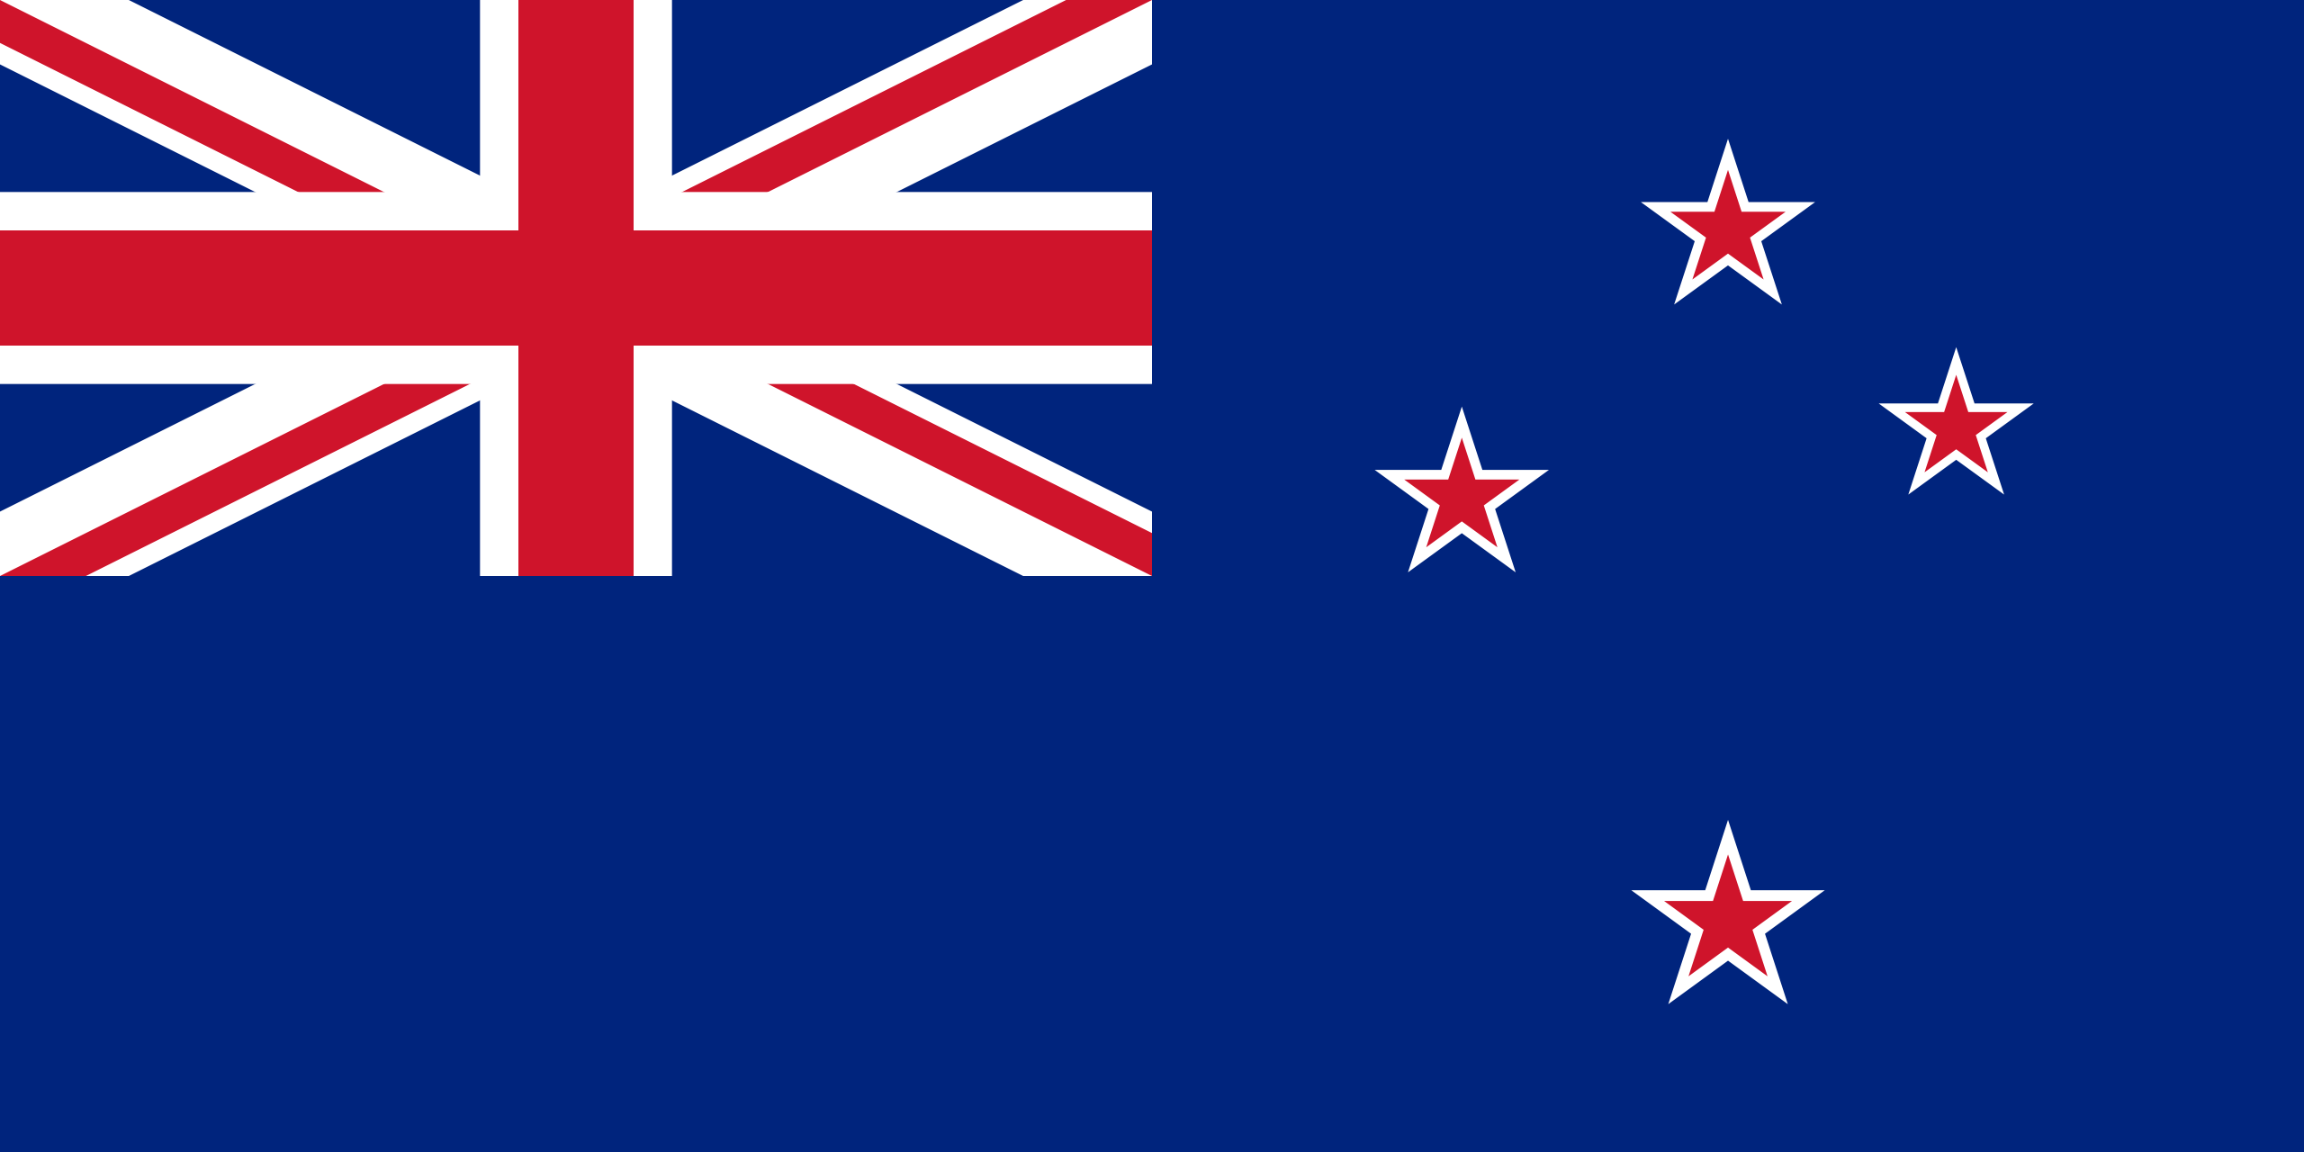
New Zealand

Slide 2
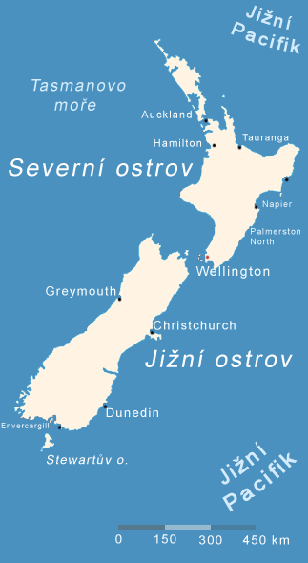
Basic information
Political system: Constitutional monarchy
Area: 268 021 km²
Capital city: Wellington
Official languages: English, Māori
Population: 4,4 million inhabitants
Currency: New Zealand dollar
Religion: Christianity
Member of Commonwealth

Slide 3
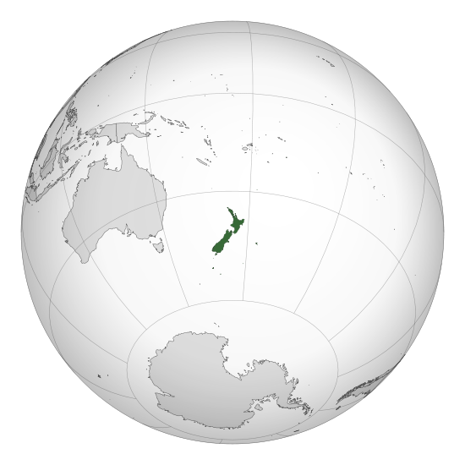
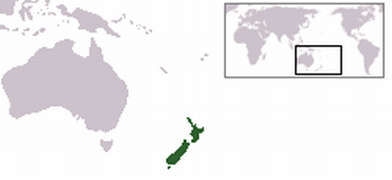
Location
New Zealand is an island country located in the southwestern Pacific Ocean
New Zealand is situated some 1,500 kilometres east of Australia
It is part of Polynesia in Oceania
Comprised of two main islands – the South and the North Island
has also couple of dependent areas such as Cook Islands, Niue or Tokelau

Slide 4
History
In 9. century the first Maors (original inhabitants) were settled
In 1641 Dutch seafarer Abel Janszoon Tasman discovered these islands
In 1840 british settlers came here and this territory was declared as a dependent territory of New South Wales under British protection
In 1907 New Zaeland became independent, but there were still strong political bindings on GB
In 1931 became totally independent as a member of Commonwealth

Slide 5
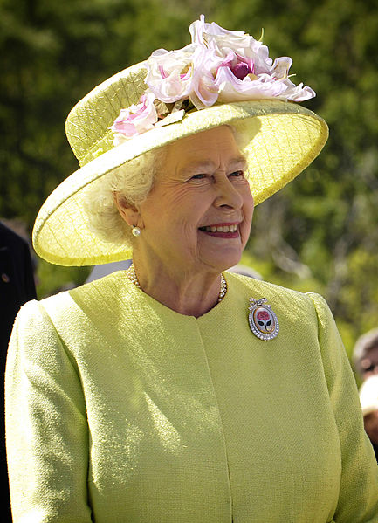
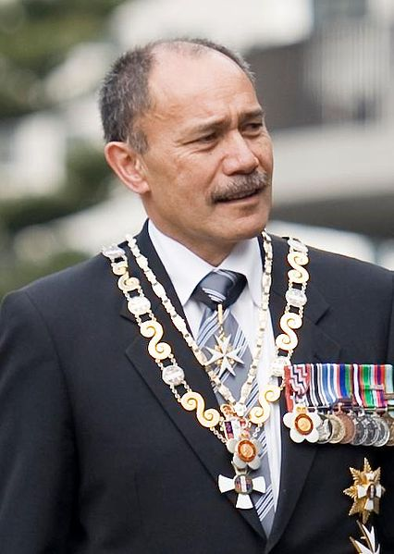
Political system
New Zealand is a constitutional monarchy with a parliamentary democracy
Queen Elizabeth II is the Queen of New Zealand and the head of state. The Queen is represented by the Governor-General, whom she appoints on the advice of the Prime Minister.
The powers of the Queen and the Governor-General are limited by constitutional constraints and they cannot normally be exercised without the advice of Cabinet

Slide 6
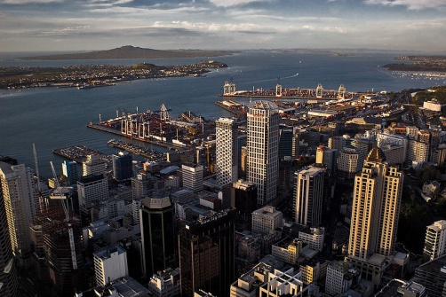
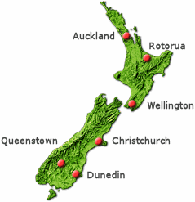
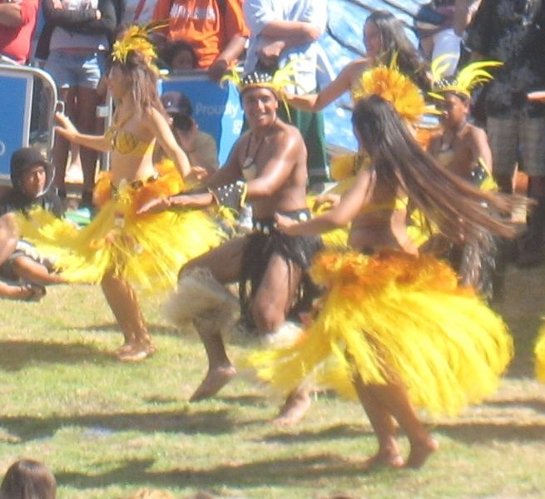
Cities and population
The biggest city is Auckland with 1,4 million inhabitants
Other important cities are Christchurch and Hamilton
Density of population is 14 inhabitants per km²
Ethnic groups: 78% European 14.6% Māori 9.2% Asian 6.9% Pacific peoples

Slide 7
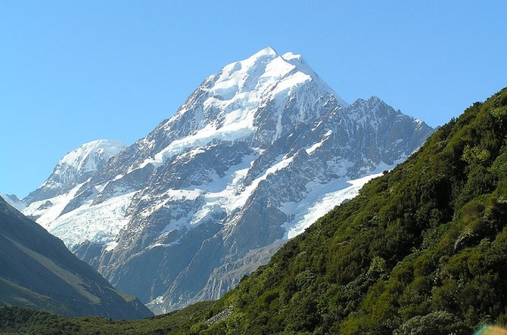
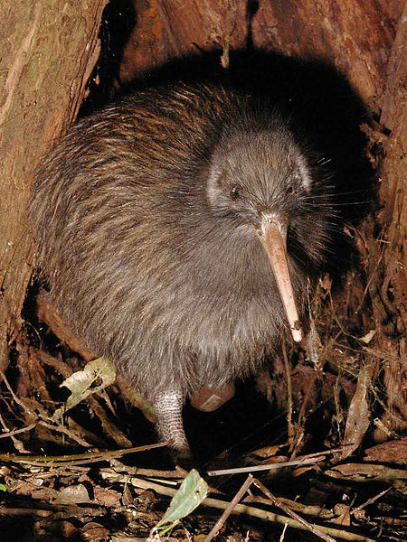
Geography, Climate and Nature
Varied landscape – lowlands on the coast, mountains in inland
Between the South and North island is 26km wide Cook Strait
The highest mountain is Mount Cook – 3754 m
New Zealand has mild oceanic climate
The northernmost part has subtropical climate
The Northern island has average temperature +18°C and on the Southern island it is +13°C
The most famous animal living in New Zealand is Kiwi
big flightless bird

Slide 8
Quiz
What is the name of original inhabitants?
Who represents Queen Elisabeth ll.?
Name at least three important cities.
What is the highest mountain?
What is the name of the big flightless bird?

Slide 9
The end
Sources:
www.wikipedia.com
www.google.com
My head
Jakub Matějček
Kryštof Kocman
6XB

