Slide 1
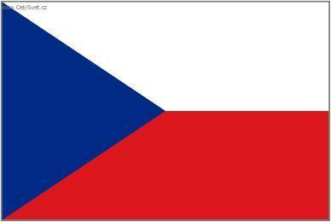
The Czech Republic

Slide 2
Basic Facts
The centre of Europe → the Heart of Europe
The capital city: Prague
Area: 78 864 km².
Population: over 10 million people
Density: 130 people per 1 km²
Three historical lands: Bohemia, Moravia and Silesia.

Slide 3
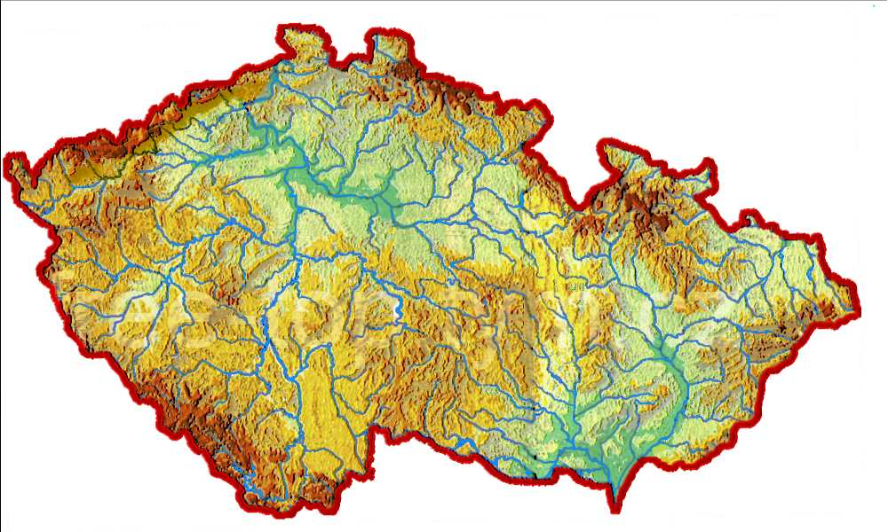
Geography
The Czech Republic borders on Germany in the west, Austria in the south, Slovakia in the east and Poland in the north.
Krušné Mountains
the Czech Forest
Šumava range
Jizerské Mountains
Krkonoše (Sněžka)
Orlické Mountains
Jeseník Mountain
Bílé Karpaty
the Vltava
the Elbe
the Odre
the Morava

Slide 4
Climate
The Czech Republic has a humid continental climate with cold winters and warm summers.
Rainfall is generally heaviest during the summer months.

Slide 5
Population
The CR has about 10 million inhabitants.
The most numerous national minorities: Slovak, Poles, Vietnamese, Germans, Russians, Ukrainians.
At least quarter of a million Romani.
Over 70 per cent of the population lives in the urban area.
The Largest cities are Prague, Brno, Ostrava, Plzeň, České Budějovice...

Slide 6
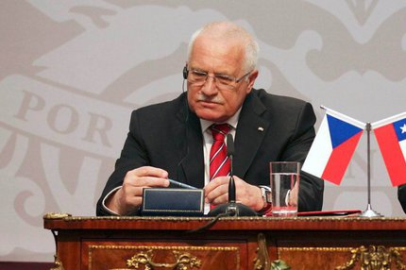
Government
The Czech Republic is a democratic state.
Three branches of the government:
the legislative (the Parliament)
the executive (president and the government) judicial (courts)
The Czech parliament consists of two chambers: The Chamber of Deputies and the Senate.
The president is elected every five
years by Parliament. Our current
president is Václav Klaus.

Slide 7
Economy
engineering
metallurgical industry
chemical industry
tourism
textile industry
glass industry
coal mining

Slide 8
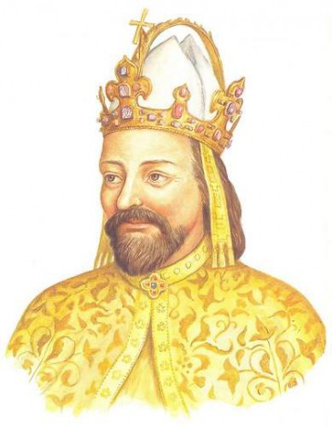
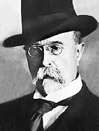
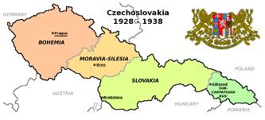
History
In the 6th century the Slavonic tribes came in our territory.
The first state was Samo’s Empire.
The Great Moravian Empire was formed in the 9th century.
Last king of Premyslid dynasty was Wenceslas III.
During the reign of Charles IV. - the Golden Age.
In the 16th century Habsburg dynasty got the Czech throne.
The 19th century is marked by the National revival.
Czechoslovakia existed from 28th November 1918.
T. G. Masaryk was first president.
Velvet Revolution in 1989.
In 1993 → the Czech Republic
and the Slovak republic.

Slide 9
International organization
Member of the United Nations (UN) and the Council of Europe (CE).
In March 1999 the Czech Republic joined the North Atlantic Treaty Organization (NATO).
In 2004 our country became part of the European Union (EU).

