Slide 1
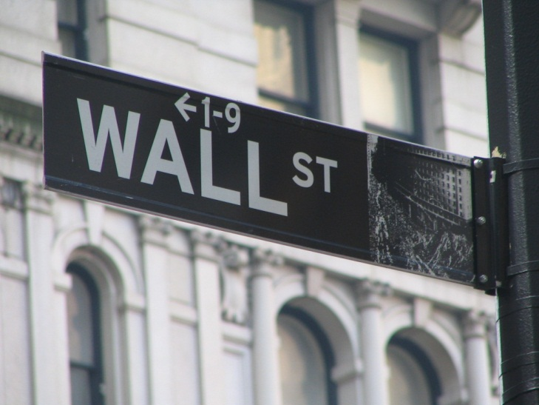
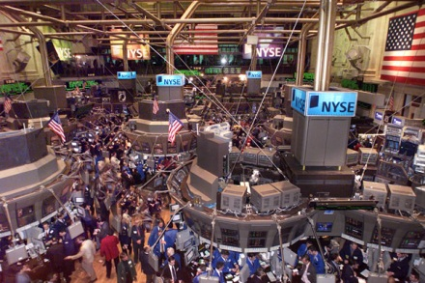
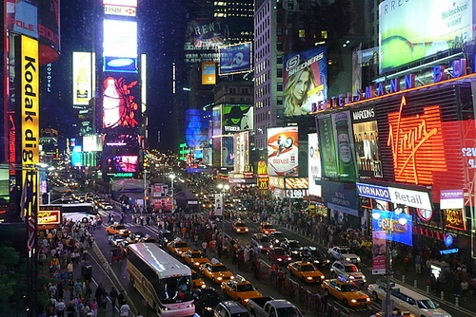
New York
Founded by Dutch explorers in 1625 as New Amsterdam
Now largest city in the U.S. – over 8 million inhabitants
Nickname: The Big Apple
Financial, commercial and cultural centre – Wall Street, NYSE, Broadway

Slide 2
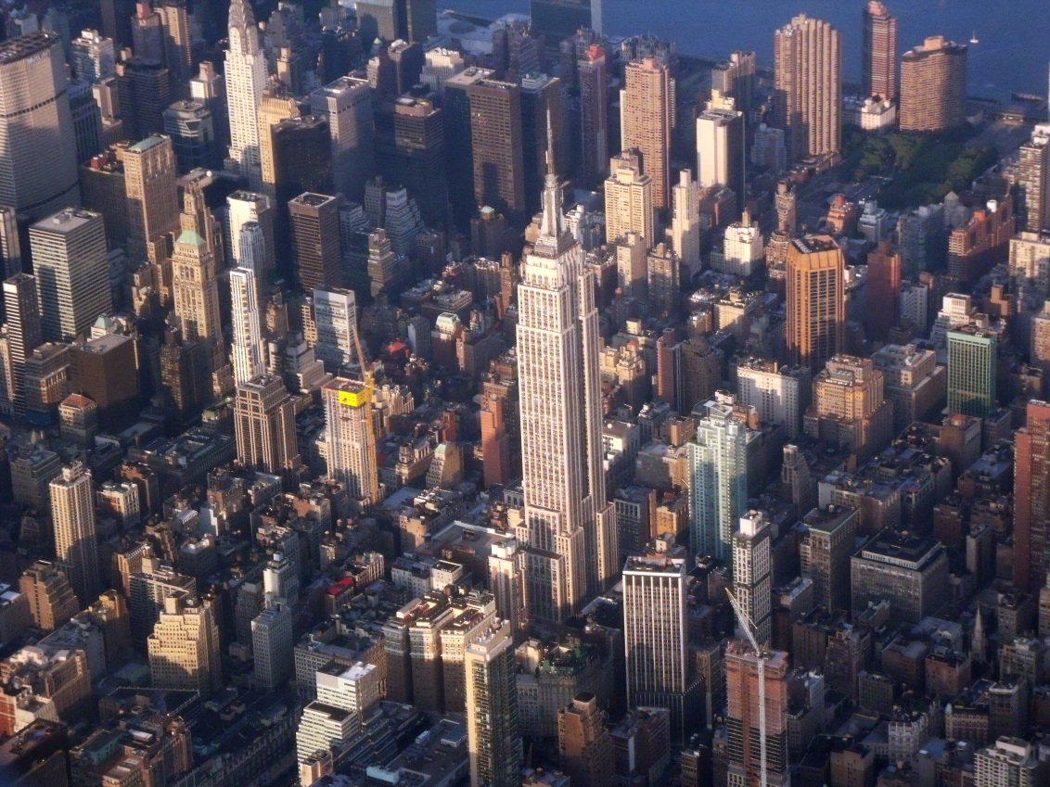
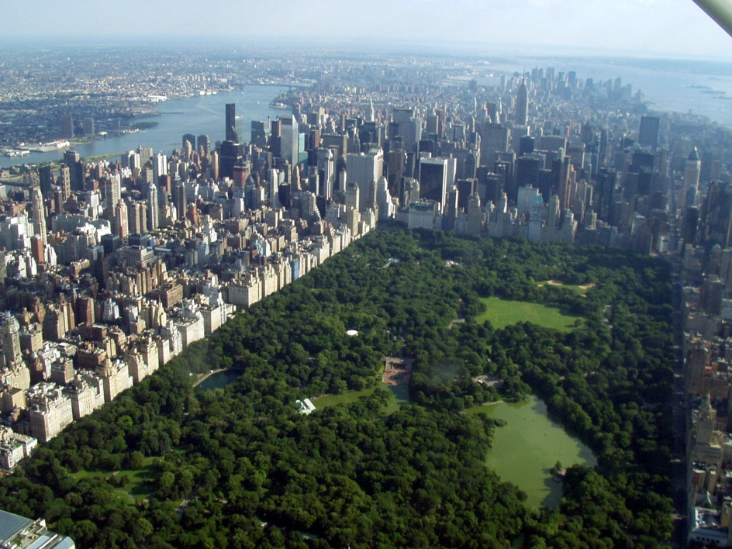
Divided into 5 boroughs: Manhattan, Queens, Bronx, Richmond, Brooklyn
Density of New York is over 27000 people per square kilometer
New York is cosmopolitan city with big minorities and great mixure of rases
Famous skyscrapers: Empire State Building, former Twin Towers, Chrysler Building
Places of interest: The Statue of Liberty, Times Square, Central Park, 5th Avenue, Medison Square Garden, Yankees Stadion and many others

Slide 3
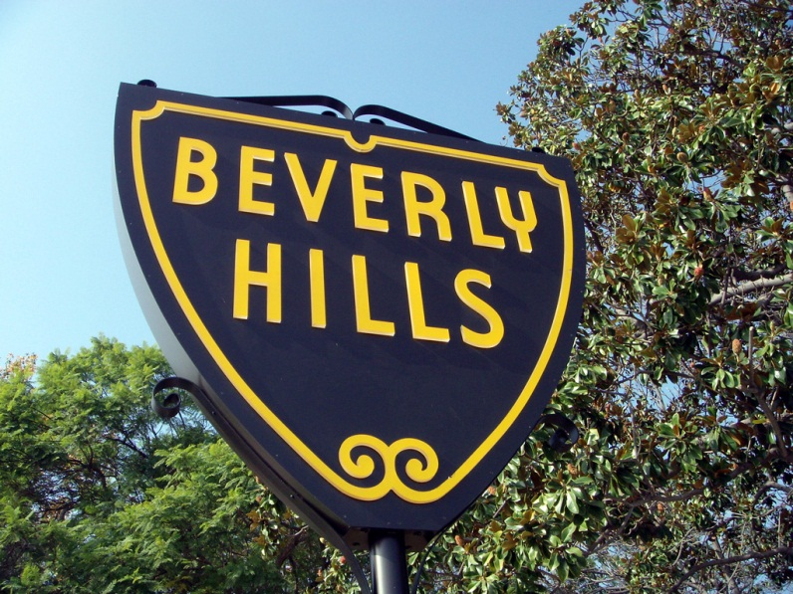
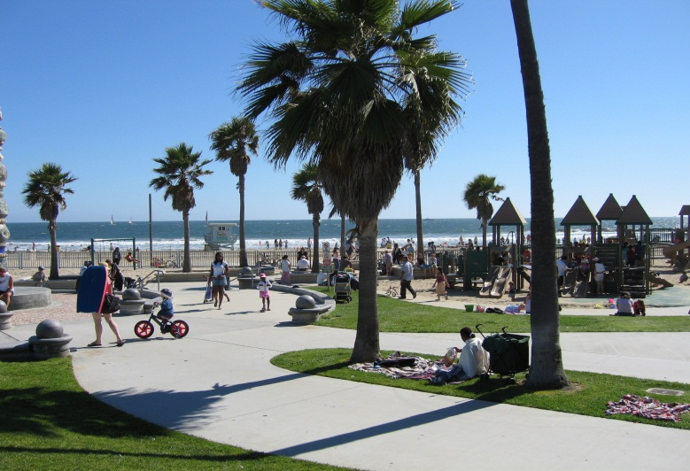
Los Angeles
The second largest city in the U.S. located on the west coast in California
In the past belonged to Mexico
Offical population is 3,5 million inahbitants (plus uncouted number of illegal immingrants)
Semi-tropical climate, palm trees, beaches
„Entertainment Capital of the World“
Hollywood, Beverly Hills, Palm Beach, Santa Monica
L.A. Lakers (basketball), L.A. Kings (ice-hockey), L.A. Dodgers (baseball), L.A. Galaxy (soccer)

Slide 4
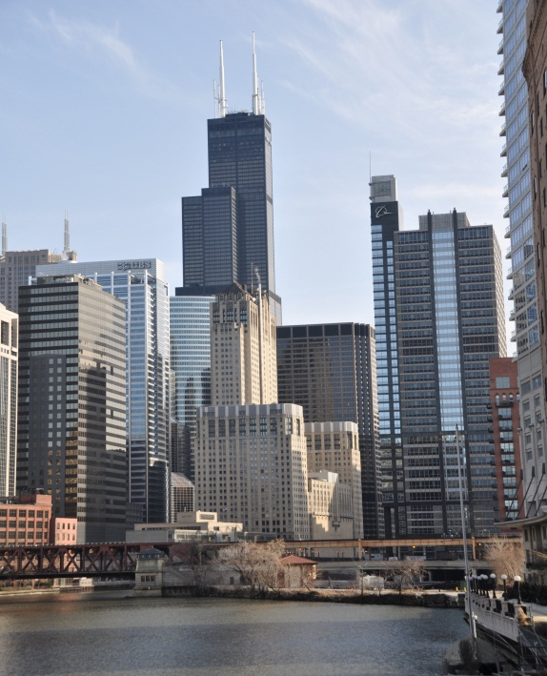
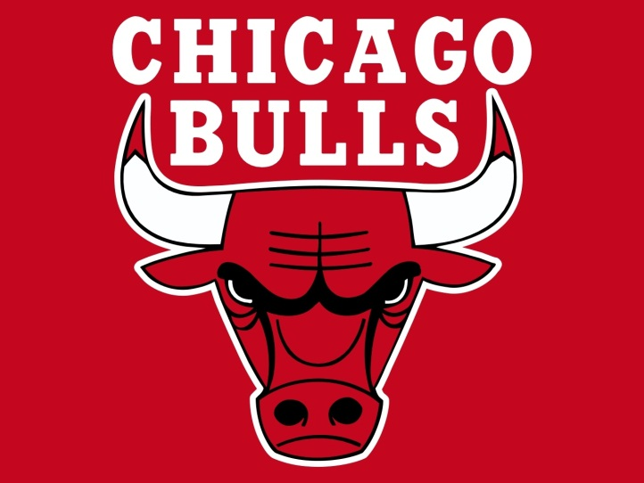
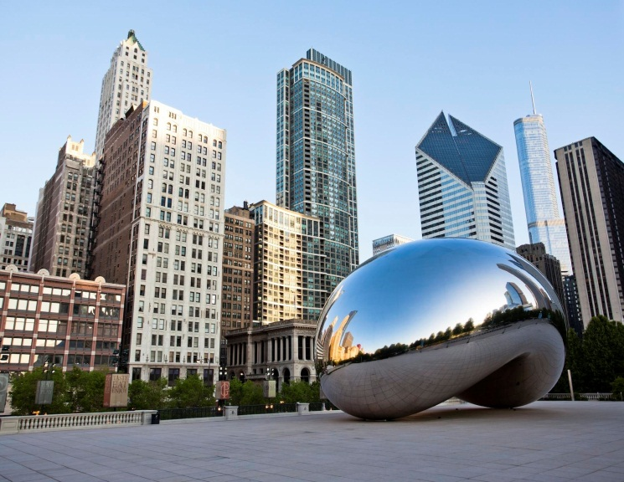
Chicago
The third largest city in the U.S. situated on the shore of Lake Michigan in state Illinois
„Windy City“ due to permant strong winds blowing from lake
Population of 2,7 million inhabitants, large Czech and Slovak community
Industrial centre – steel mills, headquaters of Boeing, McDonald´s or Motorola
Major transportation centre in the U.S.
Big cattle market founded in 1898 – Chicago Mercantile Exchange
Airport O´Hare – busiest airport in the world

Slide 5
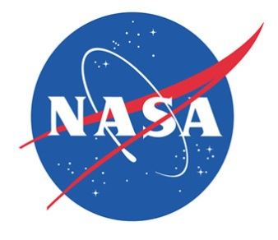
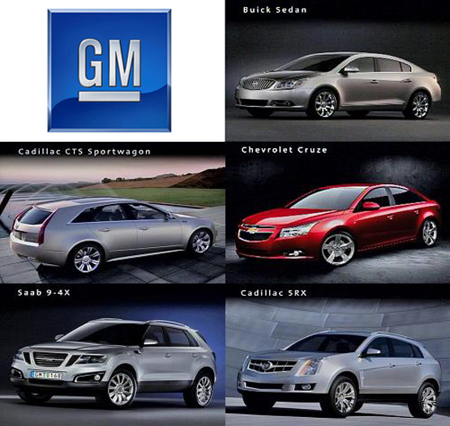
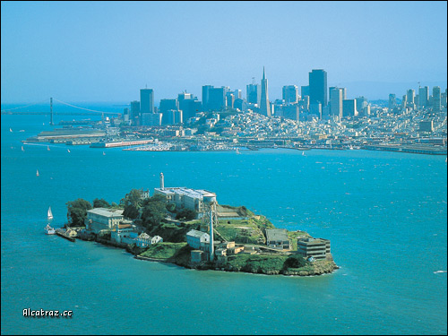
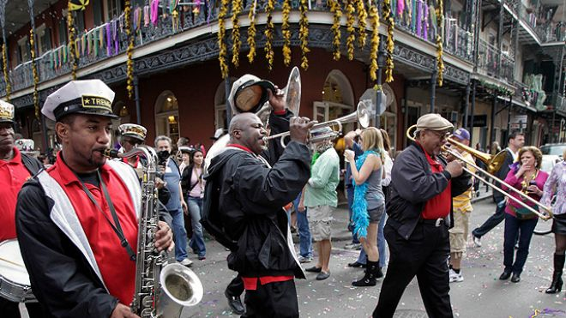
Other cities in the U.S.
Detroit, Michigan – The centre of the car industry in the U.S. (General Motors, Ford, Chrysler)
San Francisco, California – The city of Hippies, the Golden Gate Bridge and Alcatraz
Houston, Texas – centre of NASA (National Aeronautics and Space Administration)
Atlanta, Georgia – Headquaters of Coca-Cola Co.
New Orleans, Louisiana – The home of jazz (French Quarter)
Boston, Massachusetts – one of the oldest cities in the U.S., Boston Tea Party

