Slide 1
Crime and law

Slide 2
Law
system of rules
shapes politics, economics and society in numerous ways and serves as a primary social mediator of relations between people
we have many branches of law, for example:
contract law
property law
trust law
criminal law
constitutional law

Slide 3
Civil code
one of the most important codes of law
systematic collection of laws designed to comprehensively deal with the core areas of private law
each country has its own version, that can be different from other countries

Slide 4
Criminal law
also known as penal law
sets the definition of offences and penalties
tries to prevent people from committing a crime
sets down the punishments for crimes

Slide 5
Crime
violation of criminal law
person who commits crime = criminal
study of criminal behaviour = criminology
one of society's oldest problems
however, no country has developed completely reliable methods for mesuring the scale of and trends in crime yet
countries even vary greatly in their definitions of what crime is, and the reliability of their crime statistics
Notes:
Crime is something that has always been there and it also always will be. We cannot eliminate it completely or stop people committing crimes, because it’s impossible. The only thing we can do is to stop it from increasing by any kind on prevention - that means, for example, the education of young people or more strict punishments.
The main reasons for breaking the law are lack of money, problems in school, at work or family problems , mental issues, envy, drugs and alcohol and also “bad” friends. Sometime it’s really hard to find a way from this vicious circle of falling from one trouble right into another...

Slide 6
Types of crimes
crimes may be classified in various ways

Slide 7
Types of crimes
1) according to the victim of the crime:
offences against people
offences against property
offences against public order or morality
2) according to morality and relevancy:
indictable offences – arson, assault, murder, robbery...
statutory offences – violation of income tax laws, liquor licensing regulations, traffic laws, …
Notes:
- Indictable offences – most of them have been long forbidden by criminal law and religious law before that, and they usually involve severe punishments.
- Statutory offences – generally punished by fines or court orders

Slide 8
Indictable offences
criminal law divides them into three categories:
treasons
endanger security of the country or sovereign
for example spying for enemy country in the time of war
punishable by extremely long terms or imprisonment
felonies
crimes such as murder or robbery
punishable by imprisonment or death penalty
misdemeanours
minor crimes such as perjury

Slide 9
Specific examples of crimes
Crime | Criminal | Verb | Definition of the crime
arson | arsonist | to ignite | setting something on fire, causing harm to someone
assault |  | to assault | hitting another person deliberately
blackmail | blackmailer | to blackmail | making a person pay money under threat of secret or dangerous information being leaked
bribery |  | to bribe | offering or accepting money for doing something dishonest
burglary | burglar | to burgle | breaking into a house and stealing things
forgery | forger | to forge | making illegal copies of paintings, documents etc.
hijacking | hijacker | to hijack | taking control of a plane or boat by force
kidnapping | kidnapper | to kidnap | capturing a person and asking a ransom for their return
manslaughter |  | to kill | killing someone by accident
mugging | mugger | to mug | attacking someone to steal from them
murder | murderer | to murder, to kill | killing someone intentionally
perjury |  | to perjury | lying to a court
pickpocketing | pickpocket | to pickpocket | stealing someone’s valuables in public
rape | rapist | to attack, to rape | forcing a woman or a man to have sex
robbery | robber | to rob | stealing money or valuables from a person or a place
shoplifting | shoplifter | to shoplift | stealing things in shop
smuggling | smuggler | to smuggle | bringing goods into the country illegally

Slide 10
Terrorism
systematic use of terror to express opinion of a group of people (often connected with religion)
methods: bomb attacks, kidnapping, hijaking, holding hostages,…
states: Iraq, Aghanistan, Iran, …
terrorist groups: Al-Qaeda, Hamas, Taliban, ETA
events connected with terrorism:
attacks on 11th September 2001 in the USA
bombs in the London underground

Slide 11
Types of punishment
a fine | the person has to pay money to the court
community service | the person has to do some sort of helpful work in their local area as a punishment for the crime
death penalty | the person is punished by death
detention centres | the person is forced to be cured (of addiction etc.)
imprisonment | the person goes to prison for a fixed period
life sentence | the person goes to prison for the rest of his life
probation | The person has to stay out of trouble. Once a week he visits a “probation officer,” who asks about his behaviour
suspended prison sentence | The person doesn´t go to prison unless they commit another crime

Slide 12
What happens when someone commits a crime (in the UK)?
The criminal commits a crime.
The police investigate.
The police arrest the suspect.
The police charge the criminal.
The criminal is/isn't released on bail.
The trial starts.
The criminal goes to court.
The jury listens to the evidence.
The jury reaches a verdict.
The judge passes sentence.
The criminal is punished depending on the sentence.
The criminal is/isn't released on parole.
Notes:
When somebody commits a crime and the police will get the announcement, they will come to start an investigation. They search for the evidences as fingerprints, blood or DNA samples, weapons, simply for anything that would help them to find the culprit. They also question all the witnesses and base on their statements they catch the criminal or criminals, take them to a police station, question them and finally charge the offender with a particular crime.
After some time, if everything works how it should, the trial starts. The accused has to appear in court where judge and jury will decide (according to the proofs, statements of witnesses and speeches of lawyer and barrister) whether the person is innocent – then he or she is acquitted, or guilty. If the guilty is proved, a particular punishment follows.

Slide 13
Questions that are dealt with in connection to crime and law
Death penalty
some people wants to keep it, but some people say that it's immoral
Low age of criminal
in the last few years there is a rising number of young criminals

Slide 14
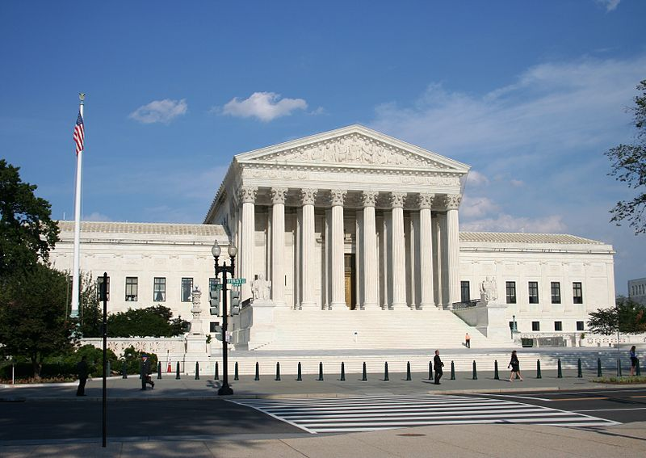
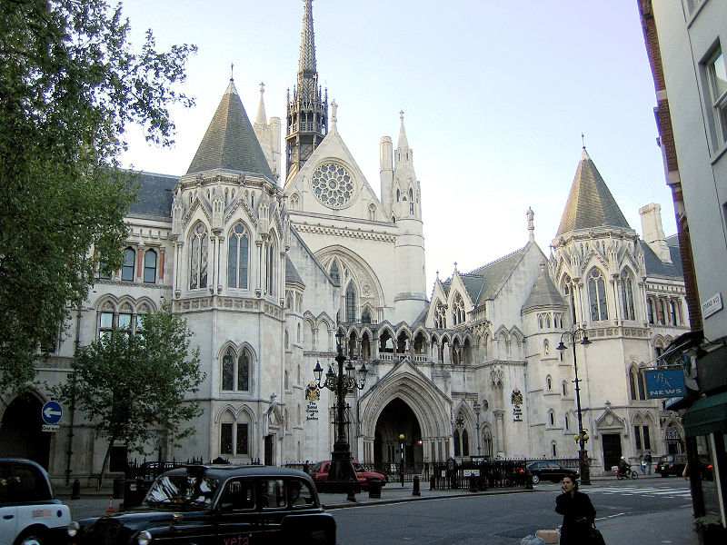
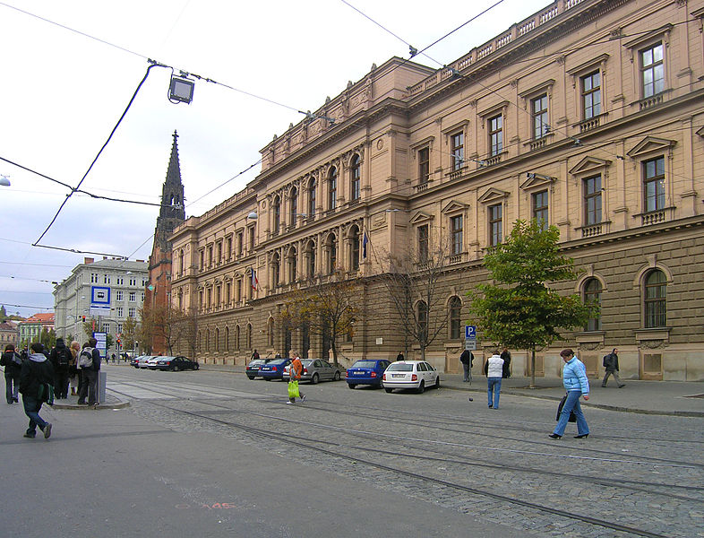
Important courts of UK, USA and Czech republic
Supreme Court of the United States
(New York)
High Court of England and Wales
(London)
Constitutional Court of the Czech Republic (Brno)

