Slide 1
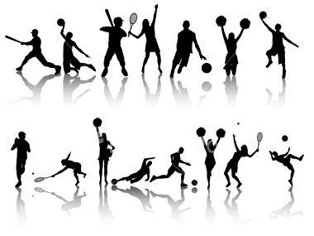
Sports

Slide 2
Why should we do sport?
Relaxation
Loose some weight
Improves skills
Good feelings

Slide 3
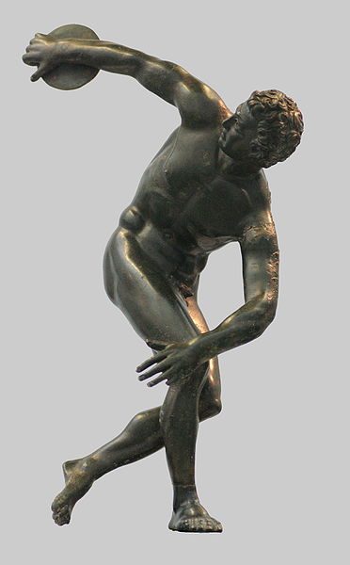
History
Chinese started in sporting activities around 4000 BC and the most popular sport was gymnastics
Egyptians established javelin throwing, high jump or wrestling
The biggest development of sports started by the time Greece
Greeks created the Olympic games
which took place in the Olympia village

Slide 4
Sports
Indoors
Outdoors

Slide 5
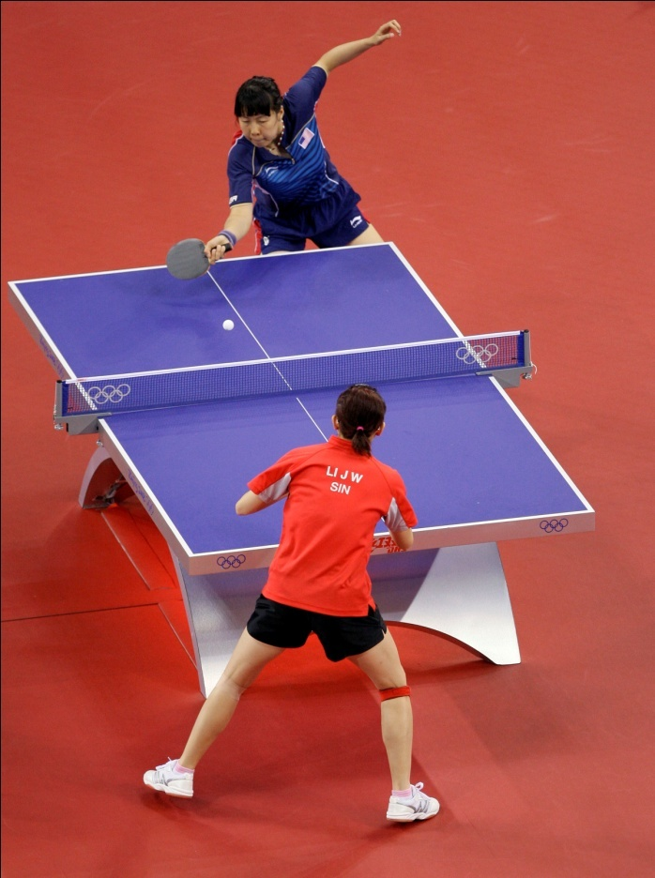
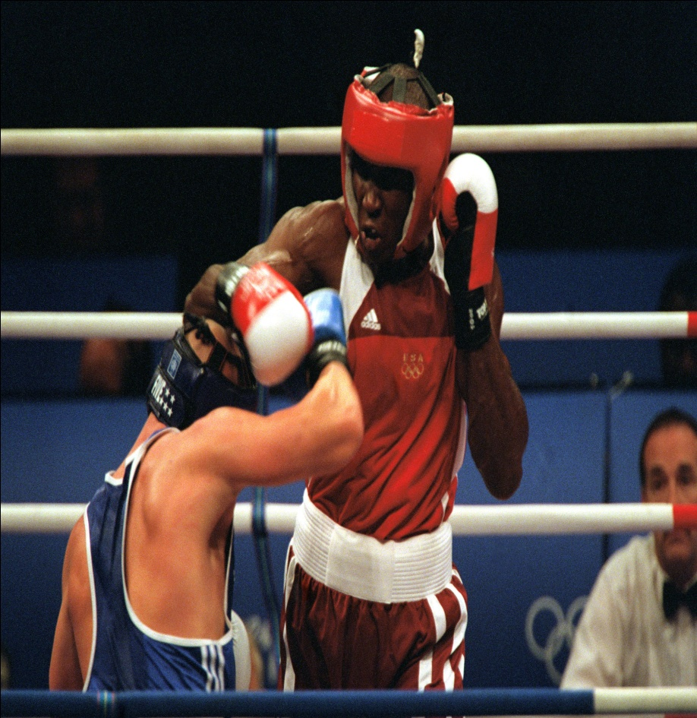
Indoors
Gymnastics, table tennis, boxing, wrestling etc.

Slide 6
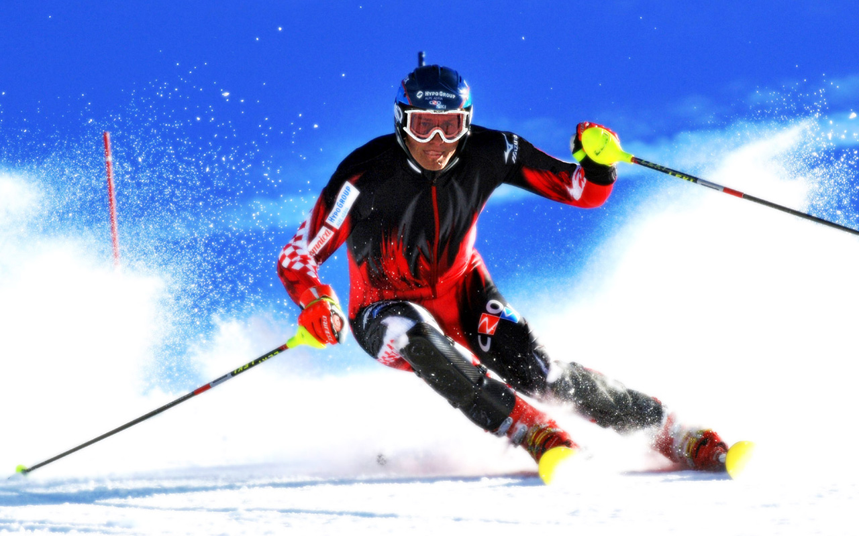
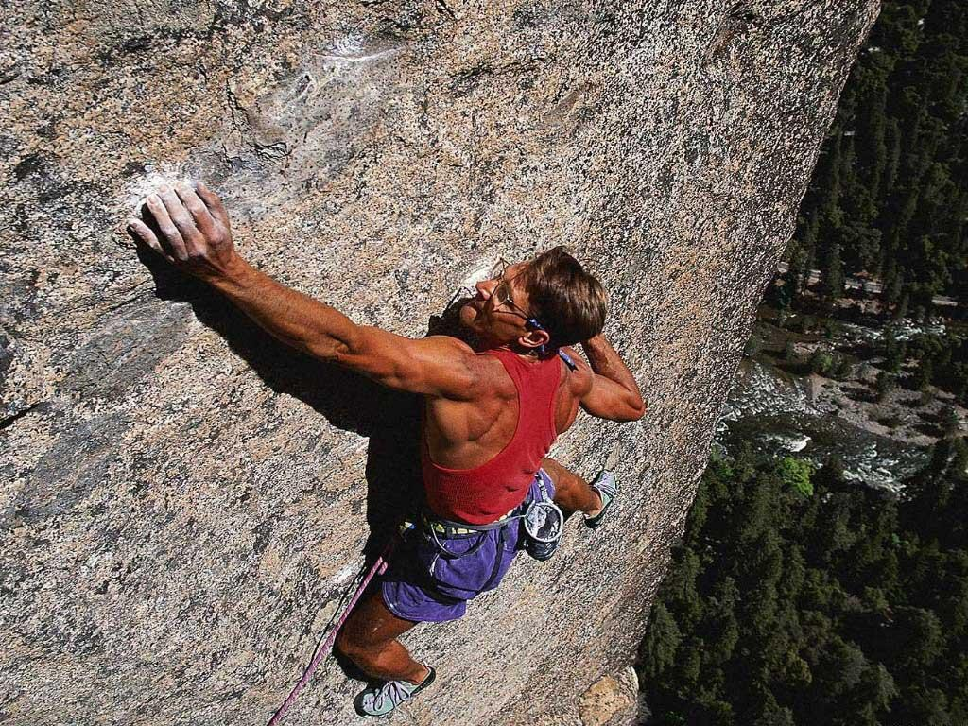
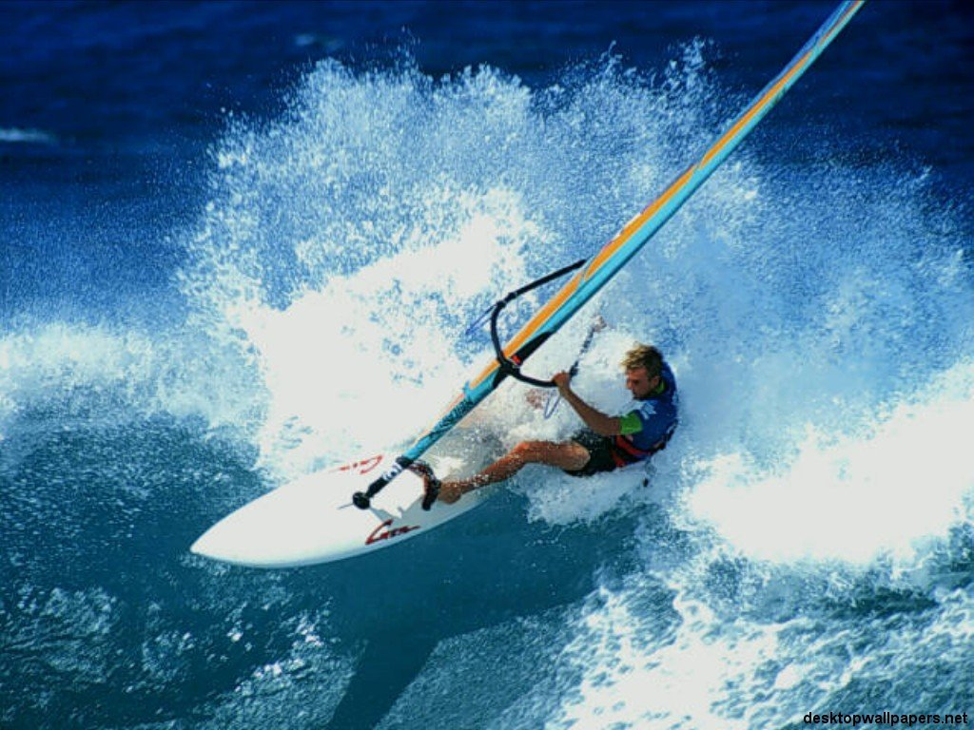
Outdoors
Skiing (down-hill, cross country, slalom, ski jump), sledding, hiking, rock climbing, golf, windsurfing etc.

Slide 7
But most sports can be done both indoors and outdoors
Meetings in all the track and field events take place in summer stadium as well as in athletic halls
Sports which can be done on ice or snow are winter sports, others are all-season

Slide 9
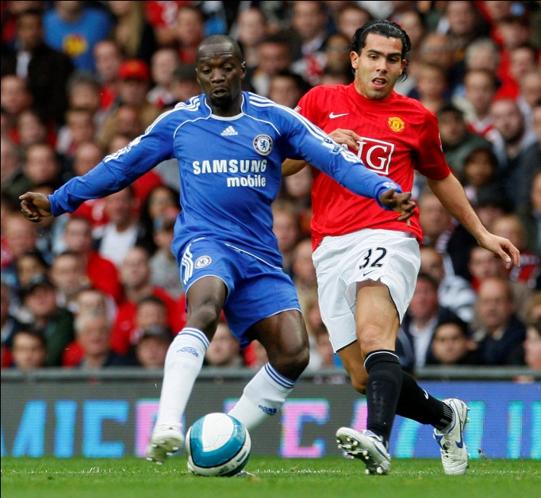
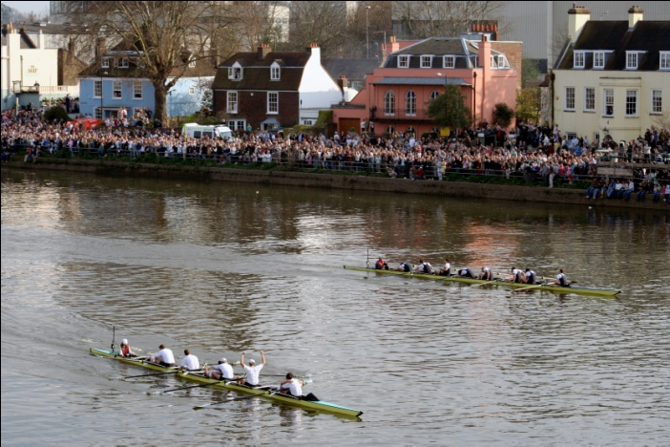
Great Britain
Lovers of competitive sports
Most popular is football → Aston Villa, Liverpool, Manchester United etc.
Rugby football
Horse-racing → “Steeple chase race”
Rowing→ Oxford and Cambridge on the river Thames
Tennis → Wimbledon
Golf → root in Scotland

Slide 10
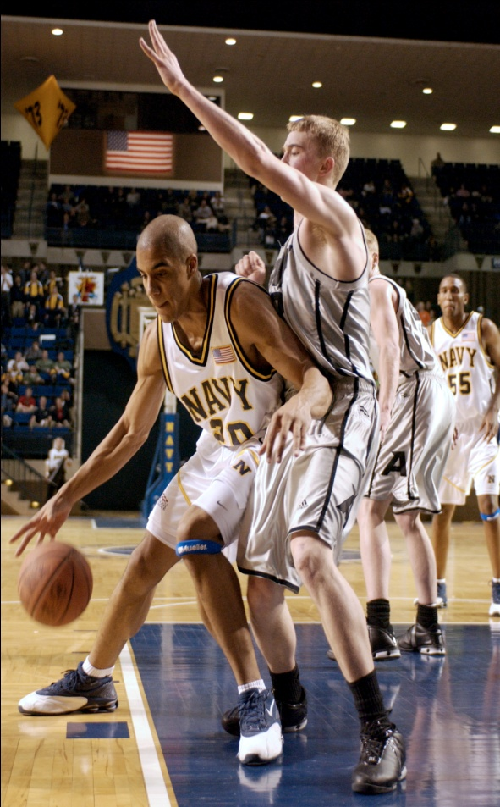
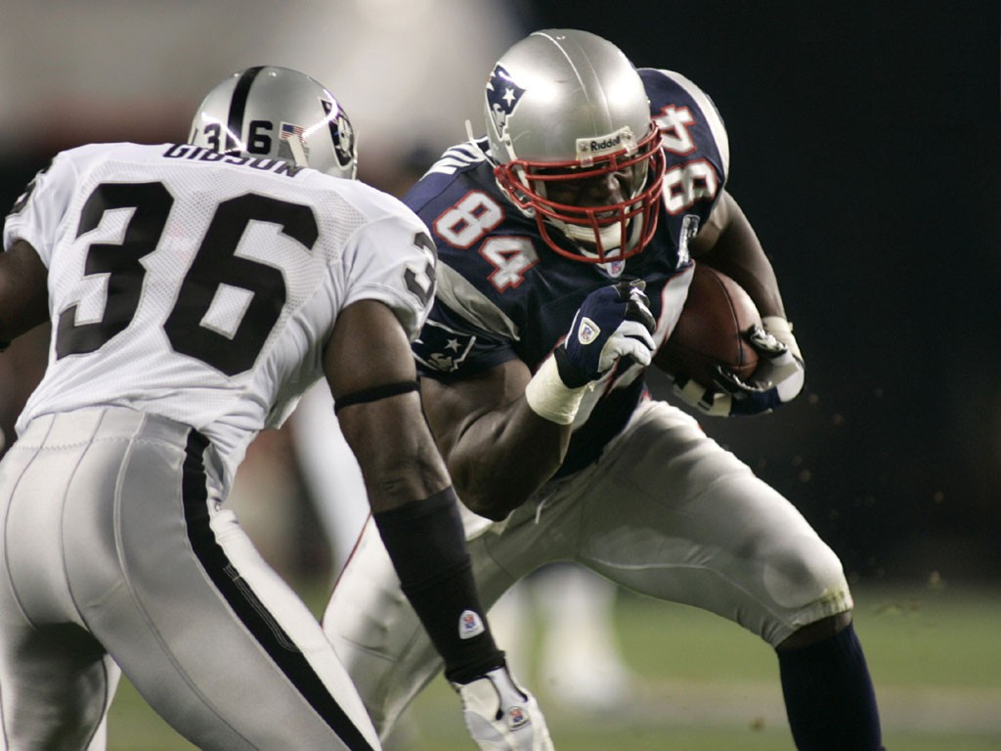
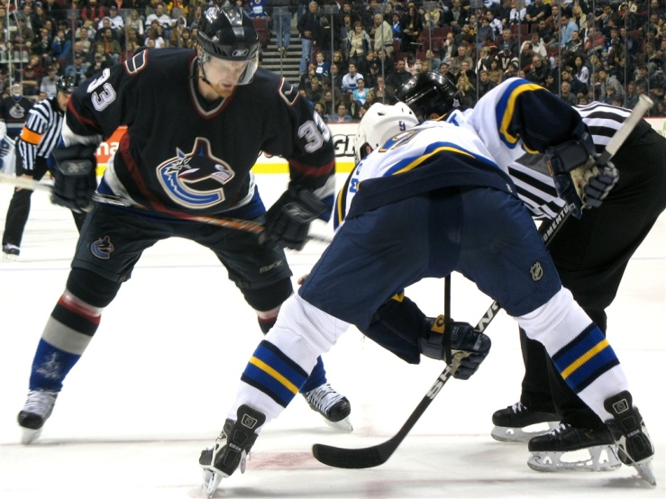
The USA
Hockey
Baseball
Basketball
American football
Lacrosse
Field hockey

Slide 11
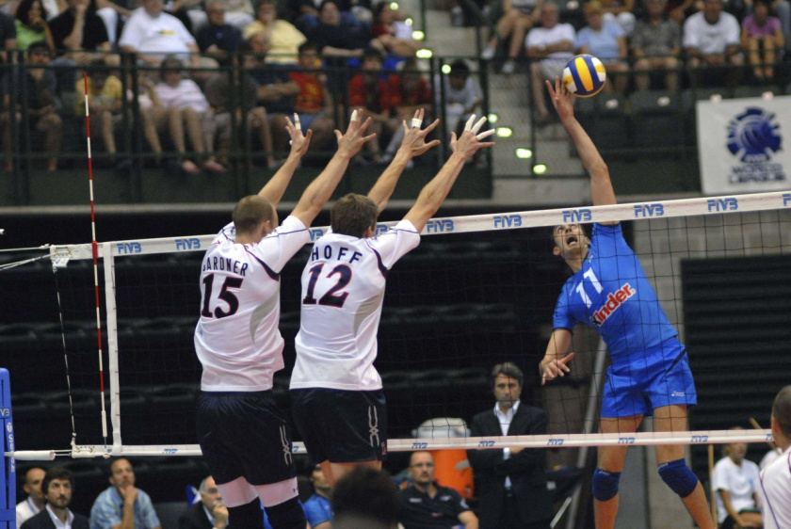
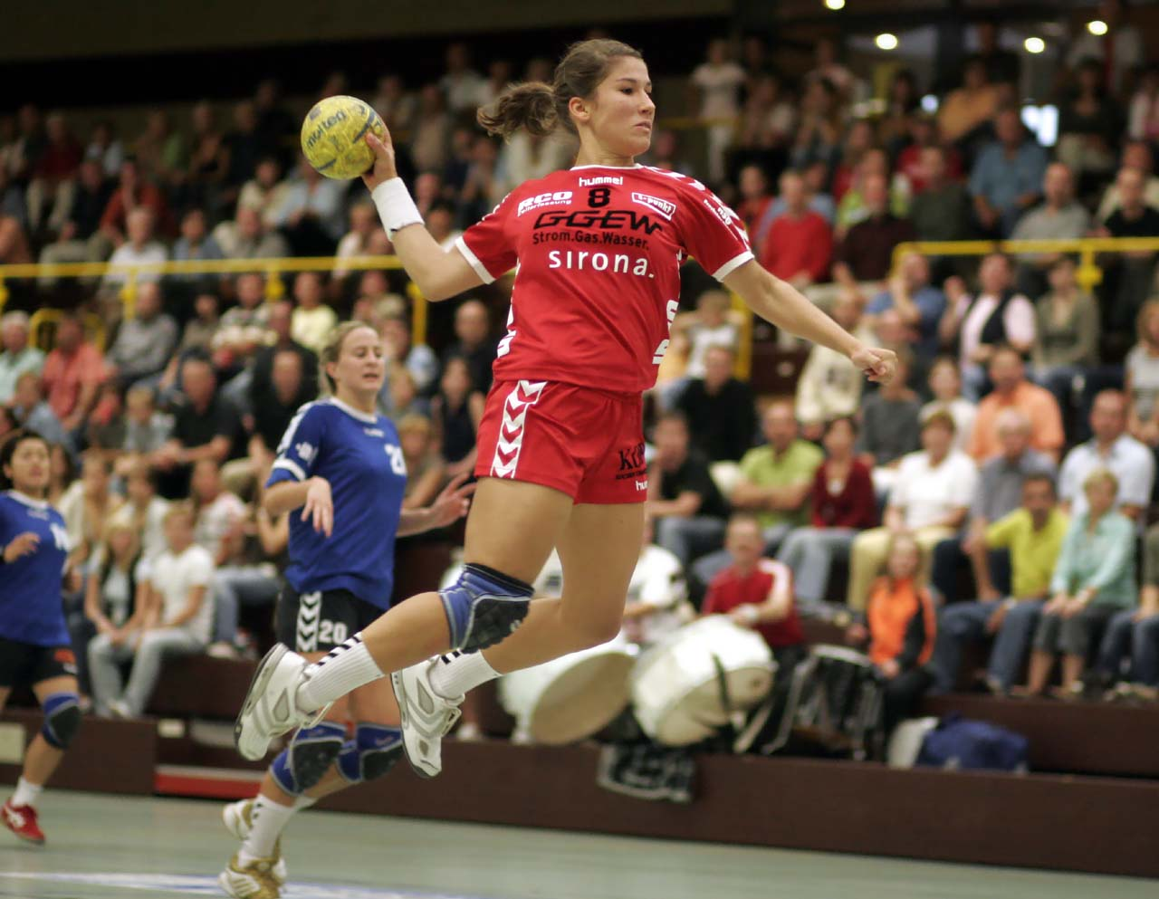
The Czech Republic
The most popular are ball games
Football
Volleyball
Basketball
Handball

Slide 12
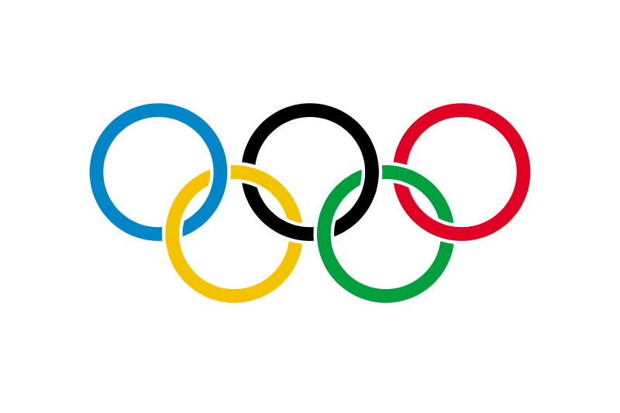
Activities
Any moment anywhere in the world are many competitions or championships in each kind of sport
The Olympic games
Watching sport events
Bet on certain sport result

Slide 13
“The most important thing in games is not to win, but to take part. “

Slide 14
Information source:
Materials for school-leaving exam

