Slide 1
19. Holidays & Festivals

Slide 2
The United States

Slide 3
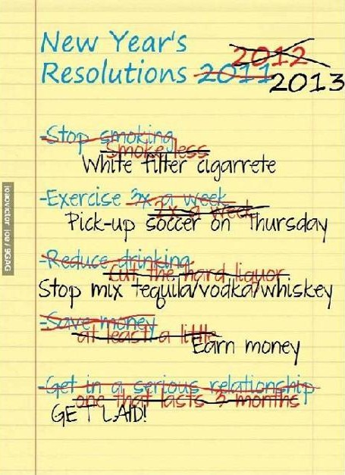
New Year´s day
New Year´s day –
most of the people
are home, resting
from previous evening
(parties, celebrating New
Year)
New year´s resolution
( dont smoke, to loose
weight…)

Slide 4
Martin Luther King´s day
The third Monday in January
To honor his fight for civil rights , he was assassinated
President´s day
Third Monday of February
Firstly it was to honor americans first president = Georg Washington
Nowdays Americans celebrate this day to honor all their presidents

Slide 5
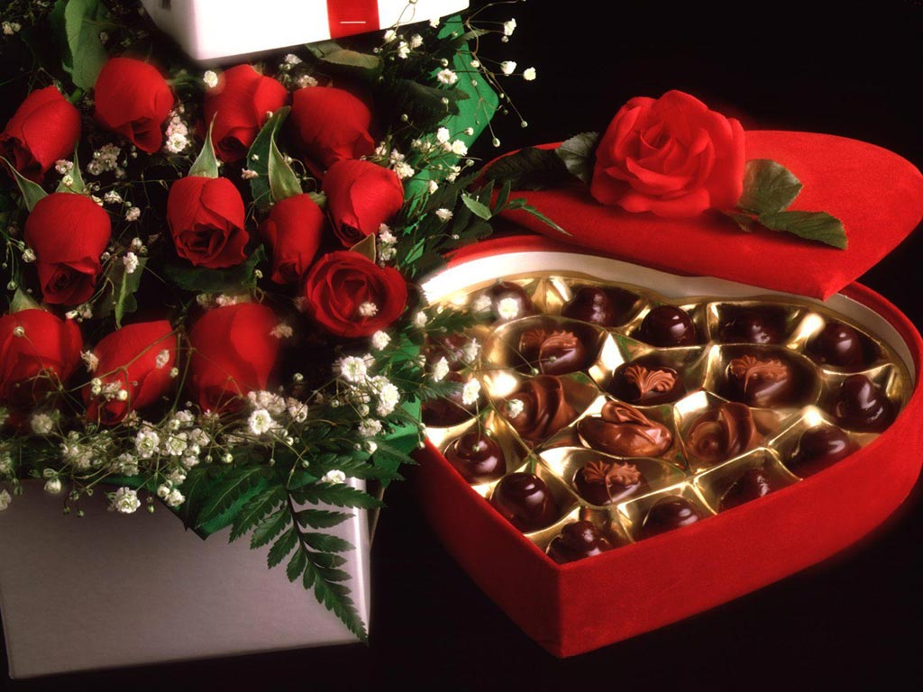
14 th February - Valentine´s day
Lover´s day, people send cards, get presents, flowers…
It is very popular in the USA,Canada…
Couples go out, have a romantic dates
(=huge bussiness) Single people are depressed
many people send a card to the one they love
or someone whom they have fallen in love with
St. Valentine- legend says that Valentine was a priest, who served during the third century in Rome. Claudius II decided that single men made better soldiers than those with wives and families, he forbid marriage for young men.
Valentine defied Claudius and continued to perform marriages for young lovers in secret. When Valentine's actions were discovered, Claudius ordered that he be put to death

Slide 6
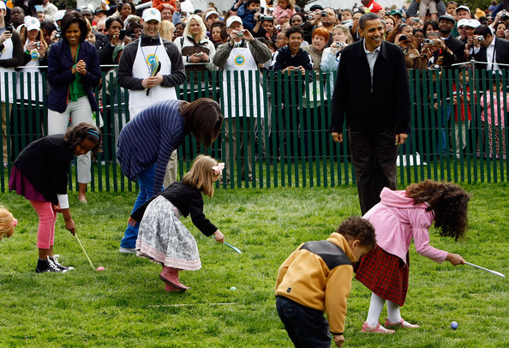
Easter
Not a national holiday
dyed eggs, sweets
Parents hide eggs, children look for them
Interesting fact:
Easter Egg roll- in front
of White house on
Easter Monday

Slide 7
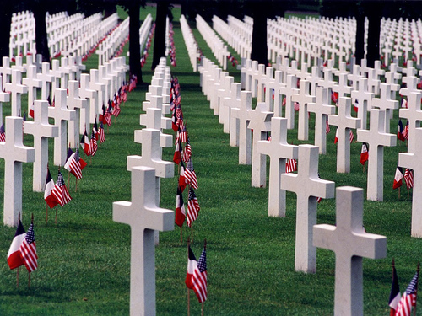
Memorial day
Fourth Monday in May
honours all Americans killed in past wars and all the dead
flowers and flags are placed on graves
Procession in Washington D..C
It is also beginnig of
summer season

Slide 8
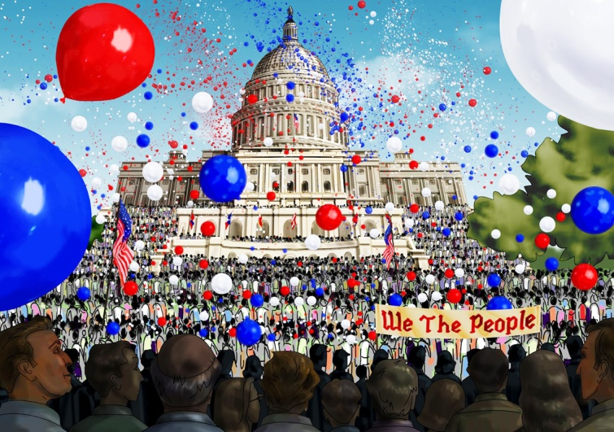
Independence Day
4 th July
American´s national day -commemorates Declaration of Independence 1776 and establishing USA
each state its own ceremony, parade
concerts and fireworks in the evening , barbecues, carnivals, fairs,
picnics, concerts, baseball
games, family reunions…

Slide 9
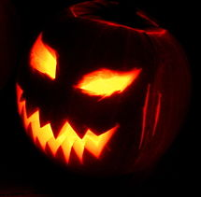
Halloween
31st October
Children wear costumes and they go to peoples' homes saying "Trick or treat!" to ask for candy, sweets
People sometimes dress up as ghosts, witches, goblins and other scary things for Halloween
Origin: Wiccans and modern Pagans celebrate the Day of the Dead. It is the day that the souls of dead people come back to Earth

Slide 10
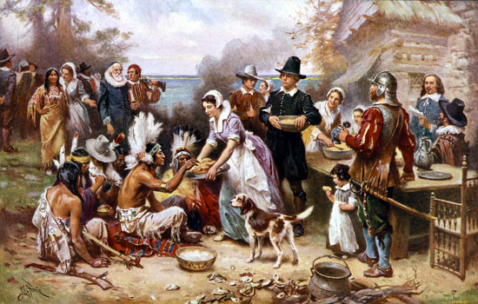
Thanksgiving
Fourth Thursday in November
The event that Americans commonly call the "First Thanksgiving" was celebrated by the Pilgrims after
their first harvest
in the New World,
in 1621

Slide 11
Celebrating of Thanksgiving
Food : roasted or baked Turkey, mashed potatoes with gravy, sweet potatoes, cranberry sauce, sweet corn,various fall vegetables(mainly various kinds of squashes), and pumpkin pie( apple, blueberry pie) with ice cream
The National Football League has played games on Thanksgiving every year since.
The Detroit Lions have hosted a game every Thanksgiving Day since 1934, with the exception of 1939–1944 (due to World War II)

Slide 12
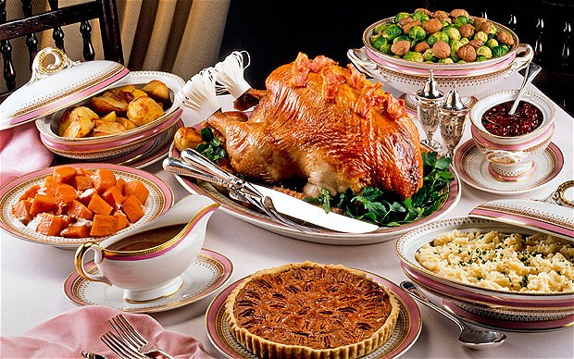

Slide 13
The United Kingdom

Slide 14
In the United Kingdom, we call official days off bank holidays.
Banks and many other businesses are closed for the day.
National Holidays:
New Year‘s Day (1 January)
Good Friday
Easter Monday
May Day (first Monday in May)
Spring Bank Holiday (last Monday in May)
Summer Bank Holiday (first Monday in August)
Christmas Day (25 December)
Boxing Day (26 December)

Slide 15
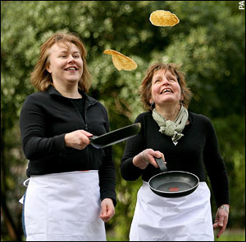
Ash Wednesday & Pancake Day
Ash Wednesday - Christian period of Lent begins.
( Christ went into the desert and fasted for 40 days.)
Pancake Day – Tuesday before the Ash Wednesday,
Some towns hold pancake races on that day.
People run through the streets
holding a frying pan and throwing
the pancake in the air.

Slide 16
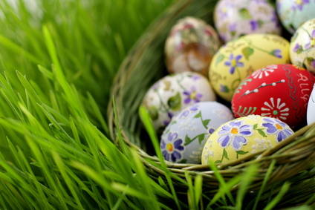
Easter
At Easter time, the British celebrate the idea of new birth by giving each other chocolate Easter eggs which are opened and eaten on Easter Sunday. On Good Friday bakers sell hot cross buns.
Easter Monday – many people travel to seaside, or they go to watch some sporting.

Slide 17
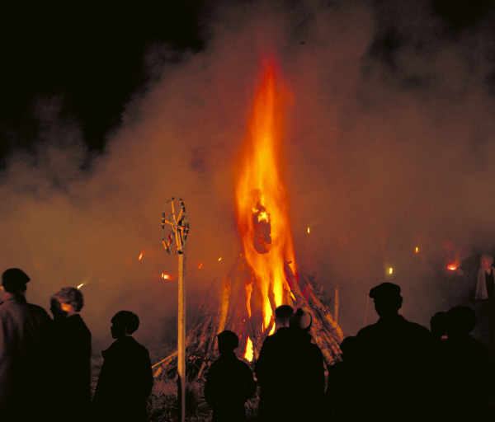
Guy Fawkes Day
5 November
In 1605 King James I. was on the throne. He was very unpopular with Roman Catholics. They planned to blow up the Houses of Parliament on 5th November. 36 barrels of gun powder under the House of Lords were to be exploded by a man called Guy Fawkes (arrested and hung).
Since that day British celebrate
5th November by burning dummy
made of straw and old clothes,
on a fire, and they let off fireworks.

Slide 18
The Czech Republic

Slide 19
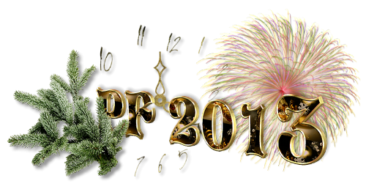
New Year´s Day
We eat soup from lentils for having enough money during the year.

Slide 20
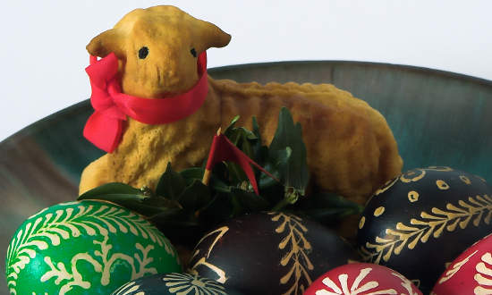
Easter
This time is celebrated especially in Christian families.
On Easter Monday boys come to houses begging for eggs and sweets while saying special carol, they hold braided whip made from willow twigs, which they use to hit girls. This is done for girls being pretty. People give them coloured eggs.
We traditionally bake a small
cake called lamb, which is
covered by chocolate.
On Easter Day people usually have turkey with stuffing.

Slide 21
The Day of Slavic Apostles Cyril and Methodus
5th July
This day we commemorate the arrival of Slavic apostles Cyril and Methodus who came to the Greatmoravian empire to spread out the Christianity. They came in 863 for appeal of prince Rastislav. They spread out Christianity in a special languge which was easy for ordinary people to understand it.

Slide 22
The Day of Mistr Jan Hus
6th July
This day we commemorate the burnt of Mistr Jan Hus who was burnt in 1415. He was the propagator of Christianity and he preached his religion in Bethlem Chappel in Prague. He was accused of bad preaching and 6.7.1415 he was burnt.

Slide 23
17th November
On 17th November 1939 was burried a victim of Nazism - a student Jan Opletal.
International Day of Students.
50 years after the funeral of Jan Opletal, students decided to make a demonstration. They went to the centre of the city - one of the students was killed.
This supported many other people to show what they thought about the political system in our coutry. They went to streets and clinked with their keys. This finished the comunism and our country went on to democracy.
17th November 1989 = velvet Revolution.

Slide 24
Christmas

Slide 25
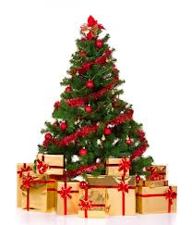
Christmas
The most important festival of the year
( the Christian celebratin of the birth
of Christ + the traditional festivities of winter )
Every country( The UK,The USA, The Czech republic, Autralia, New Zealand and Canada) has a same base of this holiday
celebrate a birth of Christ, be together with family, get a presents, eat a lot of food, have a rest of work,school…

Slide 26
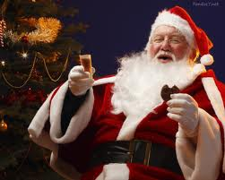
USA
The christmas season starts after Thanksgiving
(= buying gifts, have a decorated house, x-mass tress…)
The evening (24.12) before Christmas day families are together, have a meal (usually the same as for the thanksgiving)
In the morning they unwrap
gifts, then have a lunch.
Children believe that gifts come
from Santa Claus who lives in the North Pole

Slide 27
the United Kingdom
Most families decorate their houses with holly.
On 24th December children leave a long sock somewhere in the house - Father Christmas bring them small presents, fruit and nuts.
On Chrismas Day the family sits down to a big turkey dinner followed by Christmas pudding.
The Queen delivers her traditional Christmas message on TV.
26th December = Boxing Day is the time to visit friends and relatives or watch one of the many sporting events.

Slide 28
The Czech Republic
People are supposed to fast all day to see the "golden piglet„ in the evening.
Dinner is served after sunset and consists of carp and potato salad.
Some families keep their carp in the bath for several days.
A traditional Christmas bread is called vánočka.
After dinner are sung Christmas carols.
The presents are placed under the tree. Czech children believe that Christmas gifts are brought by Baby Jesus
Some people attend the midnight mass at a local church.
On the First and Second Christmas Holidays families stay at home and relax or visit relatives.

