Slide 1
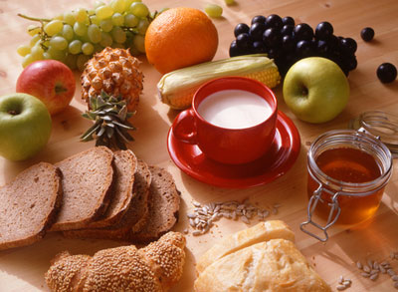
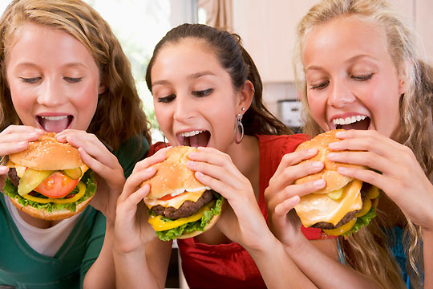
Eating habits

Slide 2
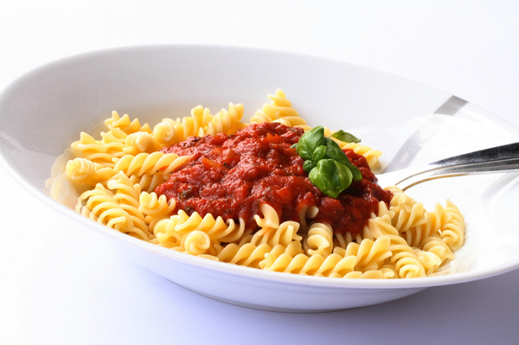
Food
Food is necessarily for our life
Different people have different tastes and each country has different eating habits
Healthy and balanced food
Five times a day:
Breakfast - energy to start a new day
Snack
Lunch
Snack
Dinner
Right water intake is important

Slide 3
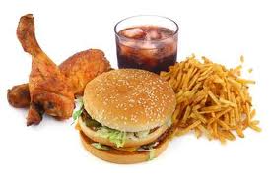
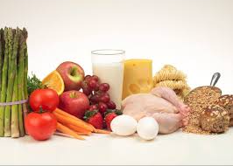
Healthy and unhealthy food
Unhealthy food: fatty food such as pork, beef, fried food etc., sweets and candies
Healthy food: fruit, vegetables, poultry (chicken, hen, duck, goose, turkey), fish, rabbits, soja, cornflakes, dark bread, honey, milk products, nuts…

Slide 4
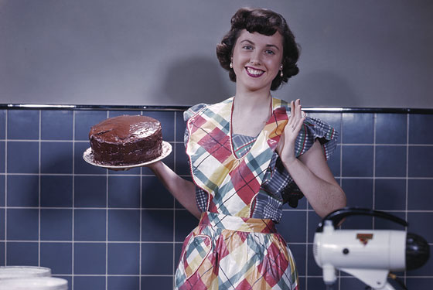
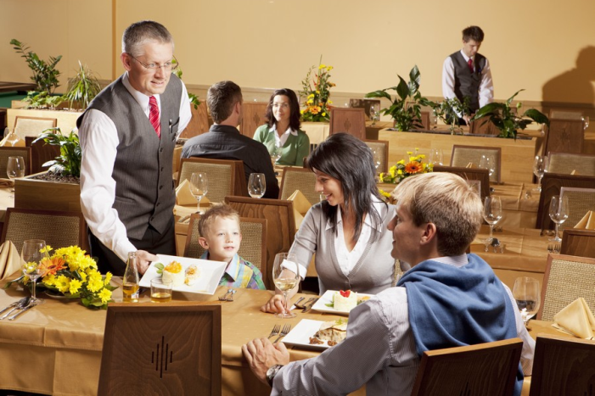
Places for eating
Basic dividing:
Home
Out – restaurants, fastfoods, canteens..
Fastfoods – can cause health problems such as obesity

Slide 5
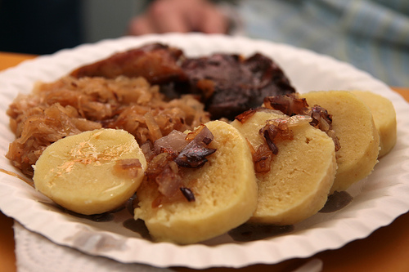
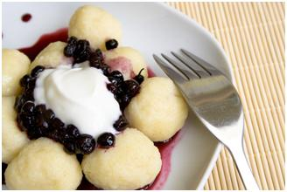
Czech cuisine
Traditional Czech food is very tasteful and varied
Unfortunately, it does not correspond with a healthy life style very much because of its high calories content
Traditional Czech food is roast pork with dumplings and cabbage
Sweet food - the fruit filled dumplings or pancakes

Slide 6
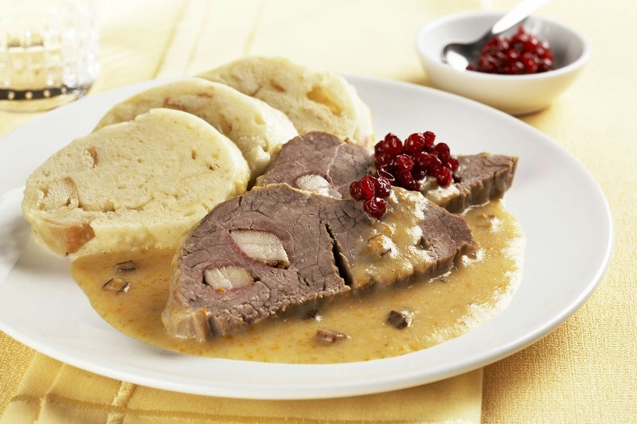
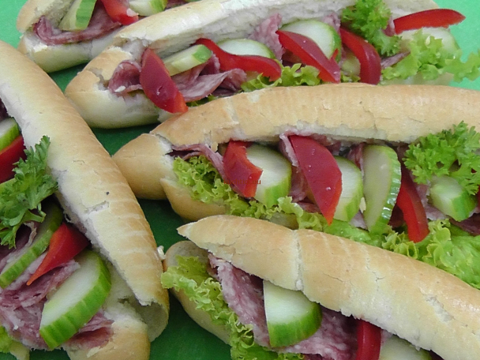
Mein meals during the day in the Czech Republic
Breakfast: light meal, usually bread and butter, rolls with cheese or ham, cakes, cereal(s), cornflakes etc., cocoa, milk, tea, coffee…
Lunch: soup, the main dish and a dessert
Dinner: usually a warm or a cold dish

Slide 7
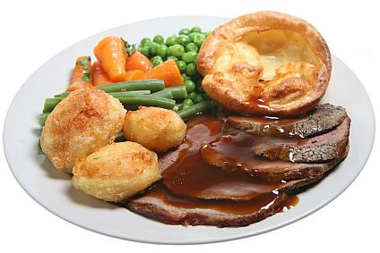
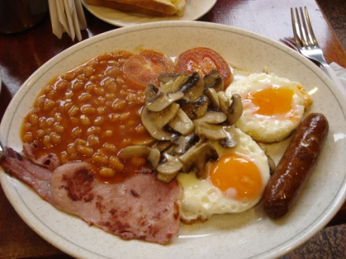
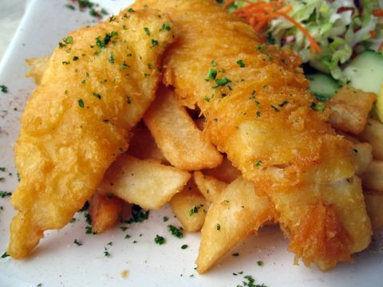
Eating habits in the UK
Breakfast
„English breakfast“ – very big – bacon, eggs, sausages, baked beans, fried bread, tomatoes and mushrooms
A normal breakfast – cereal with milk, toast
Lunch
Light meal, usually some sandwich, biscuits, fish and chips, hamburger, potatoes or vegetable
Kids usually eat at school; workers in the factory canteer, fast food restaurants,…..
Dinner
The main meal, typical dinner is a meat dish with vegetables and a dessert

Slide 8
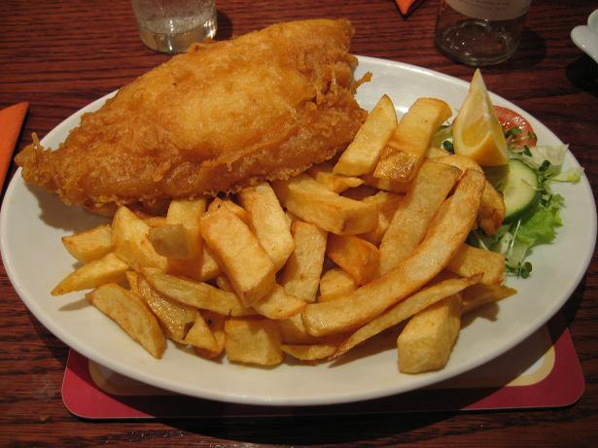
Tea
Usually around five o´clock
They put milk in their tea
Tea time is a time to talk
Takeaways
Ready-cooked food
You take it home to eat
For example – Chinese, and fish and chips

Slide 9
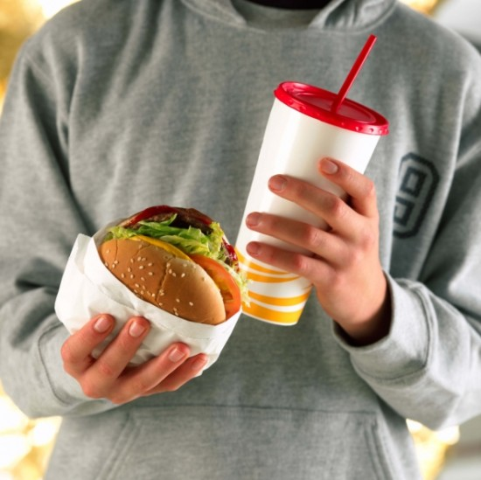
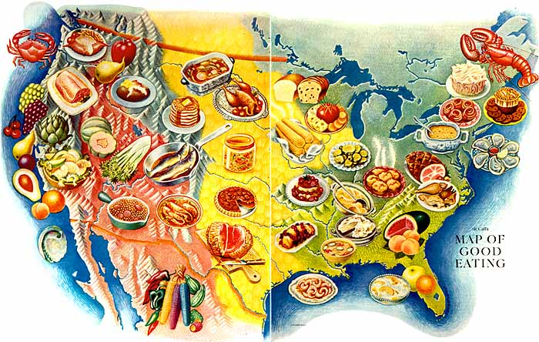
Eating habits in the USA
Americans eat a lot and they love junky food
They don´t like to eat at home and very often go to restaurants
Americans are said to eat unhealthy – they eat too much fast food
Typical american food: popcorn, peanut butter, jelly, hamburgers and fries

Slide 10
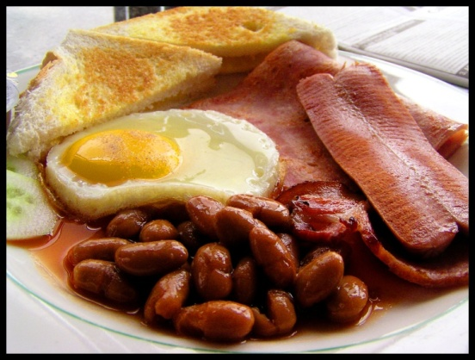
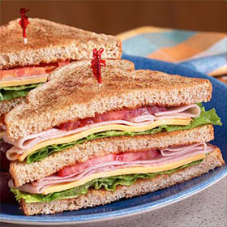
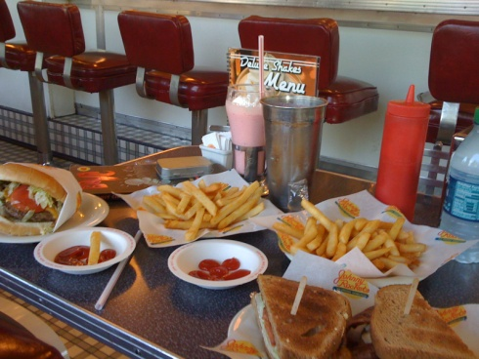
Breakfast
donut, full meal or bowl of cereals,
pancakes, eggs, toast, bagel
„Brunch“ = breakfast and lunch together
Blueberry muffins, croissants, hash browns, eggs
Lunch
Their smallest and most casual meal
Sandwich, soup, noodles or a jogurt and some fruit
Dinner
The biggest meal of the day
Consists of meat, carb and at least one vegetable

Slide 11
Interesting facts about american eating habits
Only 3 in 10 Americans believe that all sources of calories play an equal role in weight gain.
75 percent of Americans say they choose products that are lower in total fat at least sometimes.
20 percent of all American meals are eaten in the car.
At least 1 in 4 people eat some type of fast food every day.
Americans consume 31 percent more packaged food than fresh food.
Healthiness of the food we eat decreases by 1.7 percent for every hour that passes in the day.
Over 10 billion donuts are consumed in the US every year.
Americans spend 10 percent of their disposable income on fast food every year.

