Slide 1
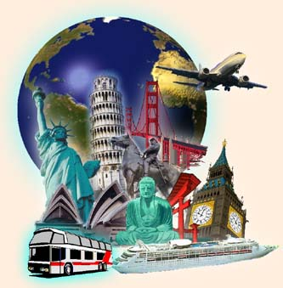
TRAVELLING

Slide 2
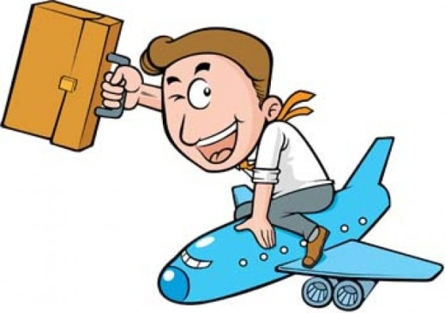
GENERAL INFORMATION
Method how to get from one place to another place
One hundred years ago people travelled on horses, by carriages or on foot
Then they used trains, steam cars and steam boats
Now is travelling very popular, common and necessary
Two main ways of travelling – you can use your own means of transport and the other is to rely on the public transport

Slide 3
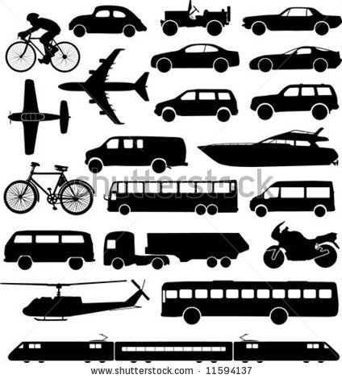
MEANS OF TRANSPORT
By bus
by plane
by train
by bike
by car
on foot
on boat
Hitchhiking
doubble decker
For young – skateboarding, roller-skating,…
Tram
Taxi
Underground
Hot-air ballooning
Windsurfing
Going on yacht…

Slide 4
ON BOAT
Water transport is relatively cheap but quite slow
Used especially for transporting goods
There are cargo and passengers vessels, ferries and steamboats on the rivers, seas and oceans
In general not many people have the courage to board a ship although the trip is not expensive (probably because of fear of seasick)

Slide 5
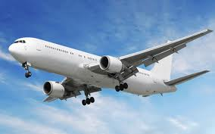
BY PLANE
Fastest way of travelling but also the most expensive one
People in the Czech Republic normally take plane when they go abroad (our country is very small, it is not worth to take a plane for a small distance)
At the airport we go through the passport control and security check, our luggage are checked in and then we wait until the plane is ready for take-off

Slide 6
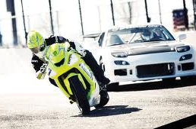
BY CARS AND MOTORCYCLES
Very popular however quite expensive
For short distance is car fast enough but when you travel by car in a town, you can get to a traffic jam
Modern cars are very comfortable
To drive a car/motorbike you have to have a driving licence, you can get it in a driving school
In the most countries of Europe people ride on the right but in Britain and some other countries people drive on the left
Bad for nature; a lot of gasses

Slide 7
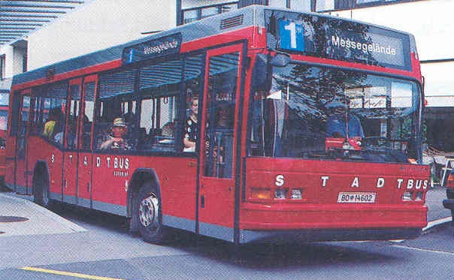
BY PUBLIC MEANS OF TRANSPORT
Buses, trolleybuses, trams (streetcars), underground (tube)
Cheaper than cars but less comfortable
Schedule
Bus – either in a town or between towns or villages
London –
double-deckers

Slide 8
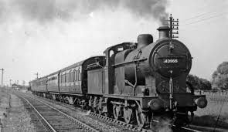
BY TRAIN
In our country going by train is cheaper but also slower than going by bus (in Britain it is reverse)
If you want to travel faster you have to pay a supplement; passenger train is without any supplement (sometime called slow train)
Railway station – big hall with a ticket office (single x return ticket, seat reservation), the departures and arrivals board, a left luggage office (lockers), telephones, waiting hall, a restaurant, toilets,…
Train - first class (more expensive and comfortable); second class (less comfortable but cheaper)
During the travelling you can chat with friends, observe the landscape out of the window, eat some food, play cards or sleep
Conductor
A train consists of passenger carriages, buffet-car, a goods wagon…

Slide 9
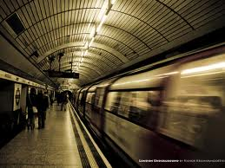
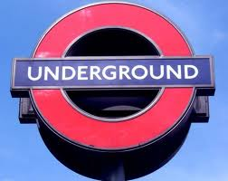
BY UNDERGROUND
In big cities it is very famous means of public transport
In the Czech Republic only in Prague (quite small, just 3 lines – A,B or C)
Very fast, it couldn‘t get to a traffic jam
In America it is called subway or tube

Slide 10
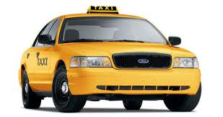
BY TAXI
It takes you exactly where you want to go
Very expensive
Quite dangerous – you can be robbed and girls can be raped as well

Slide 11
REASONS TO TRAVEL
Various reasons – to get to school/work, for a holiday, for culture,…
Travelling fever increase during holidays, people go abroad
For going abroad – necessary documents (passports, a visa), money (you can exchange it in a bank or in a exchange office)
Cities - Rome, Venice, London, Prague, Paris or Amsterdam
Recreation - Alps, and places around in Mediterranean Sea (in the Czech Republic - Šumava, Krkonoše, Bílé Karpaty or Beskydy)

Slide 12
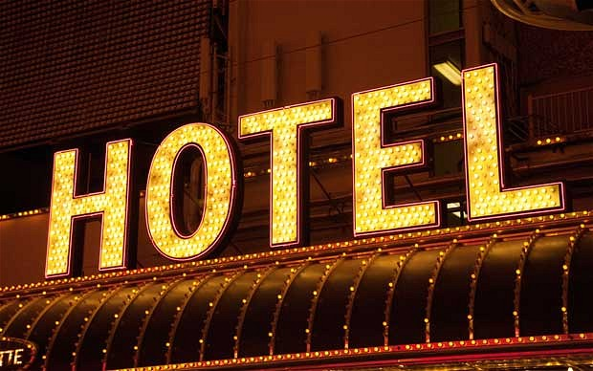
KINDS OF TRAVELLING
Many state and private agencies – here people can buy trips, tickets for foreign busses or trains or reserve accommodation
Hotels and motels – differ in price and comfort, breakfast x full board (we have to book a room before arrival)
In hotel – usually some of hotel‘s services
Some people prefer to stay at a farm or they rent a room on their own or in a camp

Slide 13
THANK YOU FOR YOUR ATTENTION
Made by: Žaneta Holková

